Slide 1


Rob Masters, Principal, CannonDesign
(646) 574-9206
rmasters@cannondesign.com
The Medical Psychiatry Unit:
Development of a New FGI Section for an Emerging Inpatient Unit Typology
September 30, 2025

Slide 2

AIA Continuing Education
The seminar has teamed with a registered provider of AIA - approved continuing education under Provider Number E240. All registered AIA CES Providers must comply with the AIA Standards for Continuing Education Programs. Any questions or concerns about this provider or this learning program may be sent to cessupport@aia.org or 800-242-3837 Option 3.
This learning program is registered with AIA CES for continuing professional education. As such, it does not include content that may be deemed or construed to be an approval or endorsement by the AIA of any material of construction or any method or manner of handling, using, distributing, or dealing in any material or product.
AIA continuing education credit has been reviewed and approved by AIA CES. Learners must complete the entire learning program to receive continuing education credit. AIA continuing education Learning Units earned upon completion of this course will be reported to AIA CES for AIA members. Certificates of Completion for both AIA members and non-AIA members are available upon request.

Slide 3
AIA Learning Objectives
Understand the elements of the new Medical Psychiatry Unit section in the FGI Facility Code (Hospital Document) and how it ties back to and builds upon existing sections of the hospital document.
Gain insights into the development of the final section through the lens of the 2026 FGI Facility Code draft process, which influenced the final text and allowed for the incorporation of ideas and insights gleaned from a visioning process through the "Reimaging" series with the Sextant Group.
Explore the ways in which the new section can be used in partnership with the development of the functional program to define the core program and specialty spaces that align with an individual institution's approach to care delivery.
Identify programming, planning, and design strategies that respond to minimum requirements and expand upon that programmatic foundation to meet the unique needs of inpatient care for medical patients with behavioral health comorbidities.

Slide 4

Disclaimer
The views expressed in this presentation are the opinion of the speakers and may not be the official position of FGI or of the Health Guidelines Revision Committee (HGRC).

Slide 5

Meet your expert
Rob Masters, AIA, ACHA, EDAC, NCARB, CLGB, LEED AP
Principal
CannonDesign
FGI HGRC member: 2022, 2026

Slide 6


2026 FGI Code for Planning and Design of
Hospitals

Slide 7
It started with The Why

Slide 8

What is a Medical Psychiatry Unit (MPU) and why are they needed?
“MPUs, also known as Complexity Intervention Units (CIUs), were created to deliver optimum acute hospital care to patients who have concomitant medical and psychiatric needs. Due to their multidisciplinary nature, MPUs are also an ideal venue for engaging patients in the services they may be struggling to navigate in a fragmented healthcare system.”
- The Association of Medicine and Psychiatry, Medical Psychiatry Unit Consortium

Slide 9
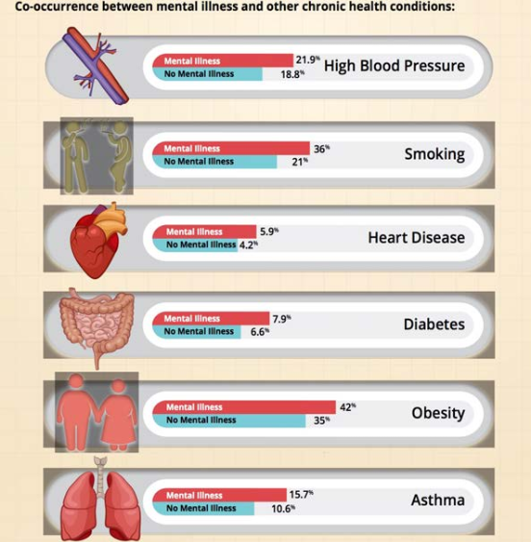
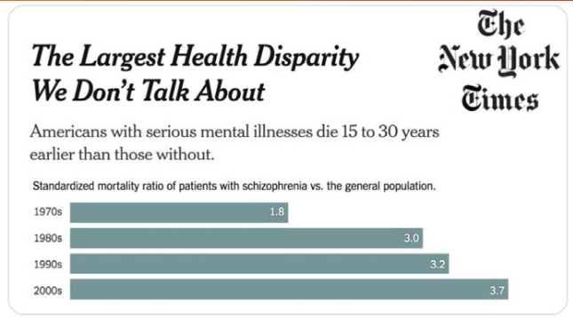
What is a Medical Psychiatry Unit (MPU) and why are they needed?
Health equity challenges are growing:
- “Medical-Psychiatric Units: What Why and How,” M. Wittink, MD MBE, 2023

Slide 10
What is a Medical Psychiatry Unit (MPU) and why are they needed?
In response, individual institutions have begun to develop specialized patient care units.
Hospitals start MPUs because:
Clinicians on medical units have difficulty managing patients with mental health needs
Psychiatric units cannot safely care for patients who may need intravenous fluids or oxygen
  Tubing is a ligature risk
  Nurses may be uncomfortable managing medical concerns
Unintended outcomes can drive the need for an MPU
  Suicide attempt on a medical unit
  Pulmonary embolus while on a psychiatric unit
- “Medical-Psychiatric Units: What Why and How,” M. Wittink, MD MBE, 2023

Slide 11
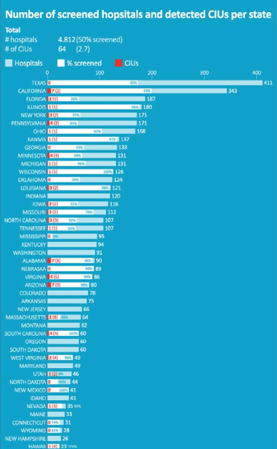
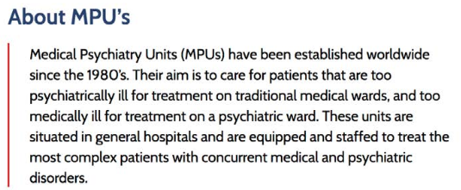
What is a Medical Psychiatry Unit (MPU) and why are they needed?
These units exist today, with the first dating back to the 1980’s.
In 2020, U.S. hospitals were screened for existing MPUs/CIUs
Of 4,812 hospitals, 50% were screened
64 MPUs/CIUs were identified (2.7%)
- “Medical-Psychiatric Units: What Why and How,” M. Wittink, MD MBE, 2023

Slide 12
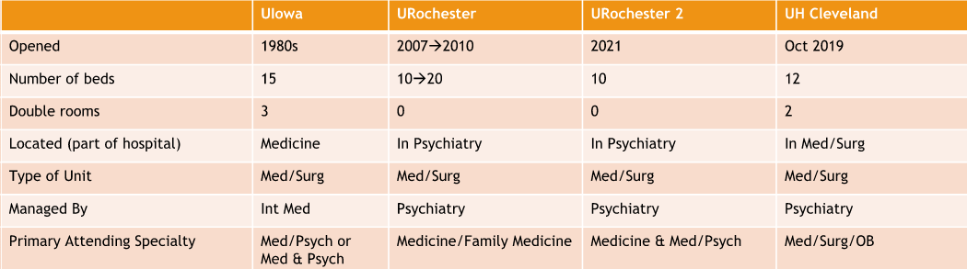
What is a Medical Psychiatry Unit (MPU) and why are they needed?
These units exist today, with the first dating back to the 1980’s.
- “Medical-Psychiatric Units: What Why and How,” M. Wittink, MD MBE, 2023

Slide 13
What is a Medical Psychiatry Unit (MPU) and why are they needed?
Locked unit, full psychiatric capability
Staffed by dual-trained (Med AND Psych) or two physicians (one each)
Dual-trained nursing
Outcomes: improved discharge to community (but increased LOS)
Locked unit, full psychiatric capability
Embedded Psychiatrist, Medicine Medical Director + Psychology, Pharmacist
Nursing-led rounds
Outcomes: decreased LOS & readmissions, decreased 1:1 sitter use
Open unit, patients stabilized then return to previous unit
Psychiatrist is Medical Director, consultants
Open staffing model – any M/S team can be primary
Outcomes: reduced restraints and violence
- “Medical-Psychiatric Units: What Why and How,” M. Wittink, MD MBE, 2023

Slide 14
The Why fueled the process

Slide 15
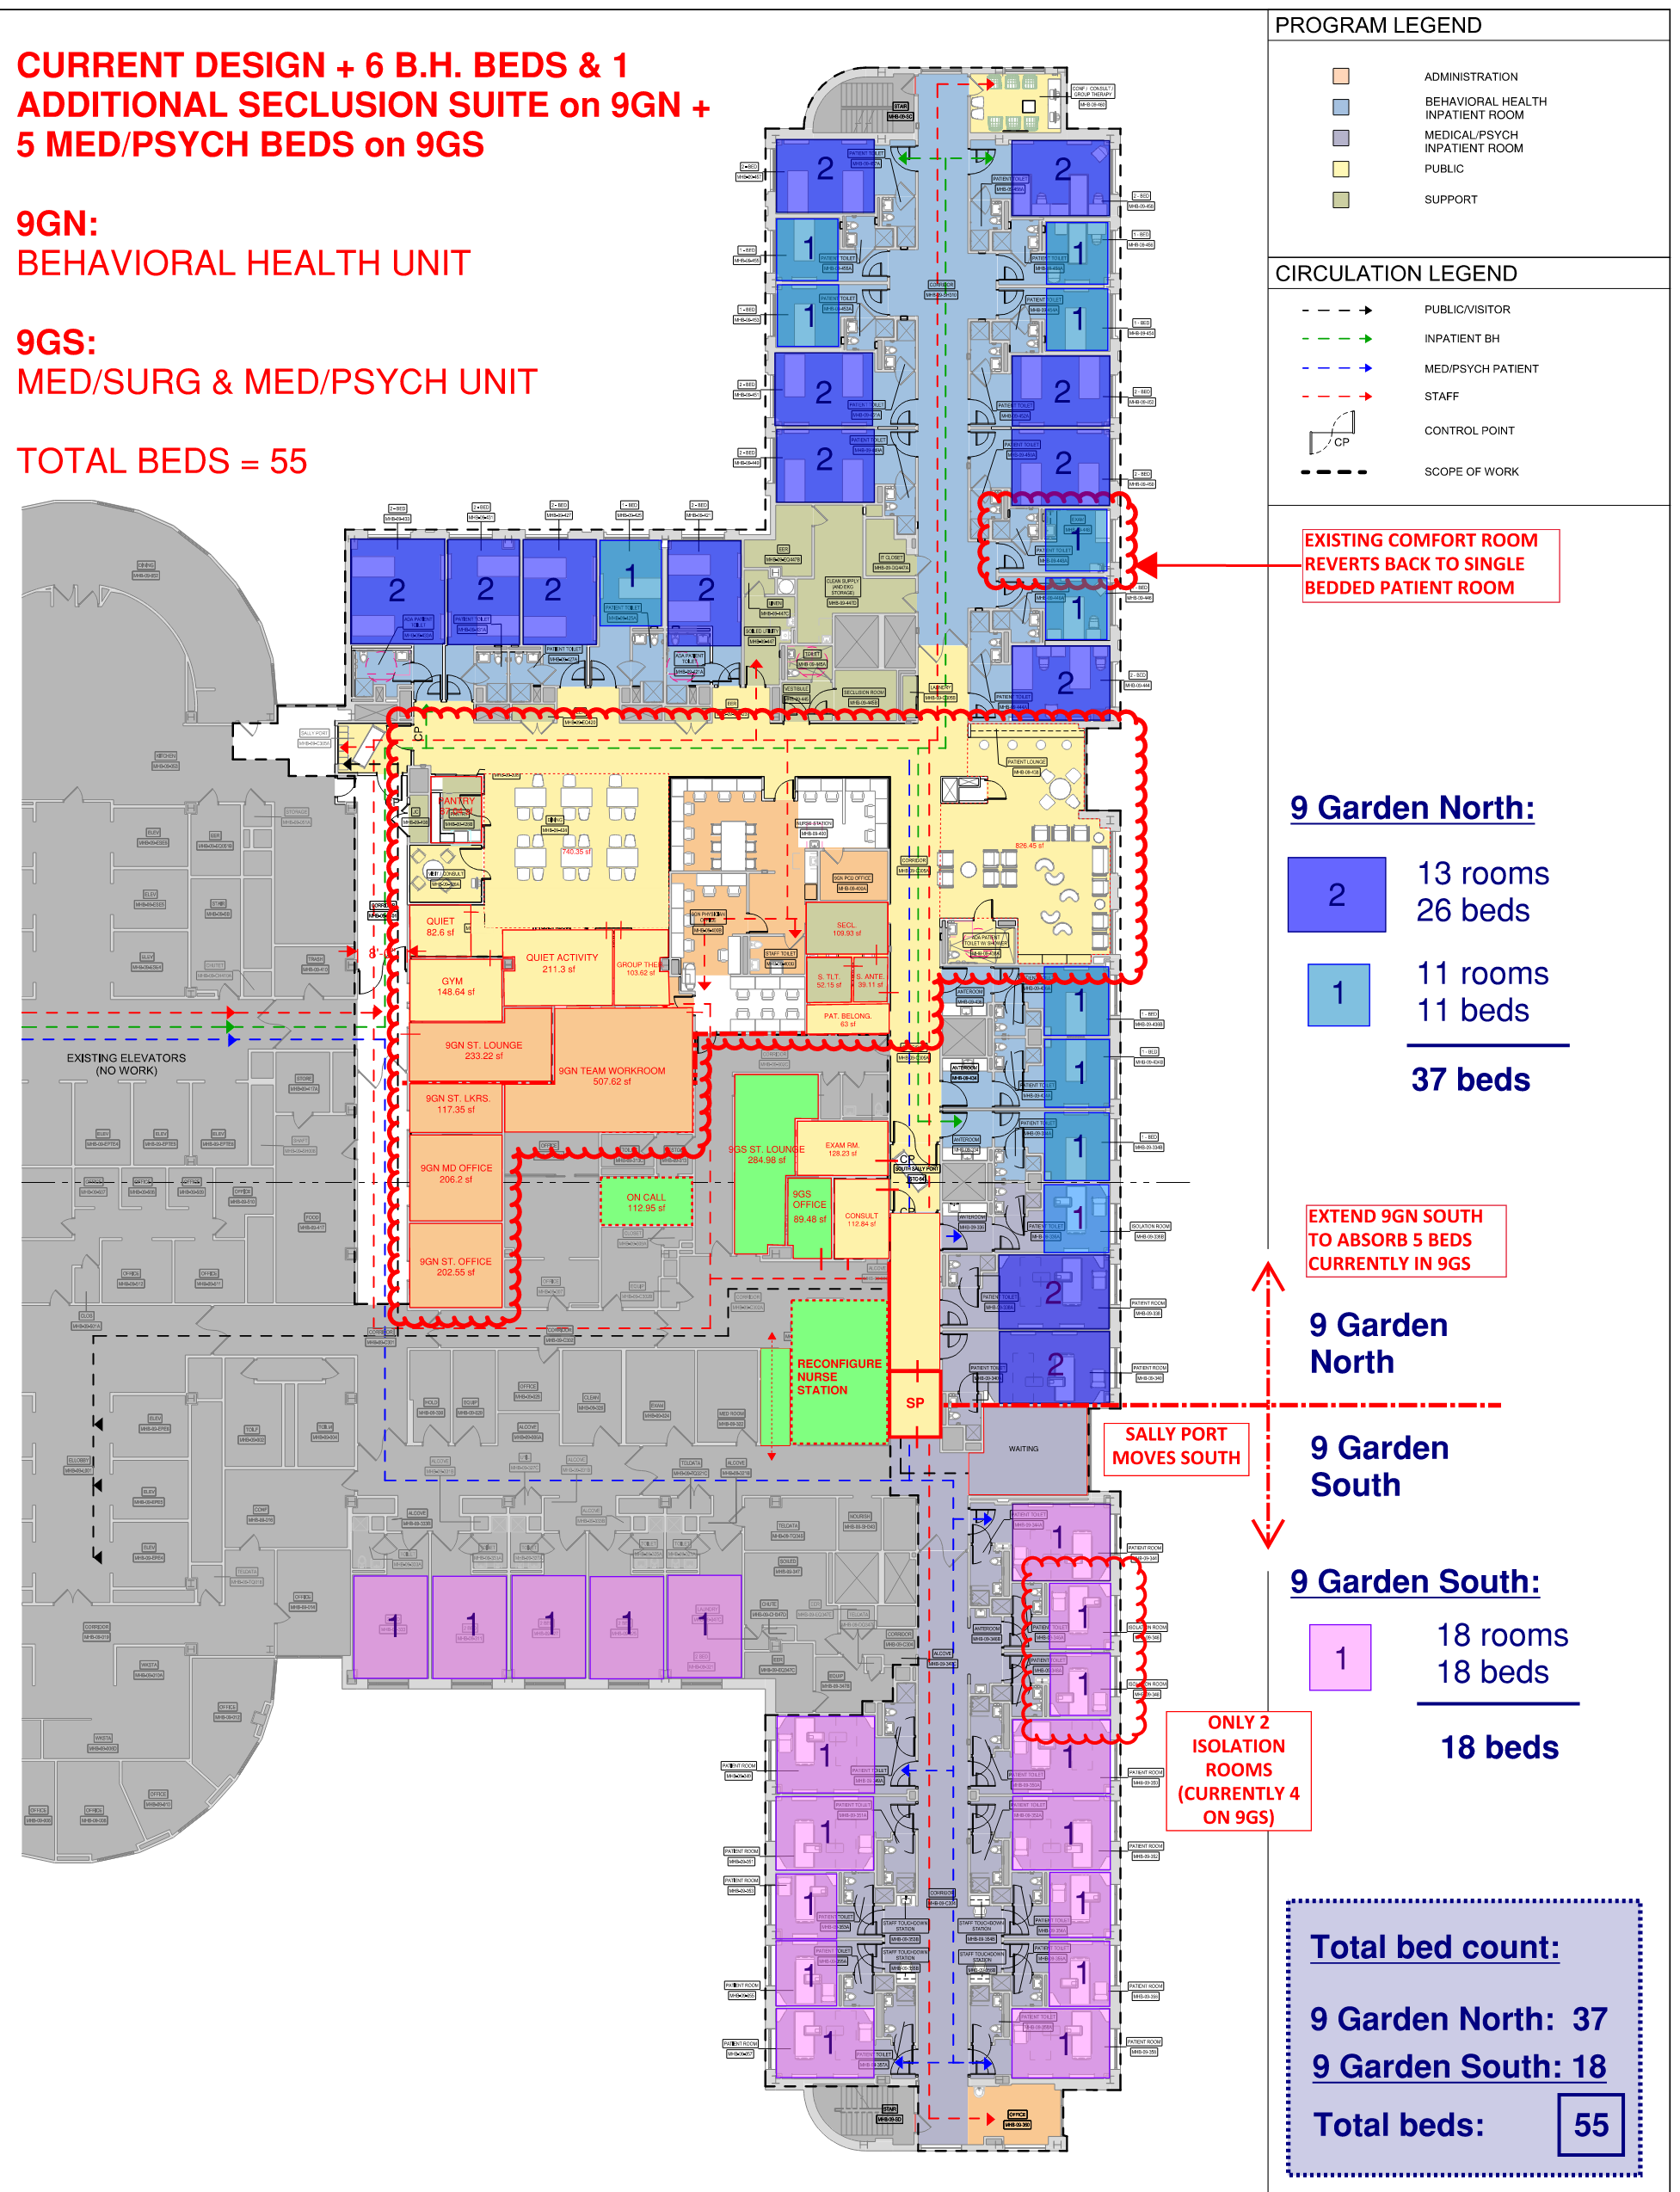
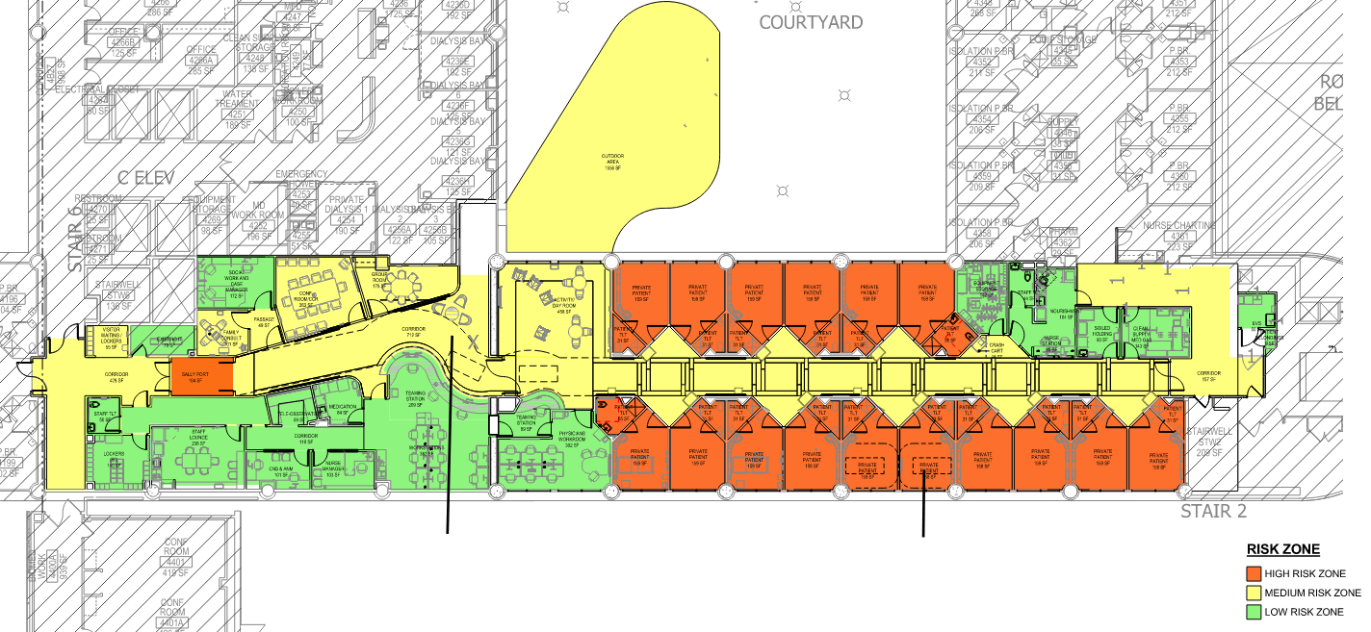
It started with collaboration...
Froedtert Health CIU (2023)
NYP CUIMC IP BH + Med-Psych

Slide 16
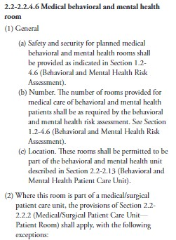
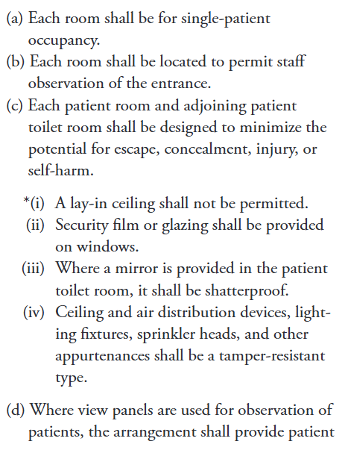

...which identified the need
In the 2022 FGI Guidelines for the Design and Construction of Hospitals Document, there is very little content to guide the design of an MPU:
Focused on the patient room
Location addressed: Med/Surg or B&MH patient care unit
Staff observation of room entry required

Slide 17
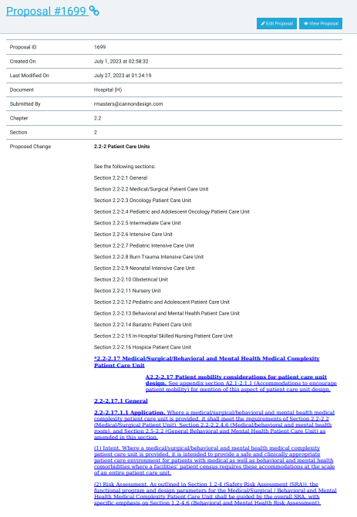
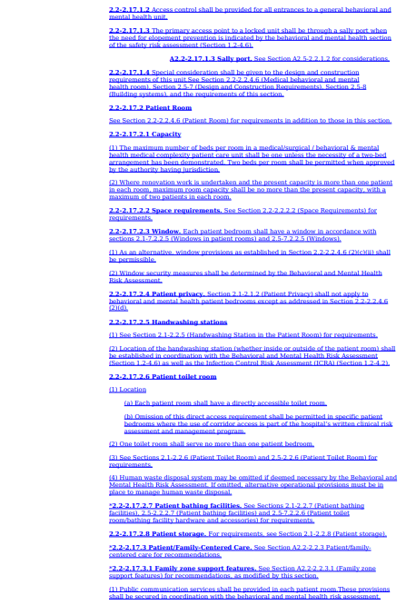
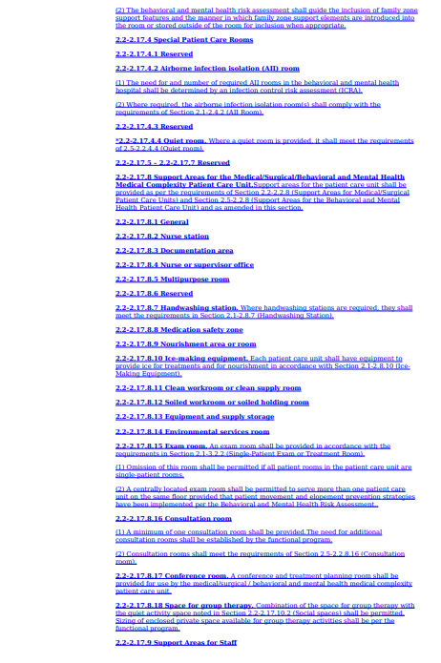
...then carrying it forward
Proposal to the 2026 FGI Guidelines – Med/Surg / M&BH Medical Complexity Unit

Slide 18
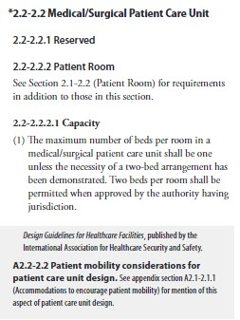
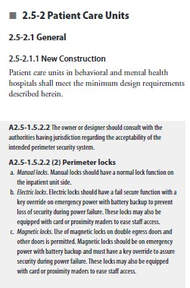
...building from existing components
Excerpts from the 2022 FGI Guidelines – Hospital Document

Slide 19
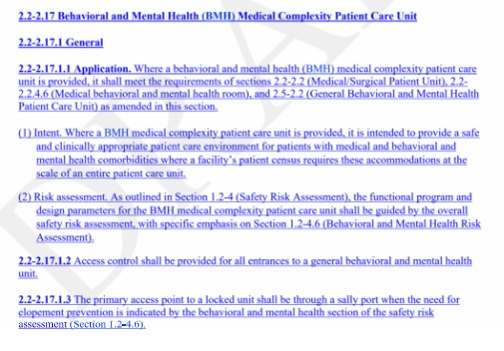
...and adding typology-specific considerations
Proposal to the 2026 FGI Guidelines – Med/Surg / M&BH Medical Complexity Unit

Slide 20
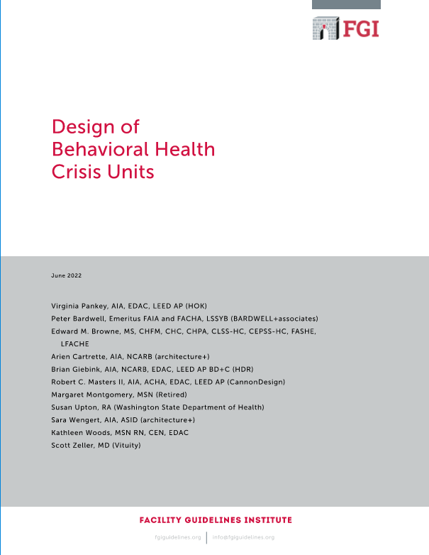
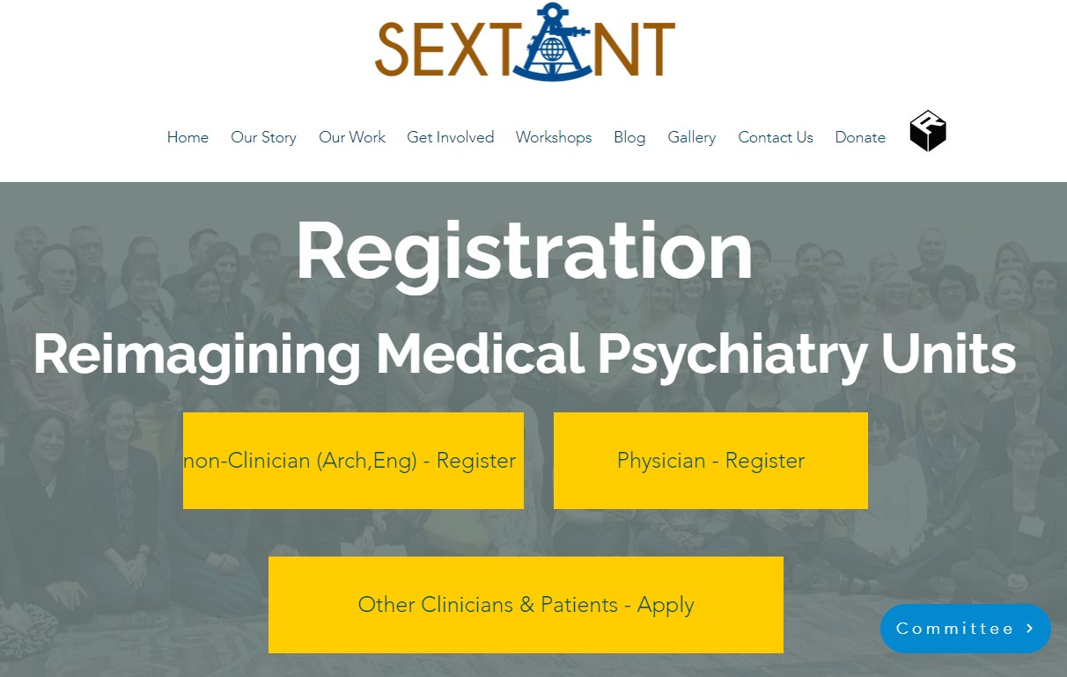

...then carrying it forward
Design of
Medical Psychiatry Units (MPUs)
Medical Psychiatry Unit Consortium
Re-imagining the Medical Psychiatry Unit Workshop
2024 AMP Annual Meeting
October 3rd, 2024
Milwaukee, WI
COMING SOON!
Creating A New Platform for Behavioral Health:
Designing a Novel Medical Complexity Unit and its Regulatory Framework
FGI Whitepaper (upcoming)

Slide 21
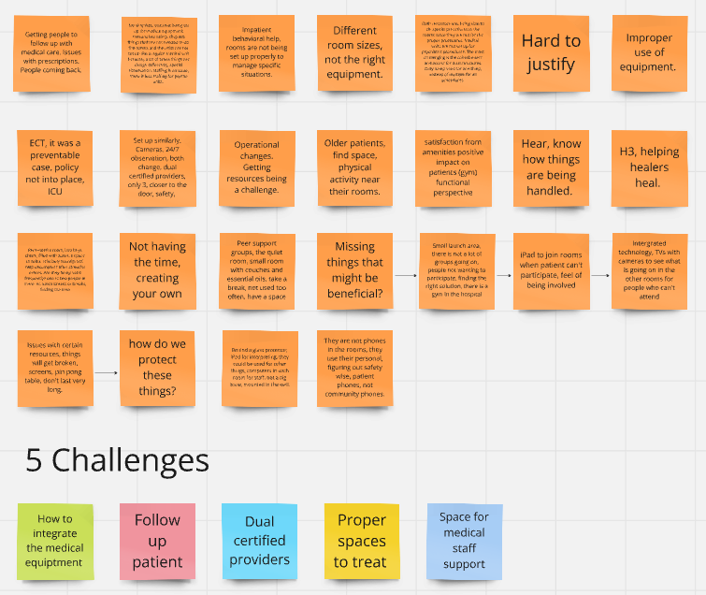
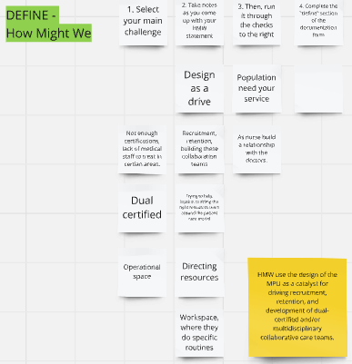
Re-imagining the Medical Psychiatry Unit Workshop
Building insight into the draft:
Virtual event: 9/11/24
Developing insights from a broad multidisciplinary team
Committee members focused in on capturing the spirit of the exercise in comments to draft by 9/30/24

Slide 22
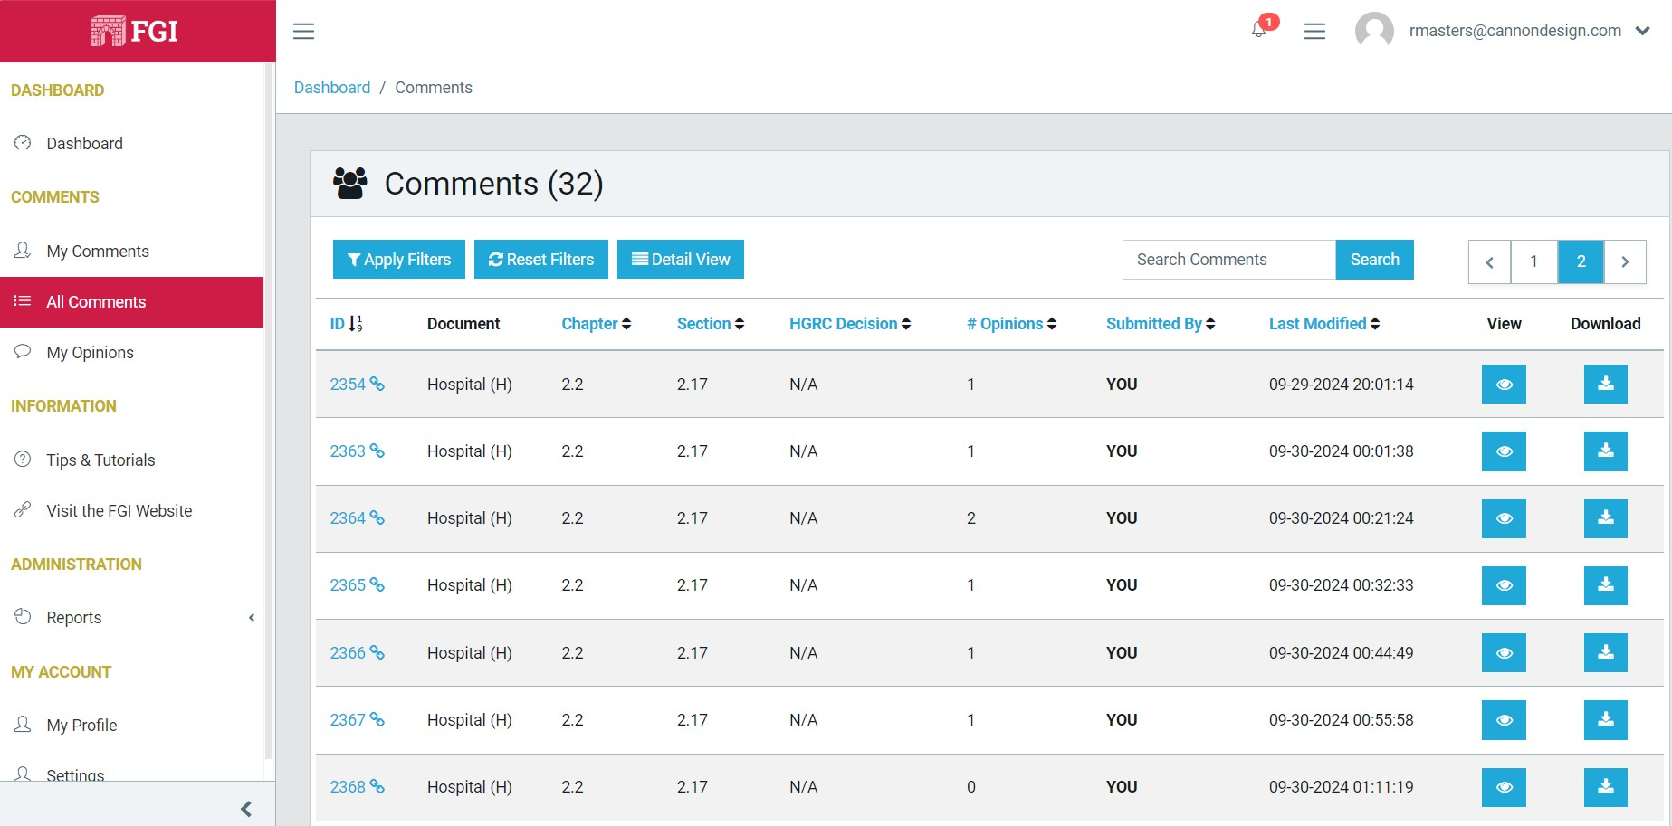
Re-imagining the Medical Psychiatry Unit Workshop
Building insight into the draft:
Section name (MPU)
Expanded Intent
Team Respite
Team Collaboration
Daylight in common spaces
Patient & care team technology
Patient gym / PT provisions
Excerpt from the 2026 FGI Guidelines Draft Comment Period platform

Slide 23
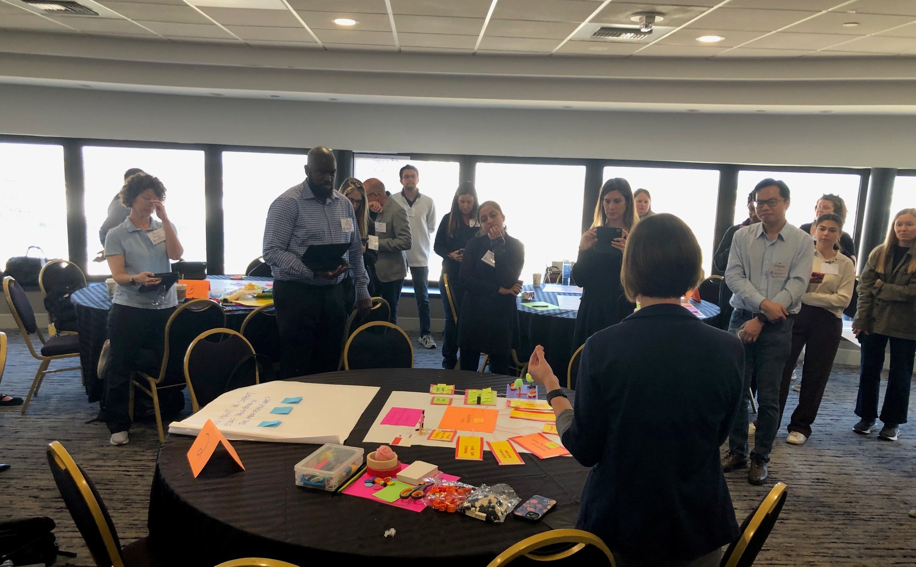
Re-imagining the Medical Psychiatry Unit Workshop: LIVE
Building insight into the draft comments:
Staff support:
      Respite
      Collaboration
      Technology
      Patient Support:
Natural light/outdoor
Mobility
Technology
Experience

Slide 24
The Why informed the framework

Slide 25
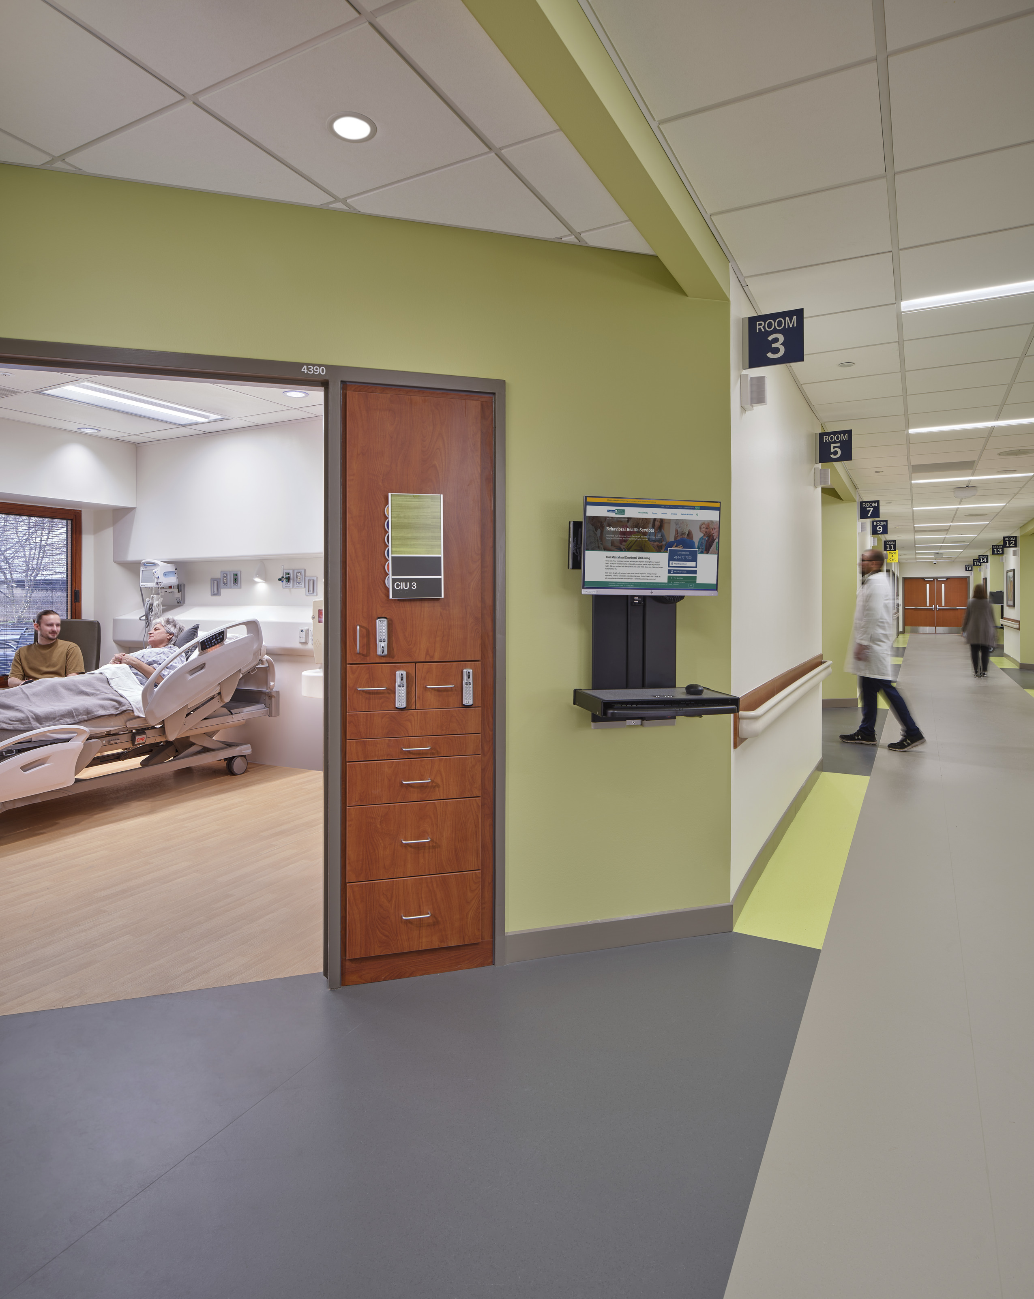
The MPU is a medical unit first.
Following the requirements of Section 2.2-2.2, Medical/Surgical Unit, including:
      Patient room
      Patient toilet room
      Patient bathing facilities
      Communication systems
      AII Room(s) per ICRA
      Support Areas for Medical/Surgical Patient Units
      Examination Room
      Support Areas for Staff

Slide 26
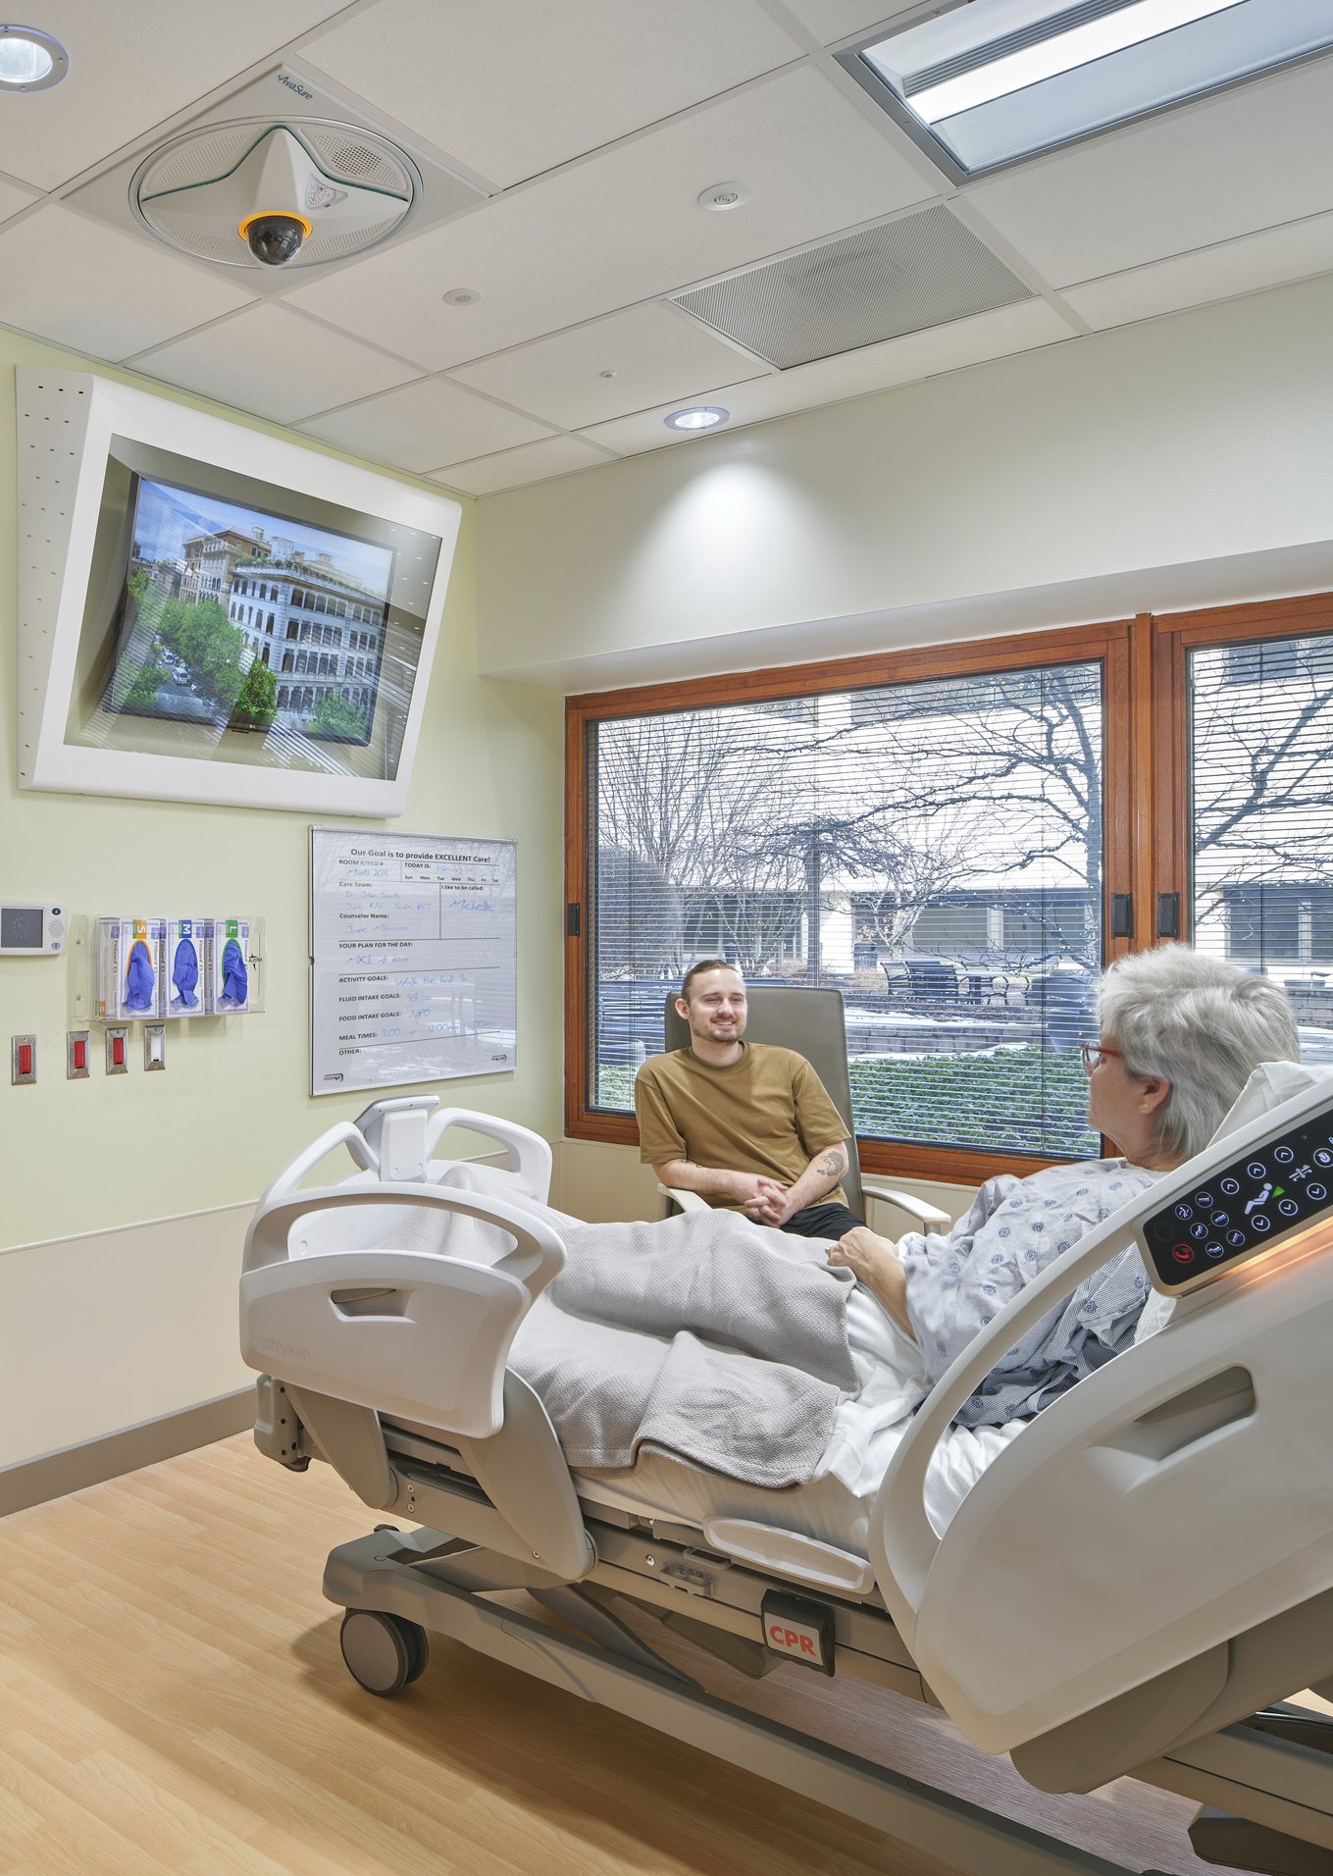
The MPU must focus on patient safety.
Following the requirements of Section 1.2-4.6, Behavioral & Mental Health Risk Assessment, 2.2-2.2.4.6, Medical/Mental & Behavioral Health Room, and 2.5-2.2, General Mental & Behavioral Health Patient Care Unit, including:
      Risk assessment
      Access control, sally ports
      Patient room, toilet room & bathing facilities
      Design & construction requirements
      Building systems

Slide 27
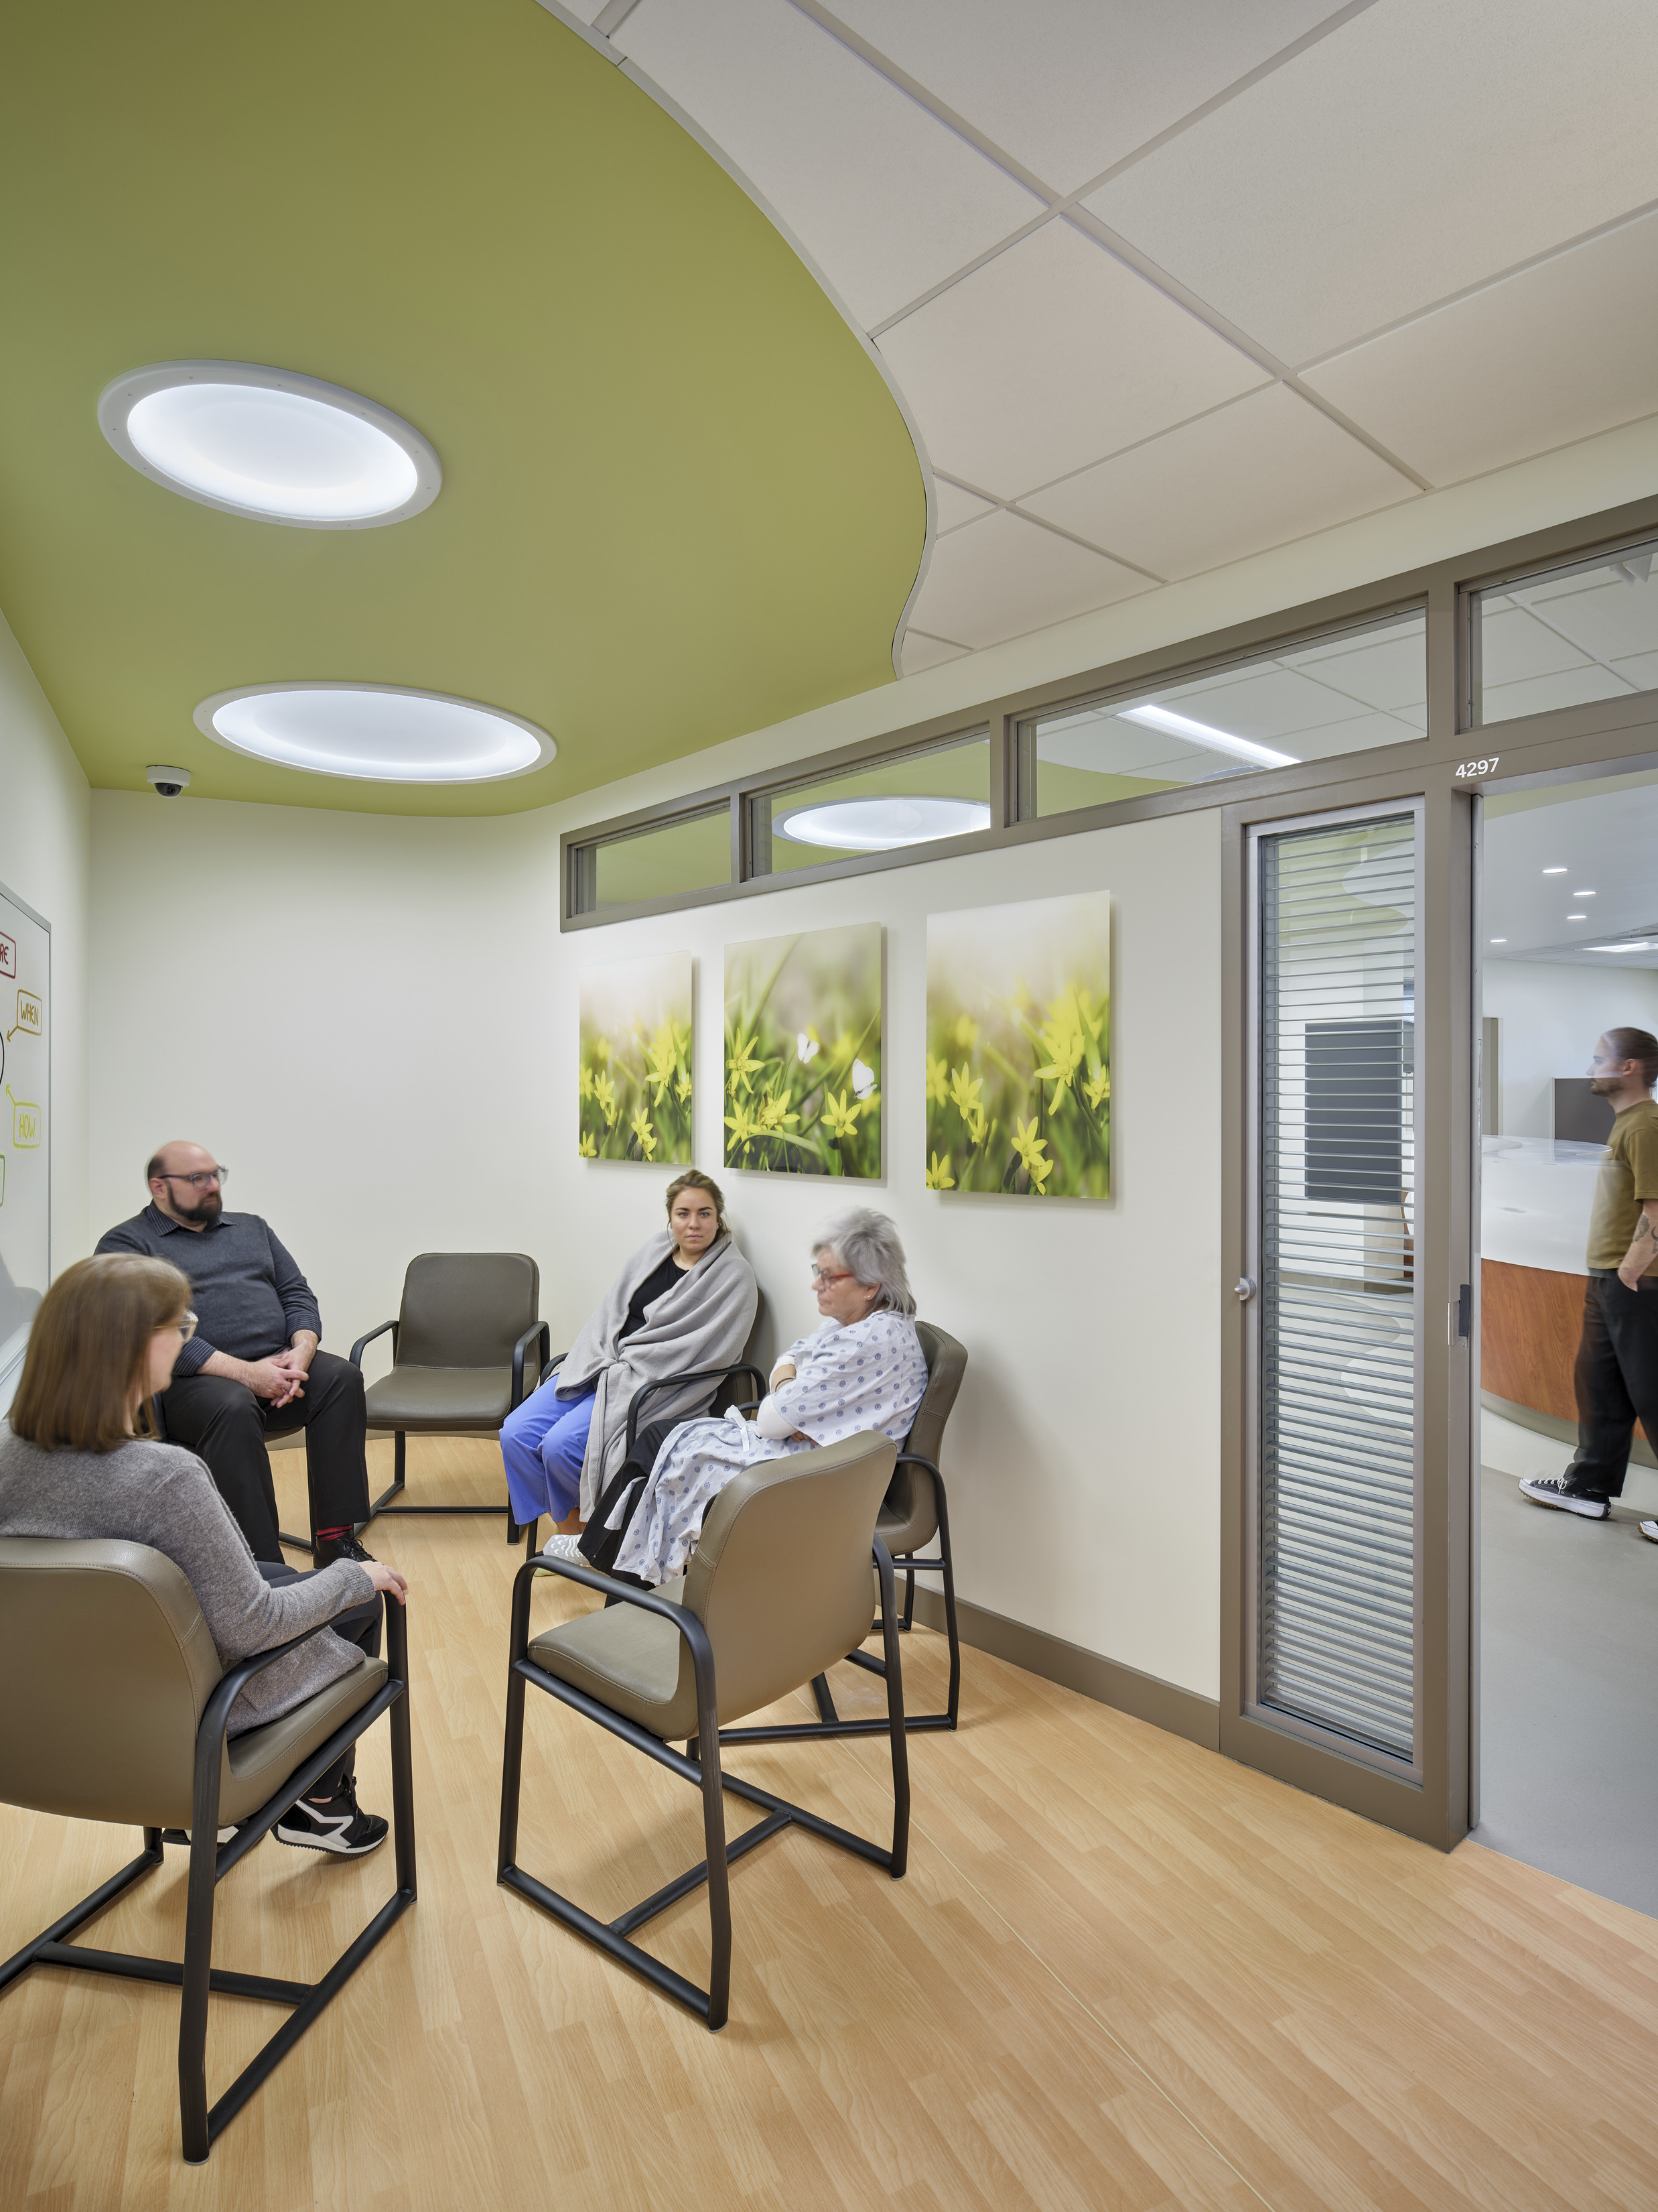
The MPU is driven by the functional program.
Building on the requirements of Section 1.2-4.6, Behavioral & Mental Health Risk Assessment and 2.5-2.2, General Mental & Behavioral Health Patient Care Unit:
Risk assessment will inform design decisions:
        Sally ports
        Handwash sink location considerations
        Communication systems considerations
      Functional program will inform:
        Social spaces, dining spaces
        Outdoor space provisions

Slide 28
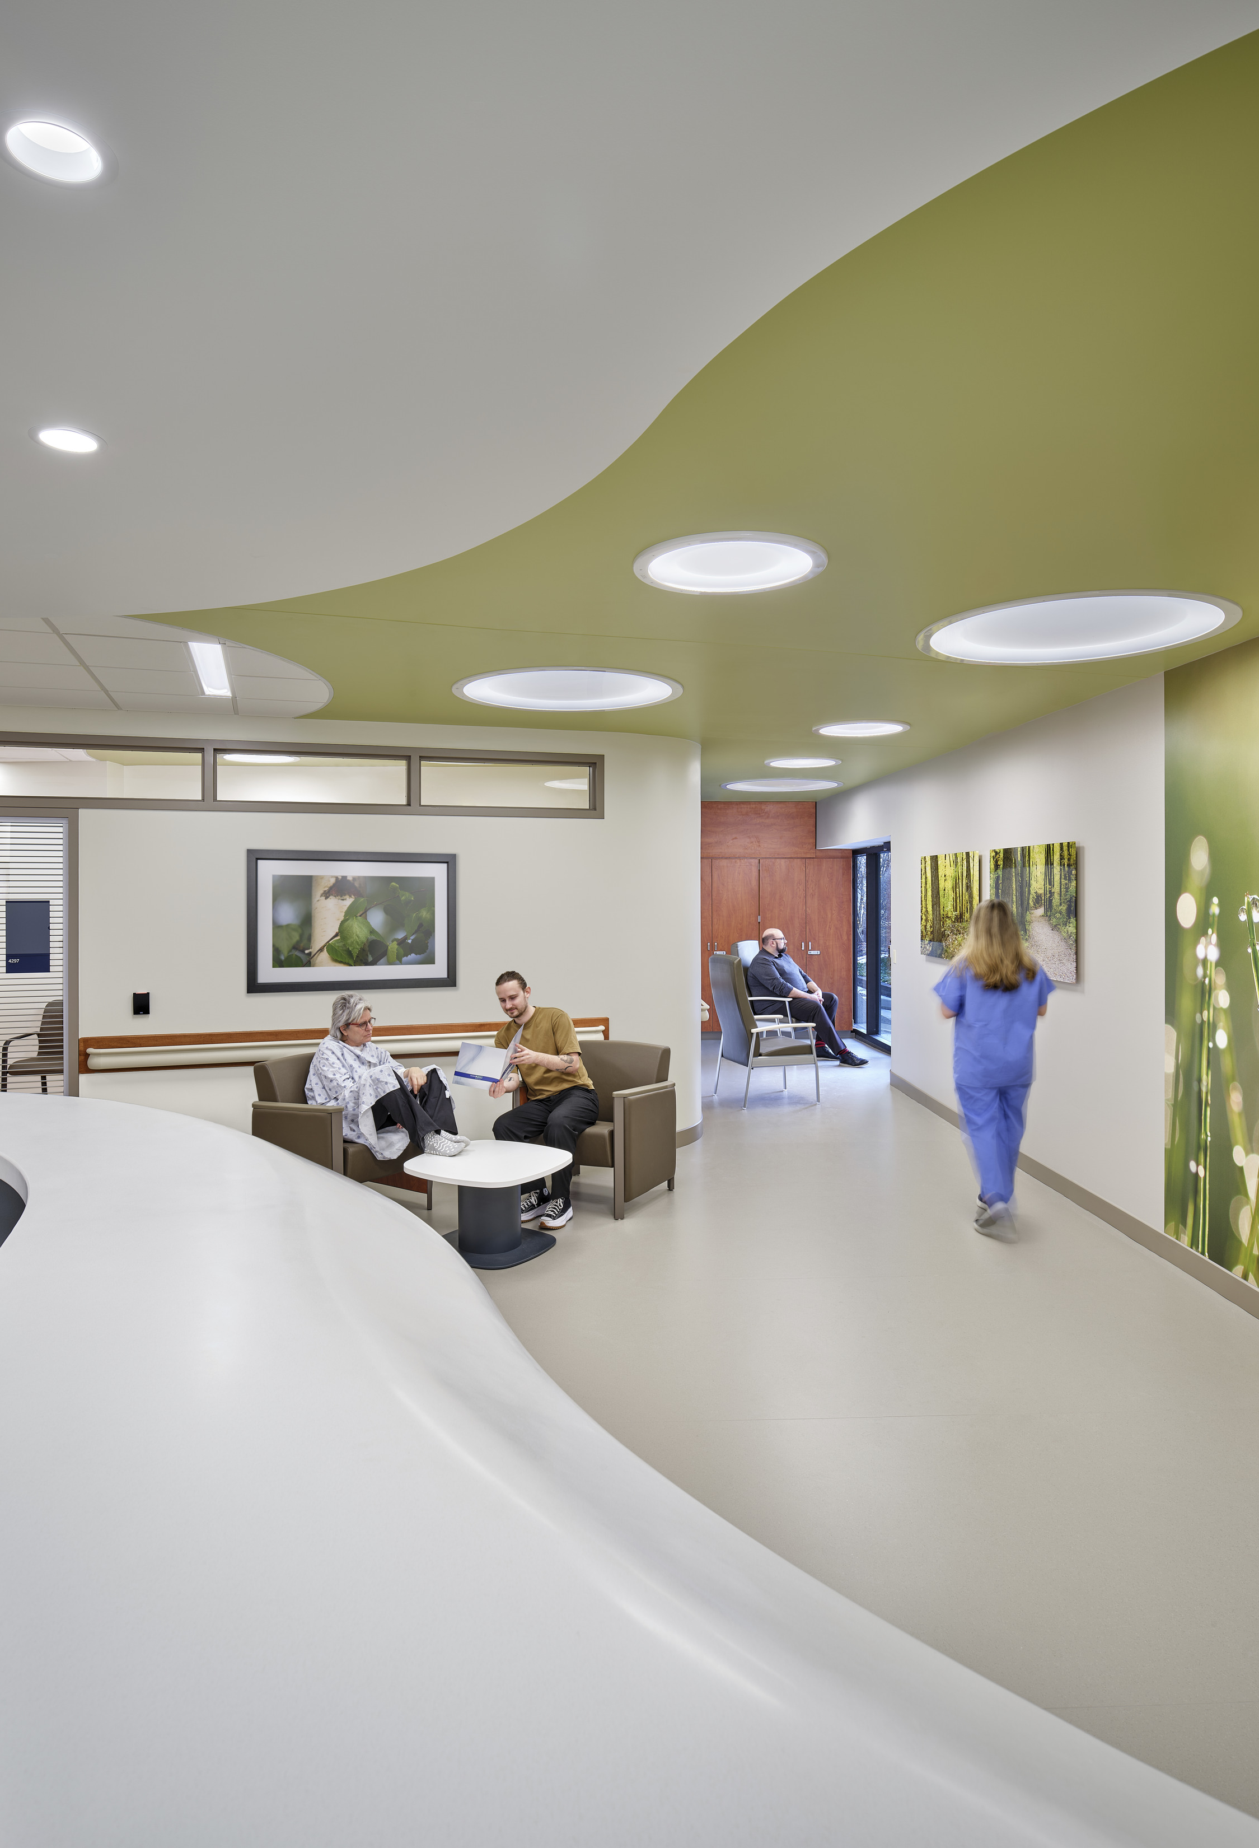
The MPU is an environment for healing.
Building on the requirements of Section 2.5-2.2, General Mental & Behavioral Health Patient Care Unit, provisions for spaces including:
      Consultation room(s)
      Group therapy room
      Calming room
      Visitor Room
      Social space, dining space
      Outdoor space

Slide 29
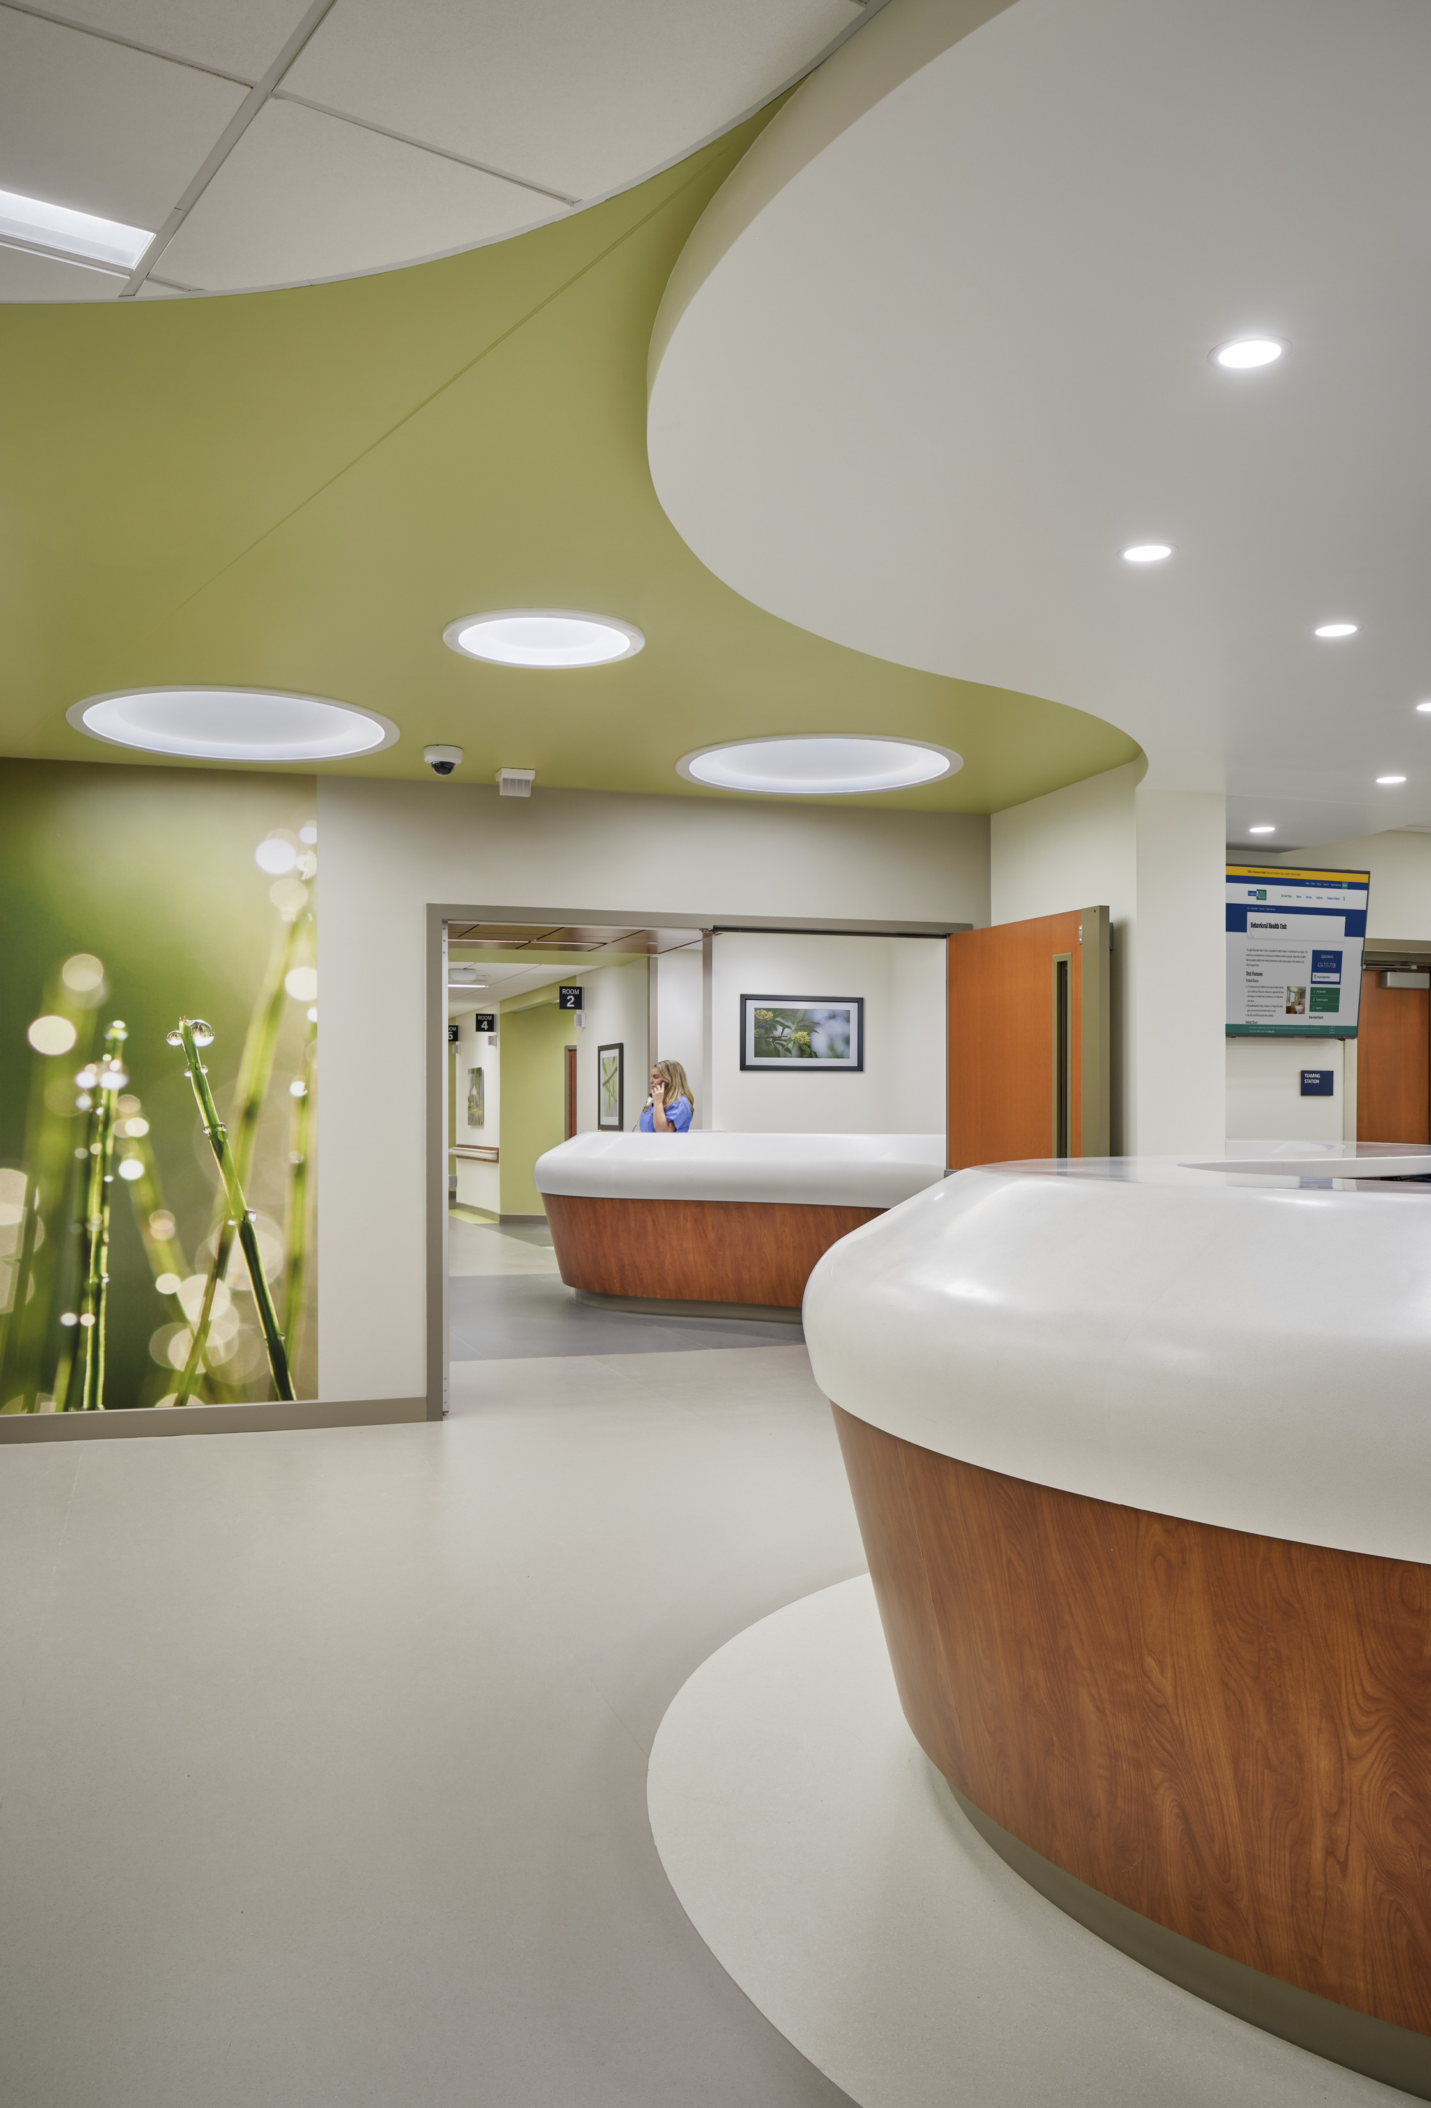
The MPU is home to an interdisciplinary team.
Following the requirements of Sections 2.2-2.2, Medical/Surgical Unit, and 2.5-2.2, General Mental & Behavioral Health Patient Care Unit, including:
      Team stations
      Conference & treatment planning room
      Support areas for staff

Slide 30
The Why will be shaped by the future

Slide 31
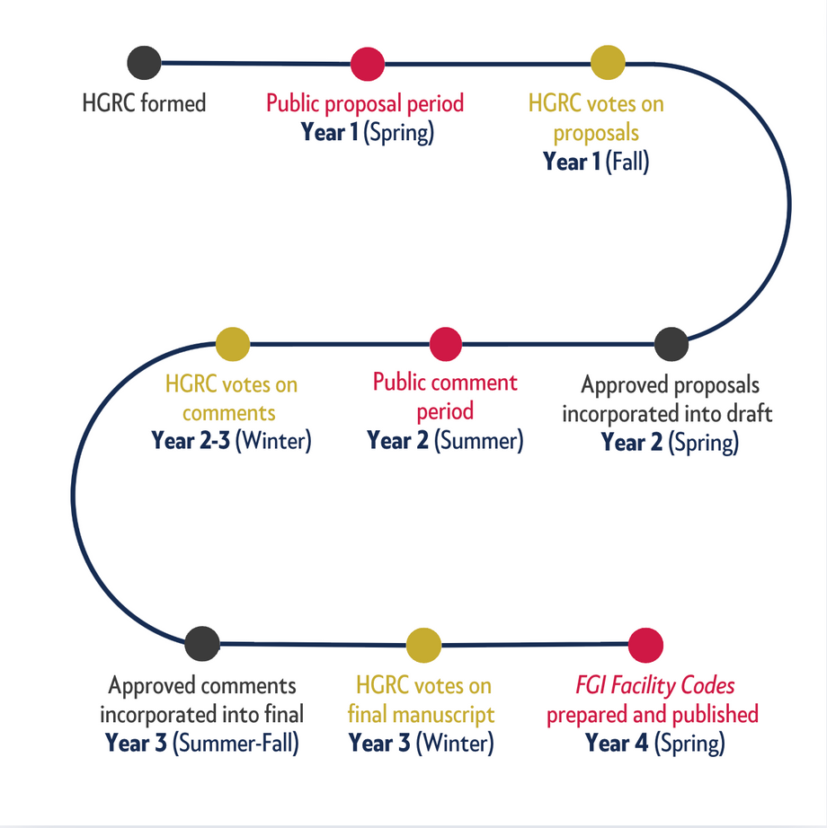


What’s next?
Your involvement in 2030!
Write a proposal to
help improve the code
and health care environments!
Review the draft and provide comments.
Notes:
Can you believe that we're already thinking about the revision cycle for the 2030 FGI Codes for Planning and Design? With the beginning of the next 4-year revision cycle in fall 2026, FGI will make an announcement in the FGI Bulletin letting folks know when the HGRC will be accepting new members. If you're interested in joining, be sure to sign up for the FGI Bulletin newsletter on FGI's website.
There are other ways to get involved as well. In Spring 2027, the public will be invited to submit proposals to revise the codes. Then, in the summer of 2028, the 2030 draft will be released and the public will again be invited to provide feedback.
Involvement in this process from the folks who use the codes is critical. We hope you'll participate and make your voice heard!

Slide 32




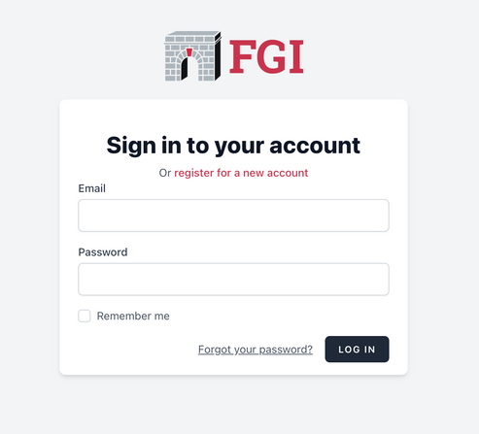
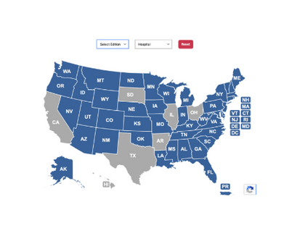
Continue learning with FGI
Between
the Lines with FGI Podcast
FGI’s
Education Platform
FGI’s
Subscription Platform
2026 FGI Codes and Handbooks to be released in Spring 2026
FGI’s
Interactive Adoption Map
Notes:
Between the Lines with FGI:
We're excited to share that Season 3 of Between the Lines with FGI is in full swing. All episodes of this podcast can be accessed on our website and where podcasts are available.
Did you know that you can receive CEU/CEHs for listening to our episodes? FGI will be providing this content as courses on our new educational platform, and take care of all the logistics to ensure you receive your CEU/CEHs upon completion.
FGI's Educational Platform: Speaking of, we're pleased to share that FGI's new educational platform is filled with e-learning courses, fireside chats, webinars, and microlearning activities, including from our HGRC experts. This is a great way to gain your CEU/CEHs while supporting FGI. If you're interested in providing group education for your team, this is a great place to start.
FGI's Subscriber Library: This platform will be a great partner to our Digital Library, which is where you’ll be able to access the new edition, along with any other editions you’ve subscribed to. You can access both the Digital Library and, when launched, our educational platform directly through FGI's website. On the landing page of the Digital Library, you'll find a guided tutorial to walk you through the platform.
​
​2026 FGI Codes and Handbooks launch this spring: This seminar will cover many of the exciting changes to come in the 2026 FGI Codes and Handbooks this spring. FGI will continue to release information and educational opportunities leading up to its release. We recommend subscribing to our emails and outreach.
FGI's interactive adoption map: We’ve recently updated the adoption map on our website to enable users to access information more easily. Now, when you click on a state, you’ll be able to see specifics on which facility types are required to meet the FGI codes, and, where available, links to state rules and AHJ contact information. Updating the adoption map is a continuous process; if you find that information in the map is out of date, we'd be grateful if you would reach out and let us know. ​

Slide 33




Connect with us
FGIGuidelines.org
FGI Guidelines
Between the Lines with FGI Podcast
Notes:
Thank you for your continued support of FGI. We'd love to stay in touch! Following FGI on LinkedIn and subscribing to our outreach is the best way to stay in-the-know of education offerings and events, updates, and more.

Slide 34


Slide 35
Thank you for your attention!

