Slide 1
Session 05
The 2026 edition of the
FGI Codes for Planning and Design of Hospitals
and Outpatient Settings
September 29, 2024

Slide 2
The 2026 edition of the FGI Code for Planning and Design of Hospitals and Outpatient Settings
John Williams
Chair Healthcare Guidelines Revision Committee
360-236-2944
john@fgiguidelines.org
Kevin Matuszewski, Chair, OPDG;
Chair, Glossary Committee
773-715-9378
kmatusz3@jh.edu
41st Annual FPC Seminar + Expo
Sept 28 - Sept 30, 2025
AHCA2025.05
1 LU| HSW
September 29, 2025

Slide 3
The seminar has teamed with a registered provider of AIA - approved continuing education under Provider Number E240. All registered AIA CES Providers must comply with the AIA Standards for Continuing Education Programs.
Any questions or concerns about this provider or this learning program may be sent to cessupport@aia.org or 800-242-3837 Option 3.
This learning program is registered with AIA CES for continuing professional education. As such, it does not include content that may be deemed or construed to be an approval or endorsement by the AIA of any material of construction or any method or manner of handling, using, distributing, or dealing in any material or product.
AIA continuing education credit has been reviewed and approved by AIA CES. Learners must complete the entire learning program to receive continuing education credit. AIA continuing education Learning Units earned upon completion of this course will be reported to AIA CES for AIA members. Certificates of Completion for both AIA members and non-AIA members are available upon request.

Slide 4
AIA Learning Objectives
Identify and describe the key 2026 revisions to the Code for both hospitals and outpatient facilities, and explain how they impact regulatory compliance and design decisions.
Analyze the evidence-based rationale for changes in the Code to support safer and more efficient environments that improve patient health outcomes and operational performance
Apply the revised Code to real-world healthcare planning and design to ensure facilities meet updated standards for infection control, patient privacy, accessibility, staff workflow and etc.
Evaluate the implications of Code changes on patient’s health, safety, and welfare, and incorporate best practices into architectural design to align with these latest nationally recognized codes and data-driven recommendations of the Facility Guidelines Institute.

Slide 5



Meet your experts
Kevin Matuszewski​, AIA
Director of Architecture + Planning ​
Johns Hopkins Health System​
Chair, Outpatient Document HGRC​
Chair, Glossary Committee
John L. Williams
VP, content and outreach, FGI
Executive director, Construction and Facilities Licensing,​
Washington Department of Health​
Chair, HGRC​ 2026

Slide 6

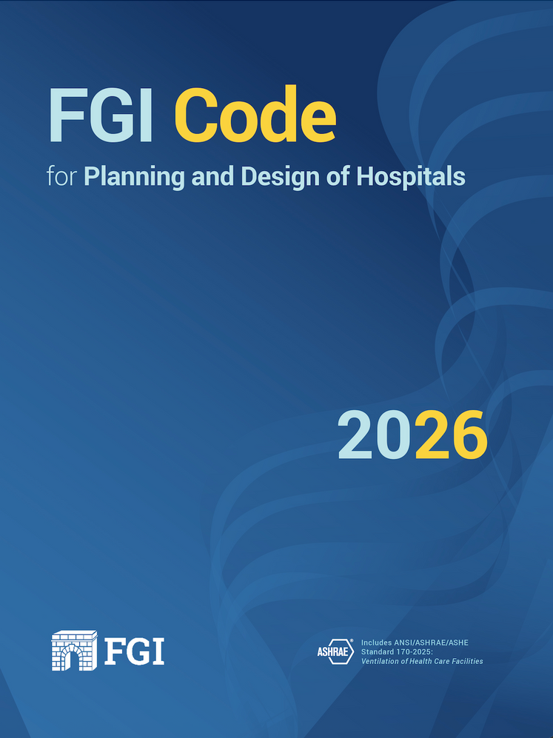
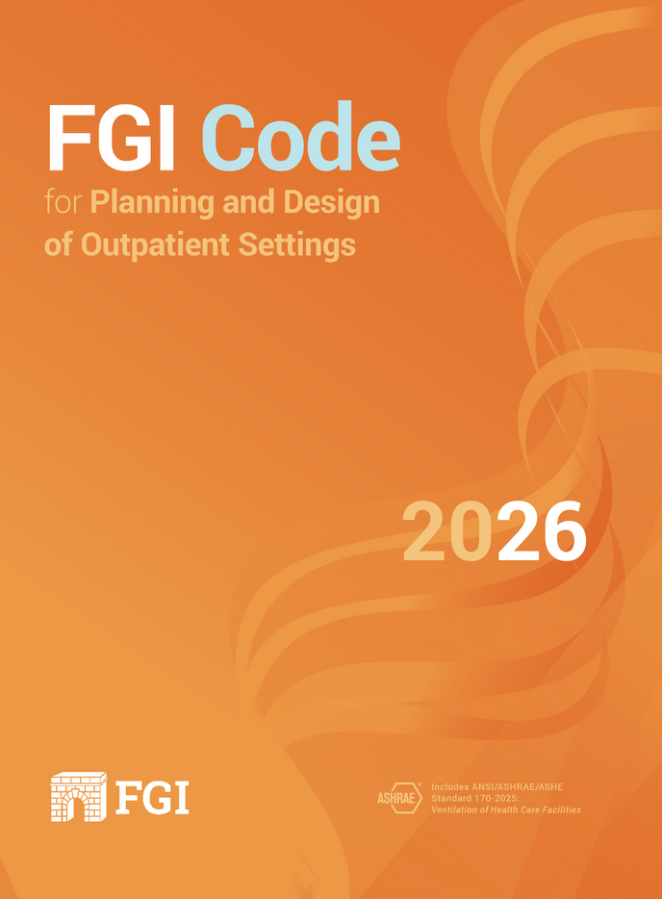
©2025 FGI
Common Revisions
2026 FGI Code for Planning and Design of Hospitals
2026 FGI Code for Planning and Design of Outpatient Settings

Slide 7
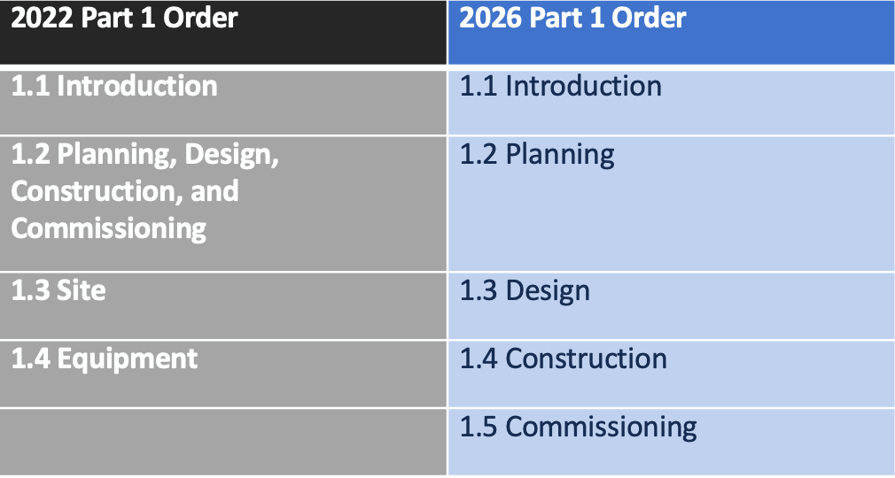

Part 1 Reorganization
©2025 FGI
v

Slide 8
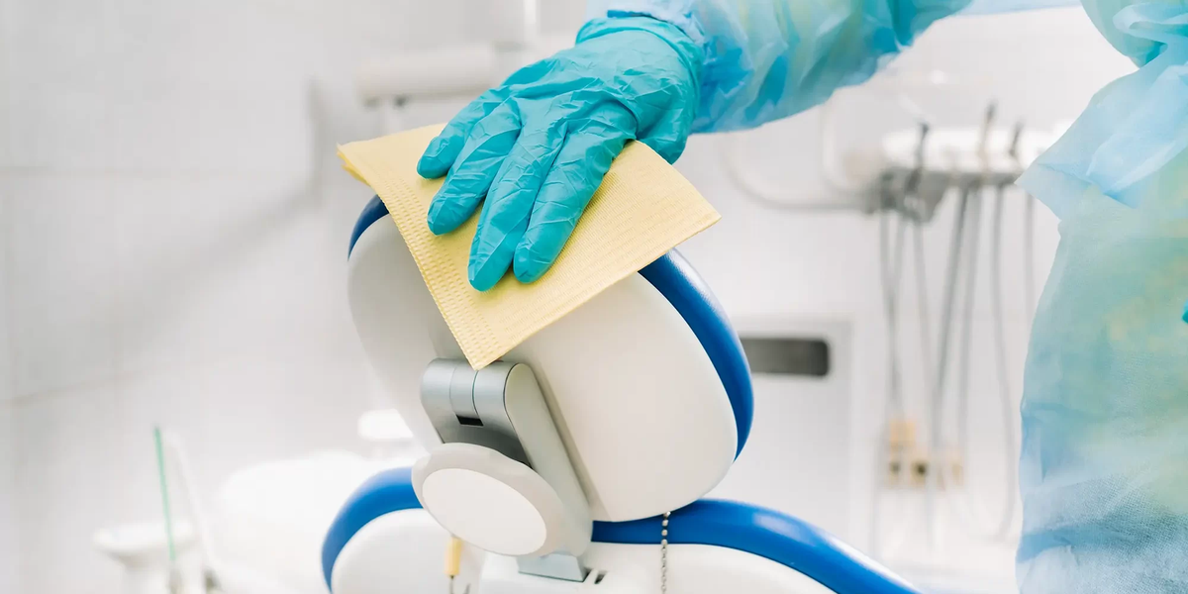
IPTG: Surfaces
©2025 FGI
  Proliferation of terms such as washable, scrubbable, etc. removed across all documents
  New standard requirement: “…able to be cleaned and disinfected”

Slide 9
Sink Terminology
©2025 FGI
Clinical service sink/hopper: A flushing-rim sink used for disposal of blood or bodily fluids (e.g. bedpan washing). ​ Note: This is not the same as a handwashing sink or a decontamination sink.​
Decontamination sink: A sink designed solely for the reprocessing of medical devices. ​ Note: This is not the same as a utility sink, a clinical service sink/hopper, or handwashing sink.)​
Floor-mounted mop sink: A sink mounted on or near the floor for personnel to rinse mops and dump mop bucket contents.​
Floor sink: A small, bowl-like structure with a drain at the bottom that is installed flush with the floor and is designed to collect and manage wastewater from specific activities such as food preparation. Floor sinks are commonly used in commercial kitchens and food service areas.​
Hair-washing sink: A sink specially designed for washing hair that is equipped with a neck rest and hair trap.​​
Hand scrub sink: A sink that is equipped to enable medical personnel to scrub their hands prior to a surgical procedure. ​ See also Hand scrub station.​​
Handwashing sink: A sink used for the sole purpose of handwashing. ​ See also Handwashing station and Hands-free faucets (or fittings).​​
Soak sink: A mobile compartment used pre-soaking dirty dishes, utensils, and silverware before loading them into a dishwasher or washing them manually in a 3-compartment utility sink. ​​
Utility sink: A sink used in support areas where water is needed (e.g., environmental services room, equipment repair room, activity room). ​ Note: This is not the same as a handwashing sink, a clinical service sink/hopper, or a decontamination sink.​

Slide 10
Glossary
©2025 FGI
ADDED – NEW TERMS
(BMH) Secure Holding Room
(BMH) Seclusion room
Change in function
Class 1-a mobile unit
Class 1-b mobile unit
Class 2 mobile unit
Class 3 mobile unit
Decontamination Sink
Dental Operatory
Disinfection
Floor sink
Floor-mounted mop sink
Handwashing sink
Milieu
Moveable equipment
Physiological Monitoring
Public communication services
Soak sink
SSLT-Location terminology
SSLT-Restricted area
SSLT-Semi-restricted area
SSLT-Unrestricted area
Utility sink
REVISED
(BMH) Calming room
Class 1
Clear dimension
Clearance
Clinical service sink/hopper
Exam room
Fixed Equipment
Hand scrub sink
Hand scrub station
Handwashing station
Individual of size
Mobile Unit
Mobility
Observation room
Observation unit
Operating room
Participant
Patient
Protective Environment (PE)
Safety Risk Assessment
Swing Bed
DELETED
Household (or country) kitchen
Independent living
Invasive Procedure
Medication errors
Mobilize or mobilization
Movement
Nature
Recreation area
Subacute care
  Focuses on terms not defined similarly in common dictionary
  Cross-comparison between documents revealed opportunities for alignment

Slide 11
Glossary (cont.)
©2025 FGI
ADDED – NEW TERMS
(BMH) Secure Holding Room
(BMH) Seclusion room
Change in function
Class 1-a mobile unit
Class 1-b mobile unit
Class 2 mobile unit
Class 3 mobile unit
Decontamination Sink
Dental Operatory
Disinfection
Floor sink
Floor-mounted mop sink
Handwashing sink
Milieu
Moveable equipment
Physiological Monitoring
Public communication services
Soak sink
SSLT-Location terminology
SSLT-Restricted area
SSLT-Semi-restricted area
SSLT-Unrestricted area
Utility sink
REVISED
(BMH) Calming room
Class 1
Clear dimension
Clearance
Clinical service sink/hopper
Exam room
Fixed Equipment
Hand scrub sink
Hand scrub station
Handwashing station
Individual of size
Mobile Unit
Mobility
Observation room
Observation unit
Operating room
Participant
Patient
Protective Environment (PE)
Safety Risk Assessment
Swing Bed
DELETED
Household (or country) kitchen
Independent living
Invasive Procedure
Medication errors
Mobilize or mobilization
Movement
Nature
Recreation area
Subacute care
  Relocation of appendix to Handbook necessitated definition of selected terms
  (i.e. Surgical Services location terms)

Slide 12
©2025 FGI
Specific Revisions
2026 FGI Code for Planning and Design
of Hospitals

Slide 13
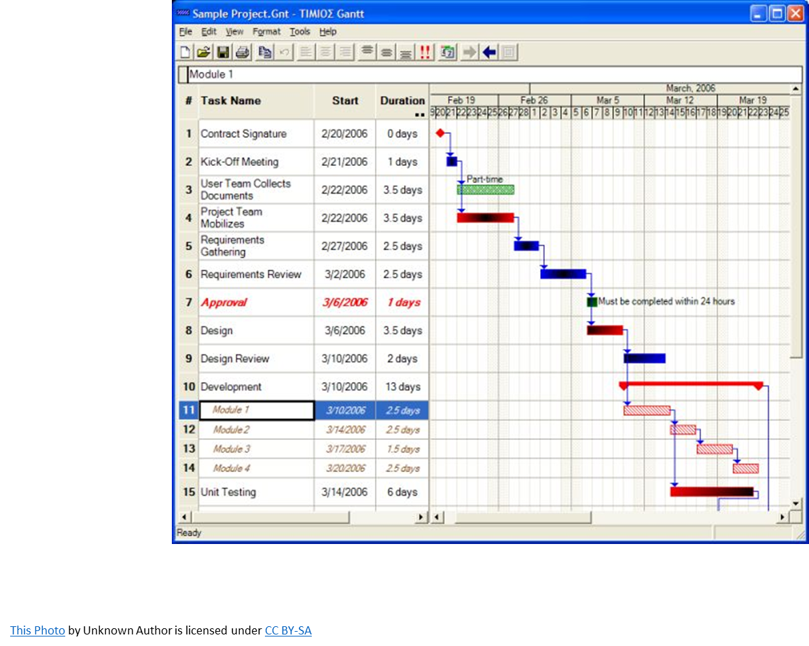
Phasing Provisions
©2025 FGI
  Operational spaces determined by the governing body
  Disruption of critical service
  Phasing plans show continuity of operations and compliance
  Interim phases shall meet the FGI Code, unless approved by the AHJ

Slide 14
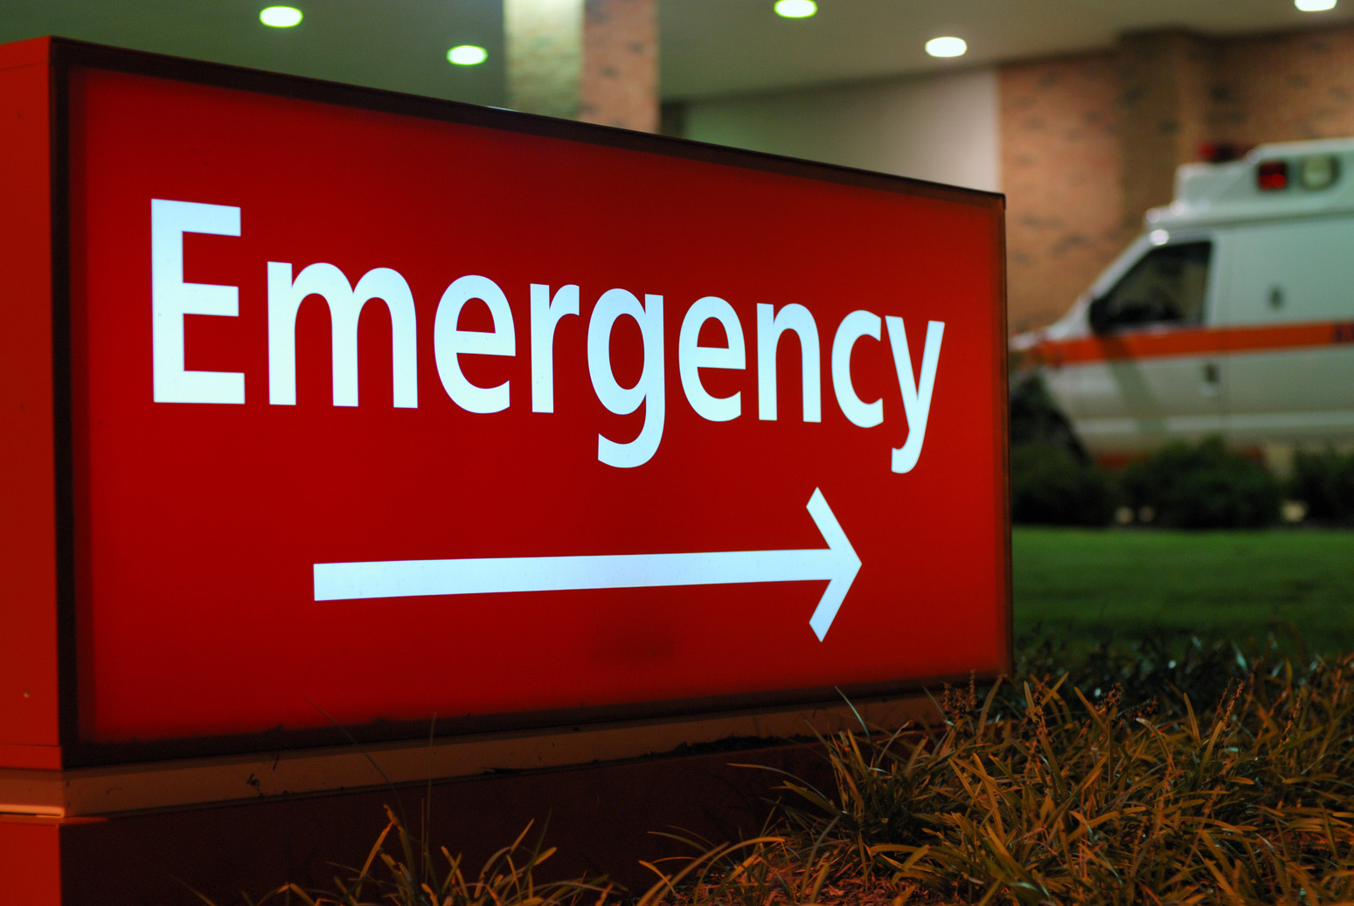
Emergency Signage
Part 1 - Site
©2025 FGI
  Illuminated “EMERGENCY” sign
  Contrasting background
  Site directional signage to emergency department

Slide 15
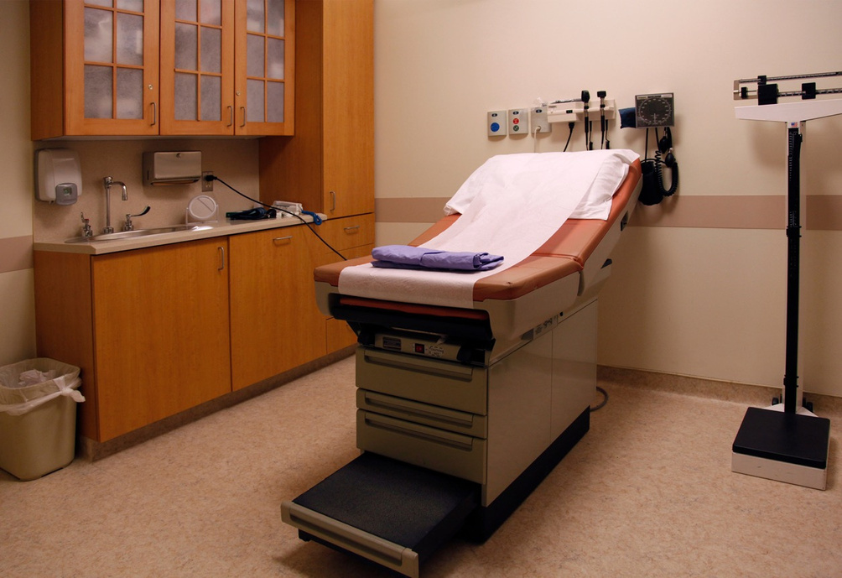
Emergency Signage
Common Elements – Surfaces and Furnishings
©2025 FGI
  Uppers shall have soffits or sloped tops @ 1:3
  Surfaces must be smooth, non-porous, cleanable and durable.
  Seams and joints must be fully sealed.

Slide 16
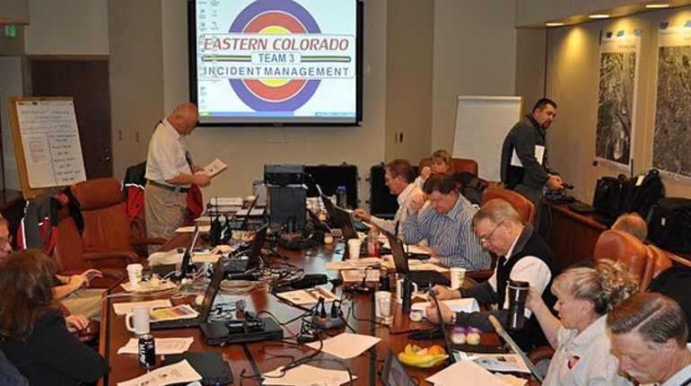
Incident Command
Where Required by DEVA
©2025 FGI
  A room must be provided.
  The incident command center shall:
    Be sized for HICS personnel
    Have HVAC on EES
    Have systems for continuity of service on EES
    Provide readily accessible storage space

Slide 17
Incident Command (cont.)
Where Required by DEVA
©2025 FGI
  The room may be used for other functions when not in use as an
incident command center.

Slide 18

Point of Care
Room or Area
©2025 FGI
  Room or Area
  Hand washing
  Work counter
  Sharps/specimen disposal
  Space for supplies and refridgerator

Slide 19
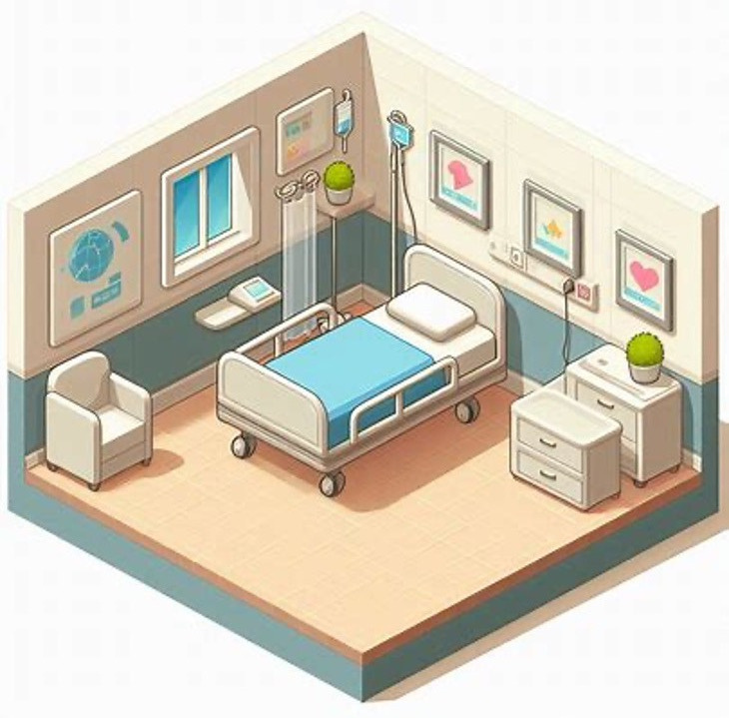
Med Psych Unit
New for 2026
©2025 FGI
  New unit type
  Medically acute with MH/SU overlay
  Addresses challenges of providing care
while protecting the patient
  Access control
  Hazard removal mitigation

Slide 20
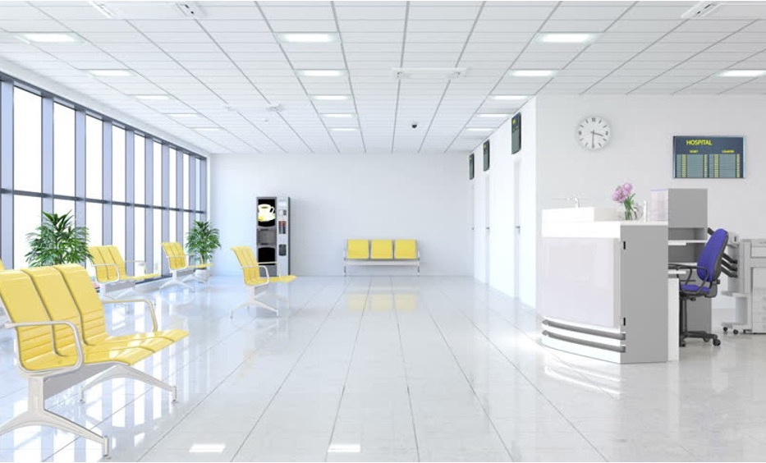
Post Acute Discharge
New for 2026
©2025 FGI
  Decompression of inpatient beds
  Quick turn-over of rooms after discharge
  Safe space for discharge patients
awaiting pick up

Slide 21
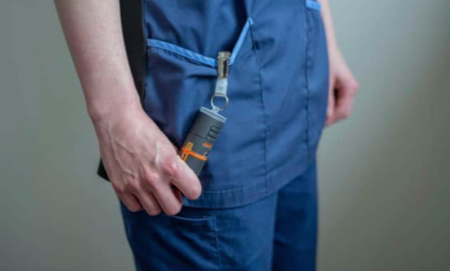
Staff Personal Alarm
Behavioral and Mental Health
©2025 FGI
  Wearable, accessible duress signal
  Operated by brief contact or voice
  Locatable within the facility
  Reports to a 24/7/365 staffed location
  Required in the BMH units

Slide 22
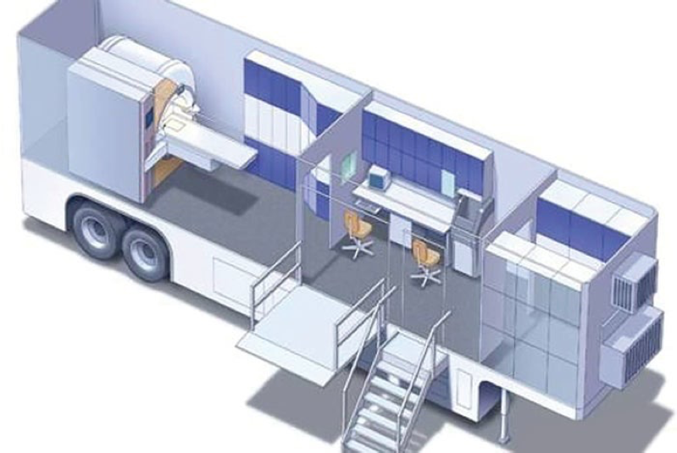
Mobile Units
©2025 FGI
  New subdivision of unit classes
    Class 1
    Class 1A - Does not park at a facility
    Class 1B – Parks at a facility
  Class 2
  Class 3
Requirements do not apply to Class 1A units
Selected requirements apply to Class 1B

Slide 23
©2025 FGI
Specific Revisions
2026 FGI Code for Planning and Design
of Outpatient Care Settings

Slide 24
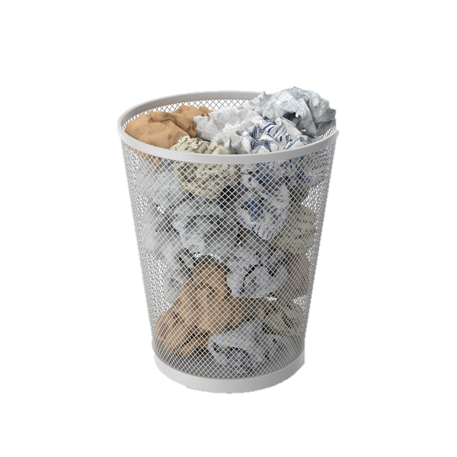
Part 1
OPDG Review for 2026 ed.
©2025 FGI
  Reduction of language
    Duplicate concepts (1.1-1.2.2.1…”not intended to restrict innovation”)
    Non-specific calls for compliance with Federal or state codes (1.1-4 Government Regulations)

Slide 25
Part 1 (cont.)
OPDG Review for 2026 ed.
©2025 FGI
  Reduction of language (cont.)
    Unenforceable planning and design concepts (1.2-1.3.1 Framework for OP Facility Design)
    “References without yield” (1.1-3.4.2 “In the absence of local parking standards or ordinances, refer to individual chapters..”

Slide 26
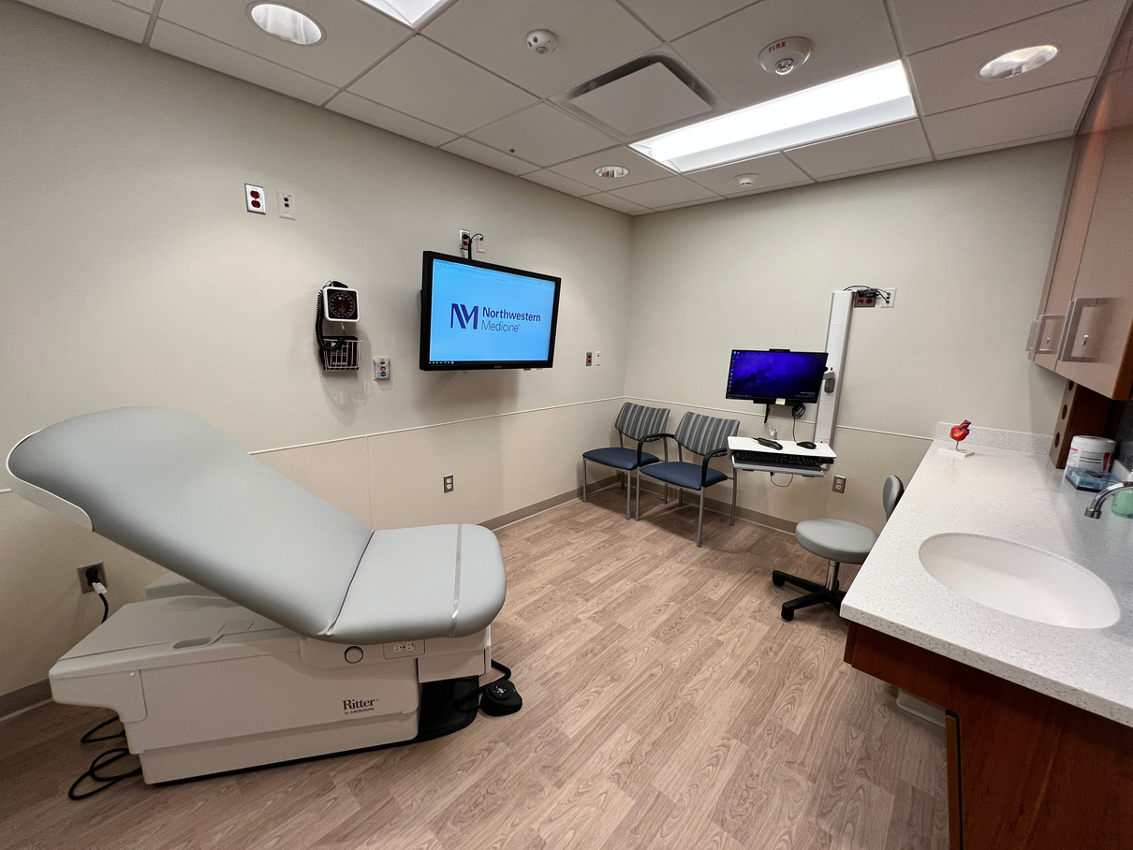
Part 1
1.1-3.1.1 Compliance Requirements
©2025 FGI
  Exceptions
    (1) Routine repairs and maintenance to buildings, systems, or equipment
    (2) Replacement of building furnishings and movable or fixed equipment

Slide 27
Part 1 (cont.)
1.1-3.1.1 Compliance Requirements
©2025 FGI
  Exceptions
    (3) Minor changes to the configuration of an existing space that have no impact on life safety or program function of the space
    (4) Cosmetic changes or upgrades to an existing space

Slide 28
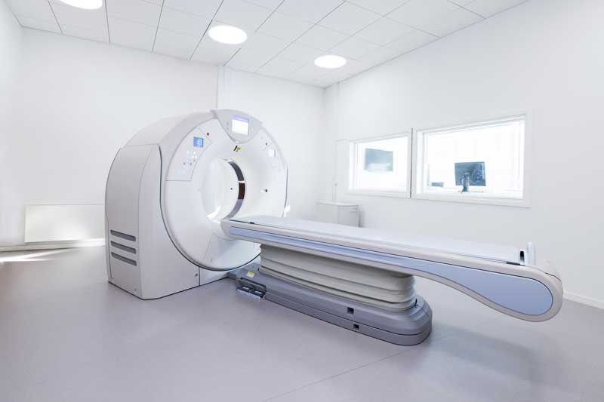
Chapter 2.1
2.1-3.5 Imaging Services
©2025 FGI
  Section moved to Chapter 2.3 Specific Requirements for Outpatient Imaging Facilities
  Chapter 2.3 substantially reorganized to improve flow and usability for document user
  No major changes to requirements
  Requirements for Class 3 Imaging room now clarified

Slide 29
Part 2 Tables
Table 2.1-4 and 2.1-5
©2025 FGI
  Functional, clearance, and finish requirements now summarized in tables
  Table 2.1-4: Exam, Procedure, Operating Room
  Table 2.1-5: Class 1, Class 2, Class 3 imaging rooms
  Hybrid Operating Room refers to Class 3 Imaging Room

Slide 30
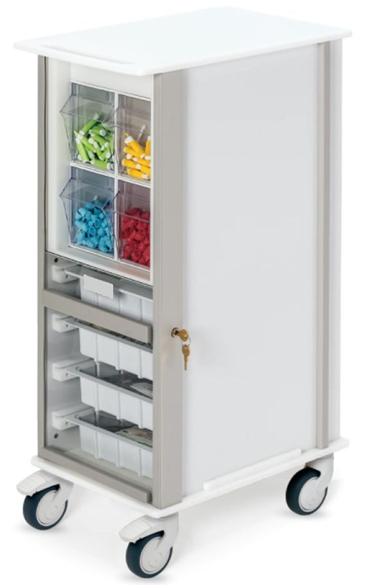
Chapter 2.1
2.1-3.8.11 Clean Workroom or
Clean Supply Room/Area
©2025 FGI
  Clean Supply Room now supplemented with concept of Clean Supply Area
  Addresses environments for which clean supply room is neither required nor minimum standard
  Presented in option through most of Facility Code for OP Settings

Slide 31
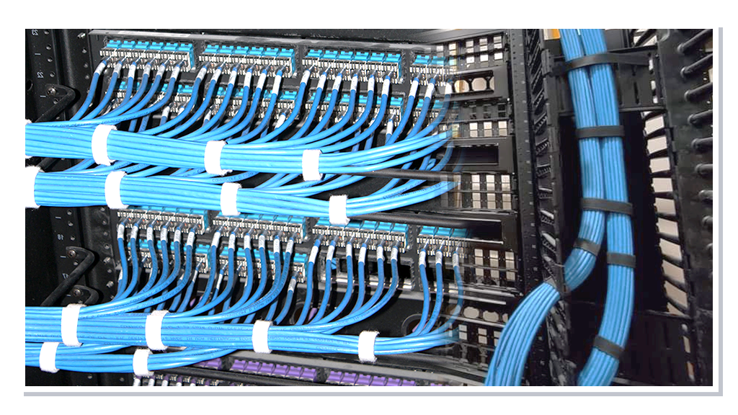
Chapter 2.1
2.1-8 Building Systems
©2025 FGI
  Electrical: Language aligned with the Hospital document where appropriate
  2.1-8.4.4.2 Hemodialysis and hemoperfusion water requirements moved from the Dialysis chapter to this section
  Plumbing fixtures and fittings – Several revisions aimed at more logical requirements (elimination of acid resistance) and reducing water age

Slide 32
Chapter 2.1
2.1-8 Building Systems
©2025 FGI
  Addition of water purification requirements that align with Facility Code for Hospitals
  Major rework of Communication Systems with provisions for EF, TER and TR room requirements

Slide 33
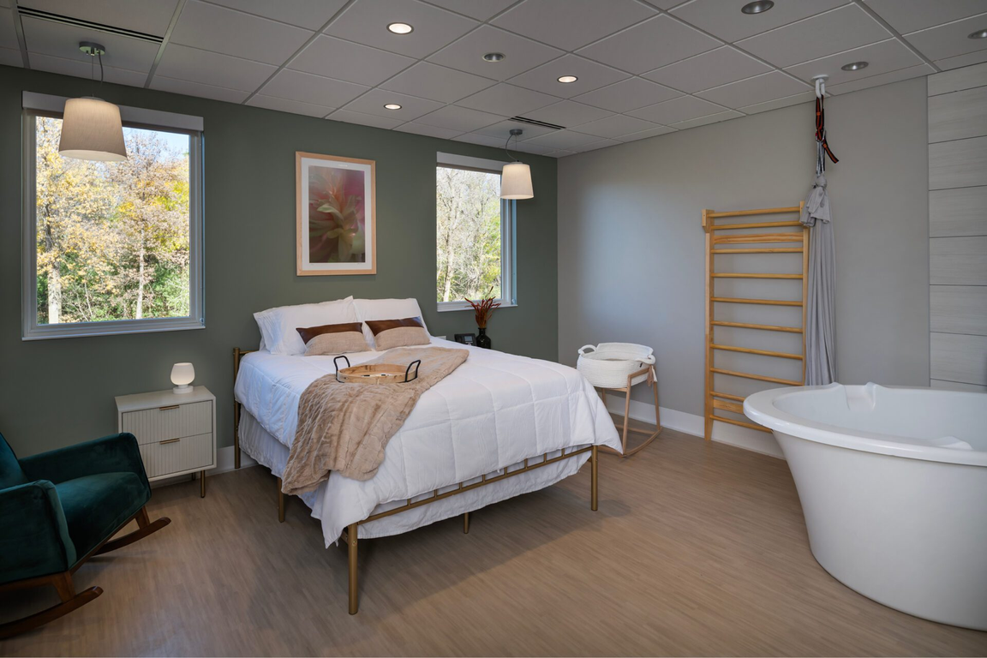
Chapter 2.4
Specific Requirements for Birth Centers
©2025 FGI
  Application
    Not in a hospital
    Low-risk physiologic births without medical interventions
    LOS – Fewer than 24 hours after birth

Slide 34
Chapter 2.4 (cont.)
Specific Requirements for Birth Centers
©2025 FGI
  Chapter 2.4-8
    Focused on minimal requirements pertaining to occupant safety and safety of building systems.
    Elevators are allowed exception for size due to constrained conditions.

Slide 35
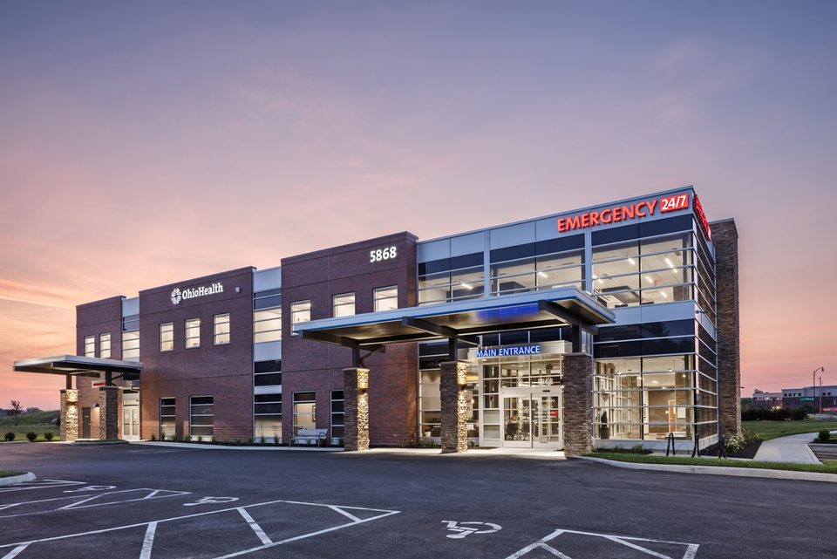
Chapter 2.8
Specific Requirements for
Freestanding Emergency Care Facilities
©2025 FGI
  2.8-1.1.2.1 Rural Emergency Hospital
    When conversion from a critical access hospital or small hospital to a rural emergency hospital (REH) requires no renovation or expansion, the requirements in this chapter of the 2026 FGI Code for Planning and Design of Outpatient Settings shall not apply.

Slide 36
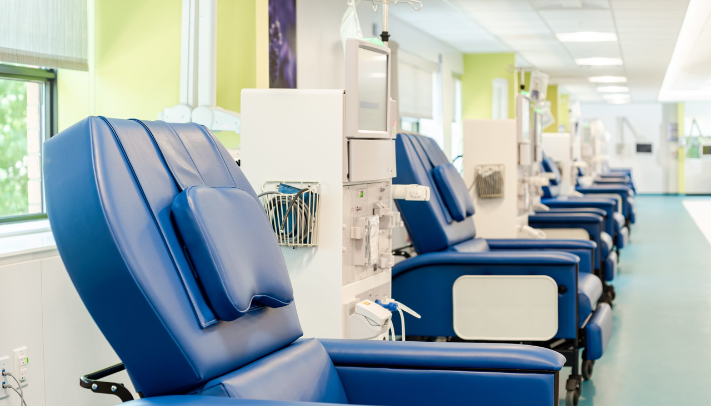
Chapter 2.10 (cont.)
Specific Requirements for Renal Dialysis Centers
©2025 FGI
  2.10-3.3
Home Training Patient Care Room/Area
    More flexible as either a room or an area
    Required area reduced to 110 SF from 120 SF;
    Clarified requirement for flushing rim fixture for fluid disposal – can be a tankless toilet, tank toilet, or CSS/Hopper

Slide 37
Chapter 2.10 (cont.)
Specific Requirements for
Renal Dialysis Centers
©2025 FGI
  2.10-4.5.1 Dialyzer Reprocessing Room
    Text removed for 2026 ed.
    Note that CMS conditions of participation continue to outline requirements for facilities that reprocess dialyzers

Slide 38
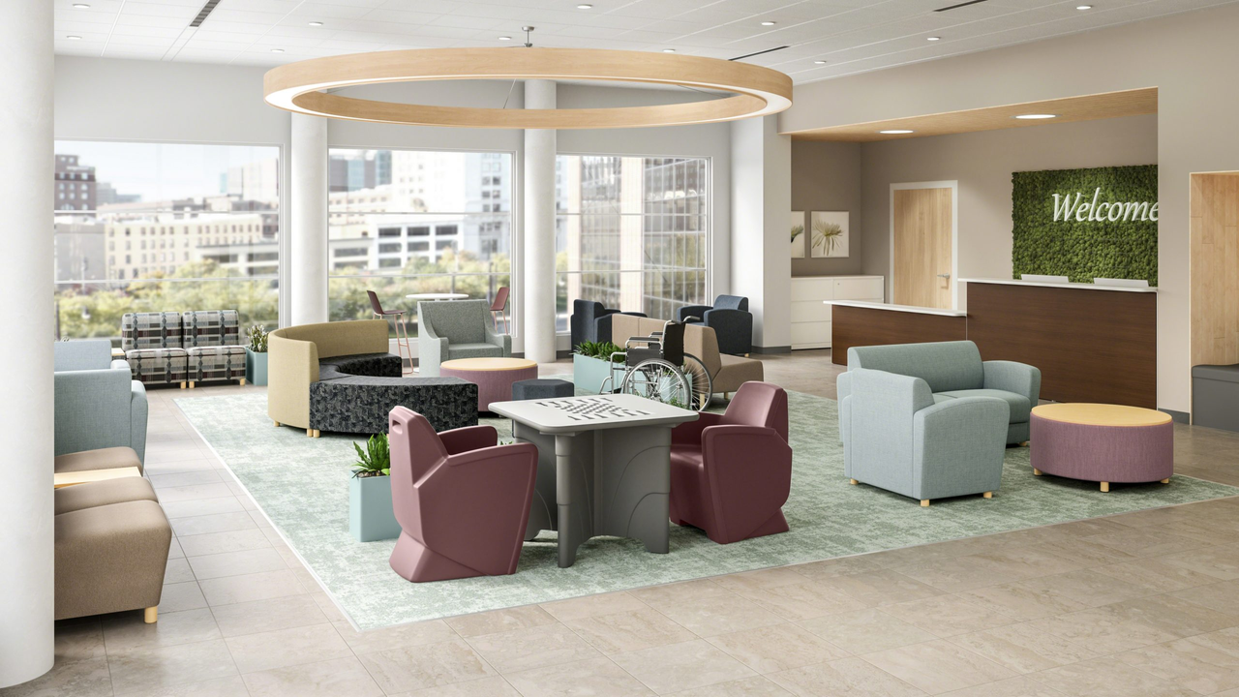
Chapter 2.11
Specific Requirements for Outpatient Behavioral and Mental Health Facilities
©2025 FGI
  2.11-3 Areas for Patient Services
    Realigned to clarify requirements and calls for attention to ligature resistant features and fittings where required
  2.11-3.3 Observation Room
    Min clear area of 100 SF rather than 80 SF, and additional requirements clarified for multiple patient observation areas including provision of toilets and showers

Slide 39
Chapter 2.11 (cont.)
Specific Requirements for Outpatient Behavioral and Mental Health Facilities
©2025 FGI
  Appendix now clarifies:
    Seclusion Room: A designated space for [residents/] patients requiring security and protection against self-harm or harm to others

Slide 40
Chapter 2.11 (cont.)
Specific Requirements for Outpatient Behavioral and Mental Health Facilities
©2025 FGI
  Appendix now clarifies:
    Secure Holding Room: Space intended to temporarily hold patients in a secure environment until the patient’s condition supports a less restrictive level of care or the patient is transferred to another facility

Slide 41
Chapter 2.12
Specific Requirements for Outpatient Behavioral Health Crisis Centers
©2025 FGI
  New freestanding chapter
  Carries forward much of language from Chp 2.8 with revisions:
    Clarifies that chapter applies to both Freestanding Emergency BHCCs and Community BHCCs
    Addresses concept and requirements for the Central Milieu Room including area per patient (80 SF), access to handwashing stations, patient toilets, showers, and ligature resistance
    Revises requirements for Seclusion Room to remove the 12’ max dimension, centering only on 7’ minimum clear dimension; Requires outswing door with view panel.

Slide 42
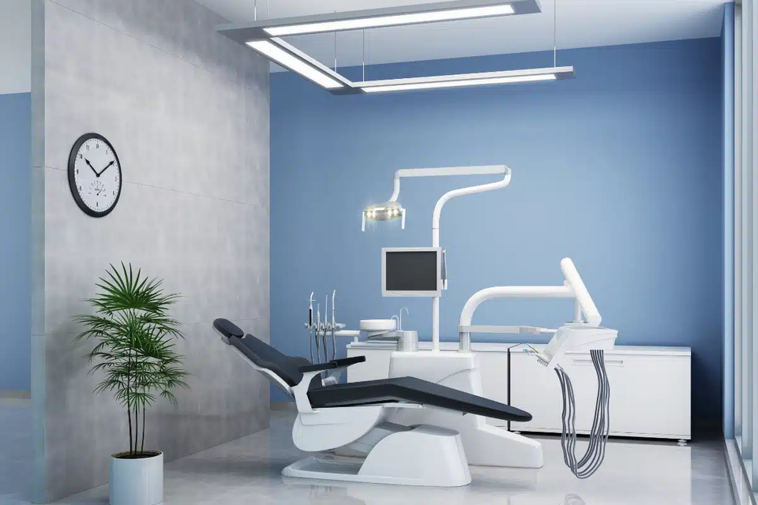
Chapter 2.14
Specific Requirements for Dental Facilities
©2025 FGI
  Dental Operatory requirements updated; 1 single operatory required, remainder can be open stations
  Operatory shall be sized to accommodate additional staff and equipment planned to be in the operatory, thus no specified min clear area
  Sedation now requires space for post-sedation monitoring

Slide 43
Chapter 2.14 (cont.)
Specific Requirements for Dental Facilities
©2025 FGI
  Training room requirements slightly refined based on min standards
  Radiography / imaging requirements clarified with allowance for off-site storage of images
  Dental prosthodontics lab updated; Calls for space for pour-up and grinding/drilling of prosthodontics

Slide 44

Chapter 2.15
Specific Requirements for Short Stay Centers
©2025 FGI
Stay tuned for the
1 PM presentation!

Slide 45
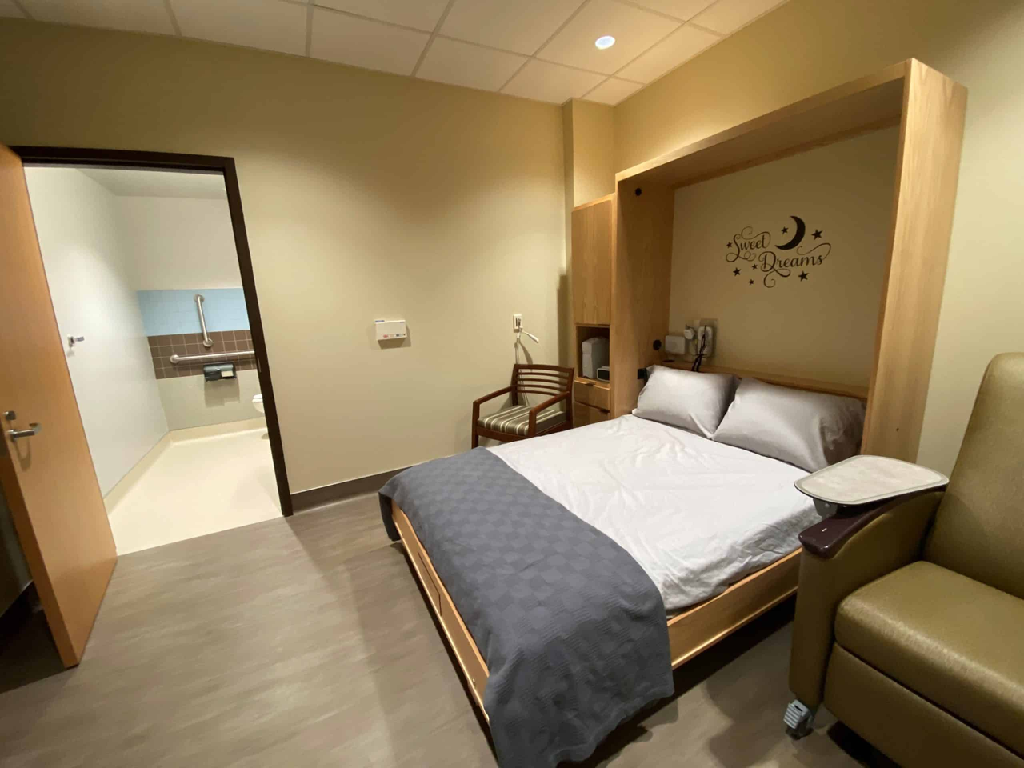
Chapter 2.16
Specific Requirements for Sleep Disorders Centers
©2025 FGI
  New chapter for 2026
  Defines requirements for Sleep Testing Room, Control Room, and key support areas
  Patient room min is 120 SF with clearances of 3’ on all sides of the bed – less restrictive than traditional patient room

Slide 46
Chapter 2.16 (cont.)
Specific Requirements for Sleep Disorders Centers
©2025 FGI
  Min support areas include patient toilet (may be shared), staff toilet, staff lounge, soiled holding room, and EVS
  Public and admin spaces are dictated by functional program

Slide 47
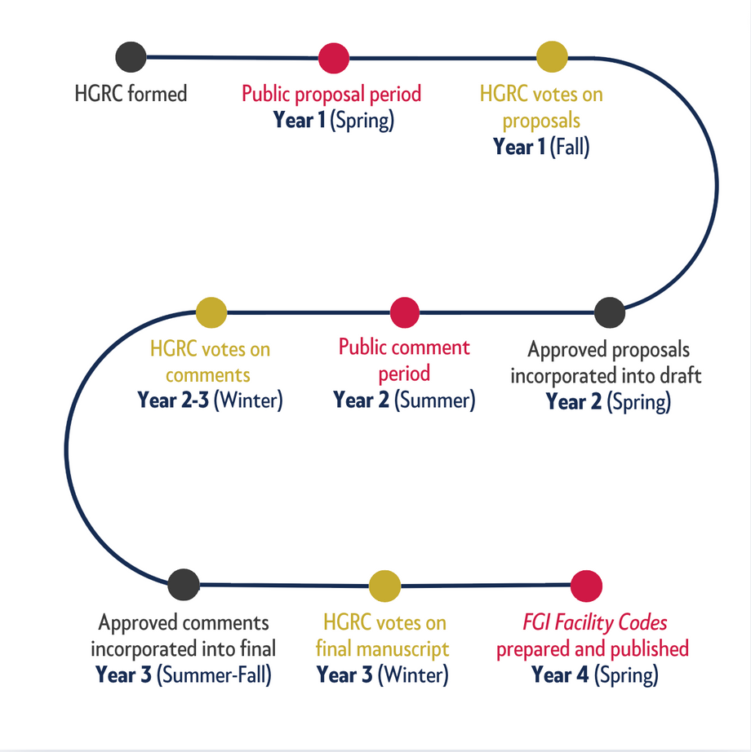


What’s next?
Your involvement in 2030!
Write a proposal to
help improve the code
and health care environments!
Review the draft and provide comments.
Notes:
Can you believe that we're already thinking about the revision cycle for the 2030 FGI Codes for Planning and Design? With the beginning of the next 4-year revision cycle in fall 2026, FGI will make an announcement in the FGI Bulletin letting folks know when the HGRC will be accepting new members. If you're interested in joining, be sure to sign up for the FGI Bulletin newsletter on FGI's website.
There are other ways to get involved as well. In Spring 2027, the public will be invited to submit proposals to revise the codes. Then, in the summer of 2028, the 2030 draft will be released and the public will again be invited to provide feedback.
Involvement in this process from the folks who use the codes is critical. We hope you'll participate and make your voice heard!

Slide 48




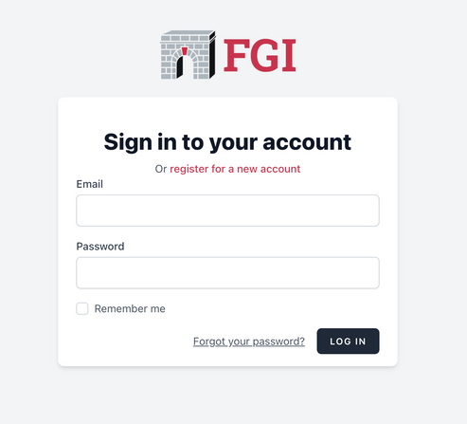
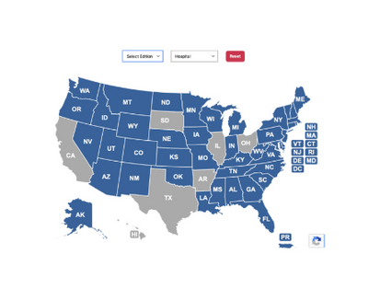
Continue learning with FGI
©2025 FGI
Between
the Lines with FGI Podcast
FGI’s
Education Platform
FGI’s
Subscription Platform
2026 FGI Codes and Handbooks to be released in Spring 2026
FGI’s
Interactive Adoption Map
Notes:
Between the Lines with FGI:
We're excited to share that Season 3 of Between the Lines with FGI is in full swing. All episodes of this podcast can be accessed on our website and where podcasts are available.
Did you know that you can receive CEU/CEHs for listening to our episodes? FGI will be providing this content as courses on our new educational platform, and take care of all the logistics to ensure you receive your CEU/CEHs upon completion.
FGI's Educational Platform: Speaking of, we're pleased to share that FGI's new educational platform is filled with e-learning courses, fireside chats, webinars, and microlearning activities, including from our HGRC experts. This is a great way to gain your CEU/CEHs while supporting FGI. If you're interested in providing group education for your team, this is a great place to start.
FGI's Subscriber Library: This platform will be a great partner to our Digital Library, which is where you’ll be able to access the new edition, along with any other editions you’ve subscribed to. You can access both the Digital Library and, when launched, our educational platform directly through FGI's website. On the landing page of the Digital Library, you'll find a guided tutorial to walk you through the platform.
​
​2026 FGI Codes and Handbooks launch this spring: This seminar will cover many of the exciting changes to come in the 2026 FGI Codes and Handbooks this spring. FGI will continue to release information and educational opportunities leading up to its release. We recommend subscribing to our emails and outreach.
FGI's interactive adoption map: We’ve recently updated the adoption map on our website to enable users to access information more easily. Now, when you click on a state, you’ll be able to see specifics on which facility types are required to meet the FGI codes, and, where available, links to state rules and AHJ contact information. Updating the adoption map is a continuous process; if you find that information in the map is out of date, we'd be grateful if you would reach out and let us know. ​

Slide 49




Connect with us
©2025 FGI
FGIGuidelines.org
FGI Guidelines
Between the Lines with FGI Podcast
Notes:
Thank you for your continued support of FGI. We'd love to stay in touch! Following FGI on LinkedIn and subscribing to our outreach is the best way to stay in-the-know of education offerings and events, updates, and more.

Slide 51

©2025 FGI

