Slide 1
Safety Risk Assessment (SRA) for NFPA 99, Health Care Facilities Code
Jonathan Flannery, CHFM, MHSA, FASHE, FACHE,
Senior Associate Director
501-813-2400
jflannery@aha.org
Jim Sagstetter, Architect, MBA,
Medical Programmer, Medical Planner
507-216-1960
sagstetter.james@mayo.edu
41st Annual FPC Seminar + Expo
Sept 28 - Sept 30, 2025
AHCA2025.10
1 LU| HSW
September 29, 2025

Slide 2
The seminar has teamed with a registered provider of AIA - approved continuing education under Provider Number E240. All registered AIA CES Providers must comply with the AIA Standards for Continuing Education Programs.
Any questions or concerns about this provider or this learning program may be sent to cessupport@aia.org or 800-242-3837 Option 3.
This learning program is registered with AIA CES for continuing professional education. As such, it does not include content that may be deemed or construed to be an approval or endorsement by the AIA of any material of construction or any method or manner of handling, using, distributing, or dealing in any material or product.
AIA continuing education credit has been reviewed and approved by AIA CES. Learners must complete the entire learning program to receive continuing education credit. AIA continuing education Learning Units earned upon completion of this course will be reported to AIA CES for AIA members. Certificates of Completion for both AIA members and non-AIA members are available upon request.

Slide 3
AIA Learning Objectives
Learn the risk categories in NFPA 99 and what they mean
Understand why a Risk Assessment is necessary for the hospital to develop
Be able assist the facility in applying these risks to the correct room or area
Improve planning and design services by being familiar with these risk categories

Slide 4
Disclaimers
Not speaking on behalf of CMS or any accrediting agencies
Not speaking on behalf of ASHRAE
Recommend you review the specific standard or guideline requirements of your own accrediting agency
Recommend you subscribe to their communications to stay up to date
Notes:
The responses and interpretations are an explanation of a specific provision of a code, standard or guideline. While every effort has been made to ensure its accuracy and reliability, it is advisory and provided for informational purposes only.
For formal interpretations please submit your question to the code/standard development organization for an official interpretation

Slide 5
Introduction to Safety Risk Assessment
What is a Safety Risk Assessment?
  Process of identifying, evaluating, and controlling risks
  Proactively minimizes the likelihood and severity of
    Accidents
    Injuries
    Illnesses
  By
    Establishing hierarchy of priorities
    Implementing appropriate mitigation strategies
Notes:
So what is a Safety Risk Assessment ?It is a process of identifying,… evaluating…. and controlling risk on projects from…. programming and planning to project closeout. It proactively helps to minimize the likelihood and the Severity of accidents, injuries, and illnesses.
It is a process of establishing a hierarchy of priorities and implementing mitigation strategies.

Slide 6
Introduction to Safety Risk Assessment
Importance of Safety Risk Assessment
  Helps establish a healthy physical environment
  Promotes a culture of safety
  Helps comply with legal requirements and regulations
  Reduces operational costs by preventing incidents
Notes:
So there are a number of reasons for implementing a safety risk assessment and those are …. It helps to establish a healthy physical environment….. it does promote a culture of safety…… it helps in complying with legal requirements and regulations For example NFPA99…………. and it reduces operational costs by preventing project incidents.

Slide 7
Why do a safety risk assessment?
CMS CoP § 482.41 Condition of Participation: Physical Environment
  The hospital must be constructed, arranged, and maintained to ensure the safety of the patient, and to provide facilities for diagnosis and treatment and for special hospital services appropriate to the needs of the community
Paragraph (c) Standard: Building Safety
  The hospital must meet the applicable provisions and must proceed in accordance with the 2012 Health Care Facilities Code - NFPA 99
Notes:
So to address the legal and regulation requirement mentioned on the last slide …. CMS CoP or condition of participation for physical environment states .... The readiness… for the hospital must be constructed ….arranged…. and maintained to ensure safety of the patient… Diagnostics… treatment… and special service needs of the community and ….that brings in the NFPA 99 2012 health care facilities code……
So this is The why we do a safety risk assessment…. It is a requirement.

Slide 8
Why do a safety risk assessment?
NFPA 99, Health Care Facilities Code Chapter 4
  Section 4.1 – All activities, systems or equipment shall be designed to meet Category 1 through 4
    Category 1 - Likely to cause major injury or death
    Category 2 – Likely to cause minor injury
    Category 3 – Likely not to cause injury but can cause discomfort
    Category 4 – No impact
  Section 4.2.1.1 – Governing body shall conduct documented risk assessments and determine risk categories
Notes:
In section 4.1 of NFPA 99…. Chapter 4 ….there are 4 categories stated and they are listed here as ….Category 1 through 4 …. 1 being… of course the most severe… the most likely to cause major injury or death…. to a category 4 which…. will have no impact to Staff or Patient care. And then to mention section 4.2 .1.1….. It states…. The governing body…. Of your facility… shall conduct and document risk assessments and … risk categories

Slide 9
Why do a safety risk assessment?
Facilities Guidelines Section 1.2-3
  Projects shall be designed and constructed to facilitate safe delivery of care
  SRA Components
    Infection Control (ICRA)
    Patient Handling and Movement
    Fall Prevention
    Medication Safety
    Behavioral and Mental Health
    Patient Immobility
    Security Risk
Notes:
There's also a series of guidelines written by the Facility Guideline Institute that brings in additional requirements to deliver safe care….the safety risk assessment ….. of components of your inter disciplinary team are listed here and their involvement is needed….. from the beginning of a project too project close out.

Slide 10
Why do a safety risk assessment?
Facilities Guidelines Section 1.2-3
  Interdisciplinary Team shall develop SRA
  SRA Team Members
    Frontline Caregivers
    Facility Management Staff
    Performance/Quality Staff
    Safety Specialists
    Security Specialists
    Infection Preventionists
    Designers/Engineers
    Human Factor Specialists
    Other Appropriate Individuals
Notes:
There's also a series of guidelines written by the Facility Guideline Institute that brings in additional requirements to deliver safe care….the safety risk assessment ….. of components of your inter disciplinary team are listed here and their involvement is needed….. from the beginning of a project too project close out.

Slide 11
Introduction to Safety Risk Assessment
Benefits of Conducting a Safety Risk Assessment
  Improved Safety: Risk Assessments proactively reduce accidents and injuries
  Legal Compliance: Avoidance of Penalties and Fines
  Cost Savings:
    Healthy Environment for Patients, Staff and Visitors
    Fewer injuries, lawsuits and insurance claims
  Patient, Staff, Visitors, Morale: A safer environment boosts confidence and productivity.
Notes:
There are several beneficial reasons for conducting a safety risk assessment…. and those are ….Improved safety of your projects by reducing accidents and injuries …. Dealing with legal compliance to avoid the penalties and fines that come along with those legal requirements …. Creating cost savings by having a healthier environment for patients, staff and visitors and having fewer injuries and lawsuits on the project …. Also it promotes a higher morale level by creating a safer environment.

Slide 12
Introduction to Safety Risk Assessment
Key Terms in Risk Assessment
  Hazard: A source of potential harm or danger (e.g., Airborne Infection Risk to Patients, Staff and Visitors, Mold, Construction Dust, Chemicals etc).
  Risk: The likelihood of harm occurring from the hazard.
  Risk Assessment: The process of evaluating risks and deciding on actions to mitigate them.
  Mitigation Strategies: Actions to reduce or eliminate risks (e.g., safety protocols, equipment modifications).
  System: Collection of interconnected components designed to perform a specific function
Notes:
There are several terms that need to be involved in your safety risk assessment …. and they are Hazard ….understand what the potential harm could be from the hazard …. an example could be mold, construction dust, chemicals and so on…. What is Risk from the hazard…. in creating a risk assessment to understanding the complexities of the potential hazards….. What the mitigation strategies could be so that you can reduce the OR eliminate risk …..and Understand what your system is for collecting all this data and ….. Information.

Slide 13

Introduction to Safety Risk Assessment
Evaluate
Review
The Risk Assessment Process
  Evaluate Systems: What systems serve what areas
    System purpose and who is served
  Identify Hazards: Find out what could potentially cause harm
  Assess the Risks: Evaluate the level of risk associated with each hazard
    Consider likelihood and severity of harm
  Implement Control Measures: Introduce methods to minimize or eliminate risks
    Hierarchy of controls: Elimination, Substitution, Engineering, Administrative, PPE
  Review and Monitor: Regularly check the effectiveness of control measures.
    Ongoing monitoring and regular risk reassessments.
Identify
Assess
Implement
Notes:
So…. as we get into the risk assessment process,….. we have a series of evaluation systems we should be looking at…. Which, could be the mechanical systems within the areas being served by air….. the electrical systems making sure that certain systems are always available for patients, staff, and visitors,…. Life safety systems making sure that compartment systems are intact and exit paths are always available…. We need to be able to identify all the hazards within those design and construction areas….. We need to also be able to assess those risks as they present themselves….. We need to understand what those implementation control measures are that could help eliminate some of those risks….. and we need to understand and review how we monitor all these control measures as the project continues on from the project beginning to the project closeout.

Slide 14
Introduction to Safety Risk Assessment
Risk Assessment Tools and Technique
  Qualitative Risk Assessment: Utilizes risk matrices or checklists to categorize and prioritize risks based on likelihood and impact
  Quantitative Risk Assessment: Uses numerical values and data analysis to assess risks
  Hazard and Operability Study (HAZOP): A structured method for identifying risks in complex processes.
  Failure Mode and Effect Analysis (FMEA): Analyzing potential failure points in processes.
Notes:
There are several risk assessment tools and techniques available some of which are listed here the qualitative assessments …. quantitative assessments ….. hazard and operability studies …… and failure mode and effect analysis

Slide 15
Enforcement of Risk Assessments
CMS
  K-tags: Represent the CMS requirements
    K-901, K-907, K-913
      Example : K-tag K901 invokes NFPA 99-2012 Fundamentals Chapter 4.
Accrediting Organizations:
    DNV – PE.2.SR.1a, PE.SR.13, PE.8.SR.2, 3 & 4,
    HFAP – 13.00.05, 11.05.01, 11.05.02, 11.06.09
    JC – EC.02.05.01-EP2, EC.02.05.09-EP7, EC.02.05.01-EP20
      PE.03.02.01 January 2026
Notes:
The enforcement of risk assessment comes in when CMS K tags are presented as shown here ….. as…. key tag ….. K-901 K-907 and K-913 and as an example K tag 901 it invokes NFPA 99 the 2012 version And can be found in the …..fundamental chapter 4…. The accrediting organizations supporting these requirements are listed here and their organization rules and requirements for the EC or…… environment of care

Slide 16
How to get started
Mayo Clinic Documents
  Mayo Clinic Design Guideline
    DG Z1041.02 Functional Program - Safety Risk Assessment Requirements
  Mayo Clinic Design Guideline
    DG Z1041.03 NFPA 99 Risk Assessment Procedure
  Mayo Clinic Design Guideline
    DG Z1048.20 NFPA 99 Risk Assessment and Room Information
Notes:
So how to get started…. at Mayo Clinic we started by examining the Facility Guideline Institute and NFPA 99 along with educating ourselves on the requirements….. We use that as a stepping stone to create design guidelines for us to follow…. Those guidelines are a part of influencing the design process with our outside design firms architectural and engineering ……. in order to accomplish that ….. we created a functional program which outlined a number of conditions for doing safety risk assessments ……. we created guidelines around NFPA 99 ……. and we also created a series of checks and balances that helped when formulating our room by room assessments during the planning phase of a project.

Slide 17
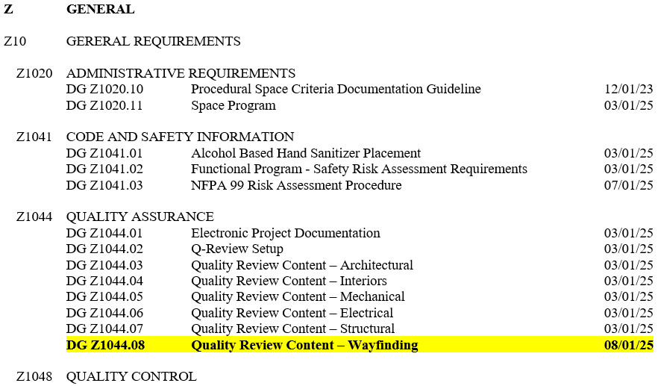
Mayo Clinic Design Guidelines
TABLE OF CONTENTS - Uniformat
Notes:
Within the ….Table of Contents of our design guidelines….. under the heading of …..Code and Safety Information we can find our Functional Program and the NFPA 99 risk assessment procedure…. Under …. Quality Control ….. we can find the NFPA 99 risk assessment and Room Number Information Table…… I will have additional slides later in this presentation showing how we register Room names with Risk categories.

Slide 18
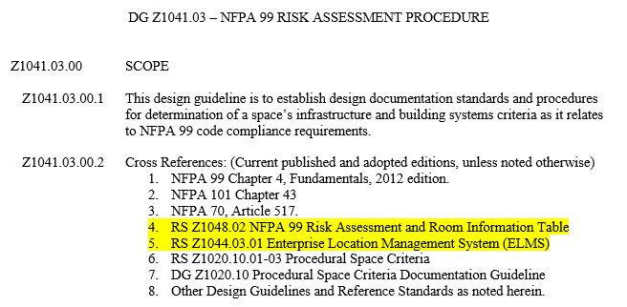
Mayo Clinic Design Guideline - DG Z1041.03
Mayo Clinic Design Guideline – DG Z1041.03
DG
20
Notes:
Within our design guideline for NFPA 99 risk assessment ….. we have listed cross references which tie design guidelines and reference standards together,

Slide 19
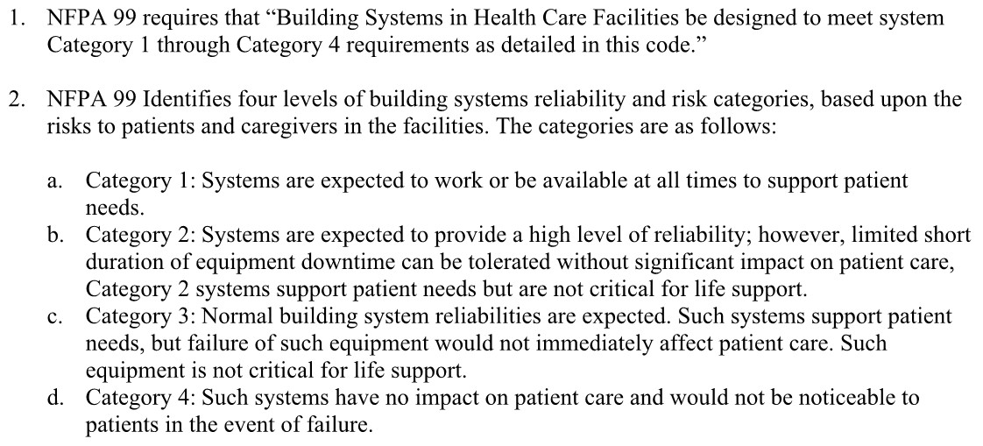


NFPA 99
Notes:
Again… NFPA 99 has these risk categories 1 through 4 and as highlighted here in yellow you can see that category one is expected to work or be available at all times …… down through category 4 which would have no impact on patient care

Slide 20
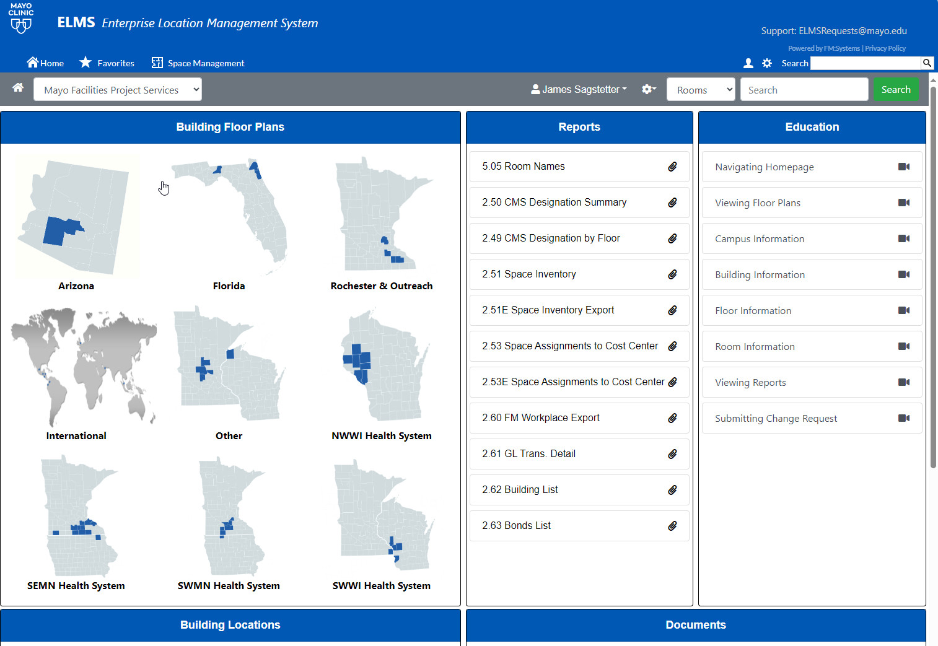

Imbedded into ELMS 5.05 Report
Location of 5.05 Room Names Report
Notes:
Now if we turn to our ELMS or Enterprise Location Management System and we'll go to report 5.05….. you will find a listing …..for our room names.

Slide 21
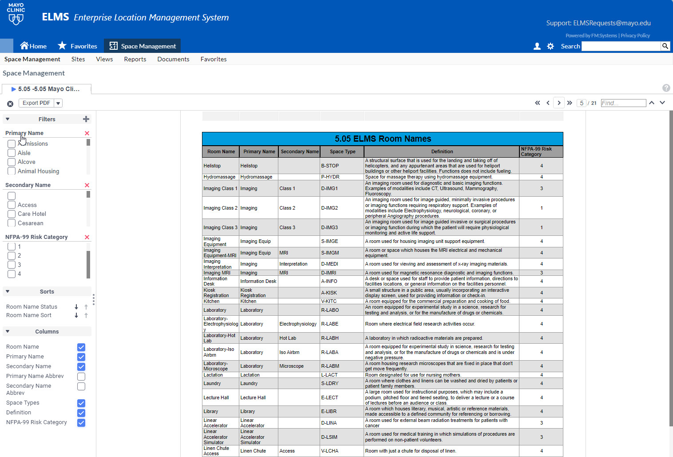
Imbedded into ELMS 5.05 Report
Location of 5.05 NFPA 99 Risk Category
Notes:
And once you've clicked on the Elms 5.05 report it will bring you to this screen and on the left-hand side at the very bottom…. you will find and additional box to check…. which will display the column on the far right…. calling out the NFPA 99 risk category for those room type names.

Slide 22
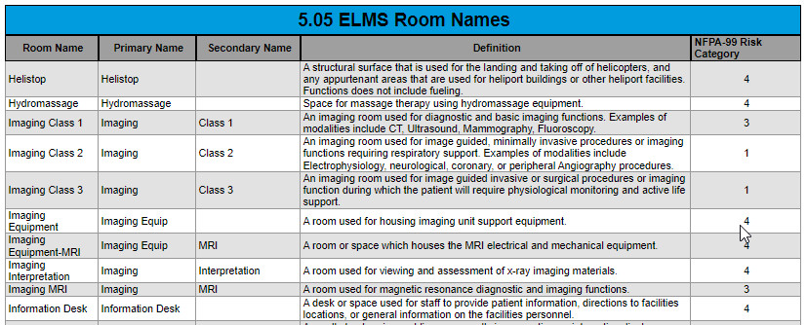
Imbedded into ELMS 5.05 Report
Notes:
The room names shown here as an example, …… will indicate the room name,….. the primary name …..the secondary name if any…… the definition of the space and the ….. risk category number of the space.

Slide 23
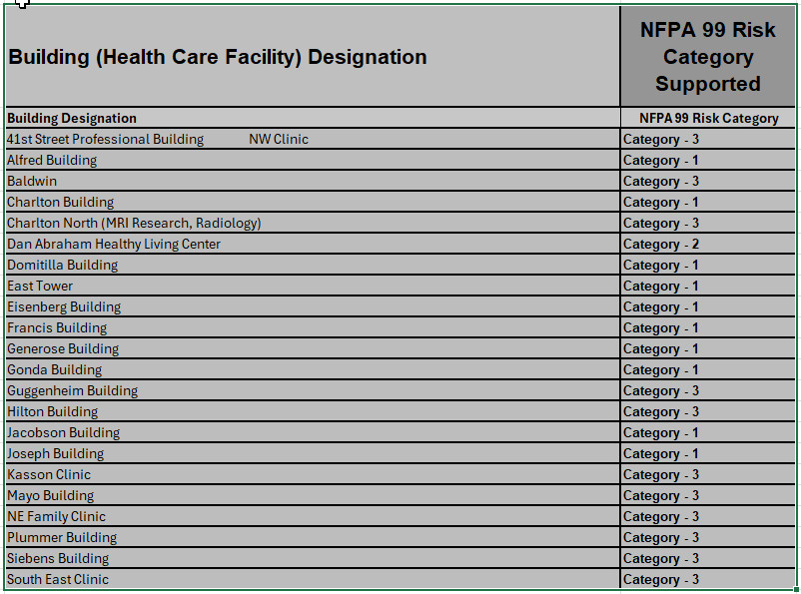
Imbedded into Design Guideline 1005.06
Building support systems available per Building
Note: Building may not support a more Intense Patient Risk Category
Notes:
In addition to our ELMS system we have also created… the listing of risk by buildings……this will indicate by building what the systems …. in the building will support the risk categories …… so our A & E consultants understand they can not place in those buildings…. Spaces…. that will be supported by a more intense category.

Slide 24
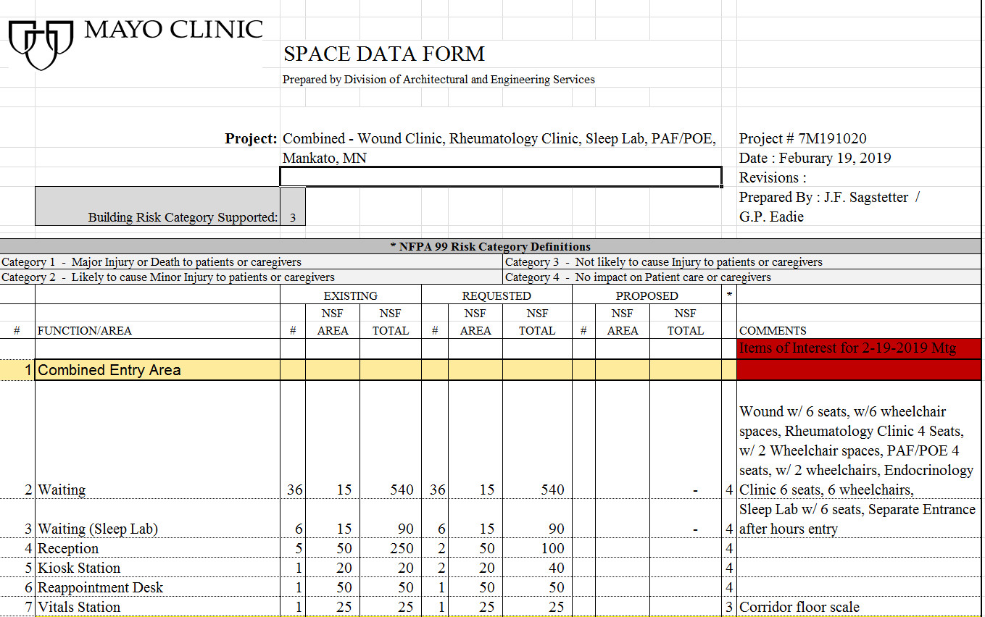
Space Data Form
Notes:
so when we do our space programming at the beginning of the projects we use this space data form…. That is when we fill in what …. that building risk category is ….. to show what the ability of the building itself can support …..this space data form …… is for a Clinic we have in the western part of Minnesota can only support a category 3 space …..There is a column on the right-hand side that indicates from our ELMS management system …. if you select the waiting room ….. waiting room names can only be supported a category type 4 space.

Slide 25
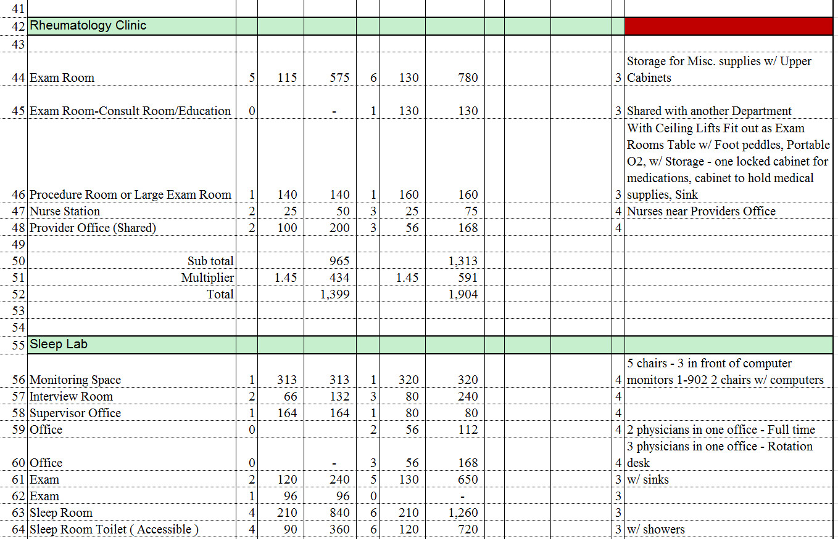
Space Data Form
Space Data Form
Notes:
if you look at line 44 here ….the exam room…. can be supported by a category 3 space…. again …. these room names are all driven by our ELMS system and categorize accordingly

Slide 26
Documentation
HOW IS THIS DOCUMENTED
DG Z1041.02 - Functional Program
Safety Risk Assessment Requirements
Z1041.02.00 SCOPE
Z1041.02.00.1 The functional program communicates the owner's intent formed from a multidisciplinary team, for the project to
the designers of record and serves as the basis for the project design and construction. It is required for new construction, major renovations, and projects that change the functional use of any hospital and outpatient facilities space as stated in the 2022 FGI Guidelines 1.2-2 and 1.2-4.
Z1041.02.00.2 The functional program shall include an executive summary, the purpose or objective of the project, the project type and size and this information is found in the Mayo Clinic Facilities Program document that is electronically stored for each individual project that includes new construction, major renovations, and projects that change the functional use of any hospital space.
Z1041.02.00.3 The construction type and occupancy, the project components and scope are found within the Life Safety Drawings and the Basis of Design portion of the project Construction Documents or the Basis of Design/Commissioning sheets. The indirect support functions, and the operational requirements are addressed during the design process to ensure the projects meet the needs of our staff, patients, and visitors. The room names and spaces are found in the Space Program document that is electronically stored for each of these individual projects. These documents are all stored within the Kahua Project Management software package information repository at all project stages.
Z1041.02.00.4 All major facilities projects follow an established system wide project delivery process, which includes a project review at Schematic Design and a quality review at the completion of construction documents. Each meeting includes a multidisciplinary team of subject matter experts to review and discuss project risk and design requirements.
Notes:
So now the question is…. How it is documented ….. Our functional program creates the chassis for us…. to continue the project moving forward

Slide 27
How is this documented
Functional Program Executive Summary Shall Include:
    The Purpose or Objective of the Project
    The Project Type and Size
    Plus - A Statement if Change of Functional Use of the Space
    Construction Type and Occupancy Documentation
Notes:
the Functional Program will have an executive summary… and shall include the purpose or objective of the project…. the project type and size….. A statement if there is a functional change of the space…And … it will also list the construction type and occupancy documentation.

Slide 28
How is this documented
Functional Program : (Mayo Clinic Facilities Program)
  The Functional Program is a document that communicates the owner's intent.
  Involves a Multidisciplinary Team for the project engaging the Designers of Record.
  Serves as the basis for the project design and construction.
  It is required for new construction, major renovations, and projects that change the functional use of any hospital and outpatient facilities spaces.
  Per 2022 FGI Guidelines 1.2-2 and 1.2-4.
Notes:
the functional program will also include a method that communicates our intent…. it involves a listing of our Multi- ….disciplinary team for engaging with the designers of record…. it will also serve as a basis for project design and construction ….. This SRA…. is required for all new and renovation projects or any change of functional use in the hospital ….. or outpatient facilities…. And this is all following the 2022 facility guideline institute guidelines .

Slide 29
How is this documented
Multidisciplinary Team: (Mayo Clinic Facilities Program)
    Team consist of :
  Frontline Caregivers
  Facility Management Staff (Operations)
  Performance or Quality Improvement Experts
  Safety and Security Staff
  Infection Control
  Architects and Engineers Professionals
  Human Resource Specialist
  Other Appropriate Individuals Based on Nature of Project
Notes:
so the multi-..disciplinary team should consist of the frontline caregivers nursing staff… physicians…. and administrators…. Facility Management staff or Operations….., Safety and security staff…. infection control staff…. architects and engineer consultants…… if needed a Human Resource Specialist or any other appropriate individuals based on the nature of the project.

Slide 30
How is this documented
Construction Type and Occupancy Documentation
  Life Safety Drawings and Basis of Design/Commissioning Sheets
  Indirect Support Functions Defined for Patients, Staff and Visitors
  Room Names and Spaces Documented with Risk Categories
Where is This Stored
  Kahua Project Management Repository at All Project Stages
Notes:
We continue to document the project using our life safety drawings… as well as the creation of a basis of design and or commissioning sheets….. We document indirect support functions for our patients staff and visitors …and as you've seen on previous slides the room names and spaces are documented with the risk categories ….we have a management repository that maintains all the stored documents at all stages of the project

Slide 31
Conclusion
Recap: Risk Assessments are Crucial to Ensuring Environment Safety for Patients, Staff, Visitors and Construction Workers.
  Involve All Stakeholders: Include workers in hazard identification and decision-making.
  Conduct Regular Assessments: Perform risk assessments periodically, especially when changes occur.
  Provide Adequate Training: Equip employees with the knowledge to recognize and manage risks.
  Document Everything: Keep records of assessments, actions taken, and review outcomes.
Call to Action: Encourage proactive identification and management of risks in your organization.
Notes:
In conclusion….. Your safety risk assessment is all about ensuring your environment is safe for patients,… staff, … visitors…. and construction workers…. In order to accomplish a SRA… you need to involve all stakeholders…. conduct your assessments on a regular basis….. Do adequate training of your employees and contractors ….. and you need to document everything keep your records in a database of sorts…. that can be accessed whenever you need to get to those records….. and the call to action here is….. To encourage the proactive identification and management of risk within your organization …… Thank you

Slide 32

Questions?
Jonathan Flannery James Sagstetter
jflannery@aha.org Sagstetter.James@mayo.edu
501-813-2400 507-216-1960

