Slide 1
ASHRAE/ASHE Guideline 43
Operations Guideline for Ventilation of Health Care Facilities
AW

Slide 2
Disclaimers
Not speaking on behalf of CMS or any accrediting agencies
Not speaking on behalf of ASHRAE
Recommend you review the specific standard or guideline requirements of your own accrediting agency
Recommend you subscribe to their communications to stay up to date
AW
Notes:
The responses and interpretations are an explanation of a specific provision of a code, standard or guideline. While every effort has been made to ensure its accuracy and reliability, it is advisory and provided for informational purposes only.
For formal interpretations please submit your question to the code/standard development organization for an official interpretation

Slide 3
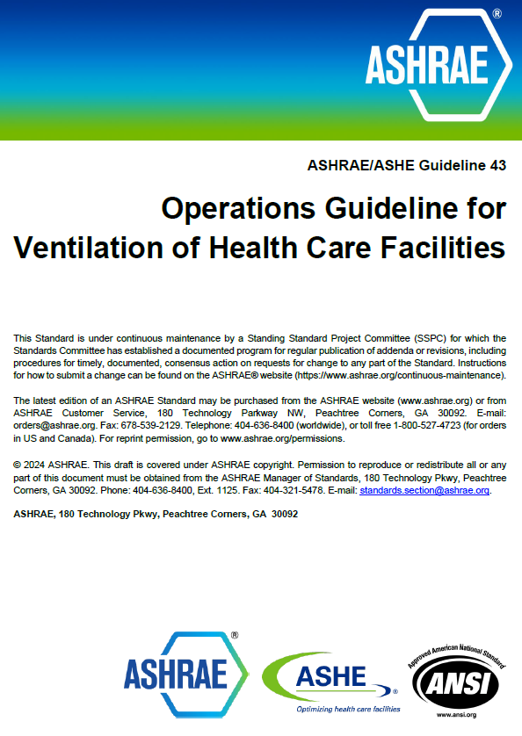
ASHRAE/ASHE Guideline 43 – Published May 2025
Operations Guideline for the Ventilation of Health Care Facilities
Purpose: to provide recommendations for the operations of heating, ventilation and air conditioning (HVAC) systems that provide environmental control in health care facilities for the safety and comfort of health care facility occupants.
Scope: The operation of health care facility HVAC systems and equipment, their normal and routine maintenance, major tasks of periodic maintenance, and energy conservation.
JF

Slide 4
ASHRAE/ASHE Guideline 43 – Table of Contents
Section 1 - Purpose
Section 2 - Scope
Section 3 - Definitions
Section 4 - Operating Practices
Section 5 - Monitored Spaces
Section 6 - Implementation
Informative Appendixes
Appendix A - Recommended System Condition Indicators
Appendix B - Sources of Program Objectives
Appendix C - Situations Requiring Review of the Maintenance Plan
Appendix D - Reasons for Adjusting Maintenance Task Frequency
Appendix E - Facility Observations That May Influence Baseline Inspection Frequencies
Appendix F - Ventilation Management Program Plan
Appendix G - Ventilation Management Program Plan Baseline Inspection and Maintenance Tasks
JF

Slide 5



The Reason Why!
JF

Slide 6
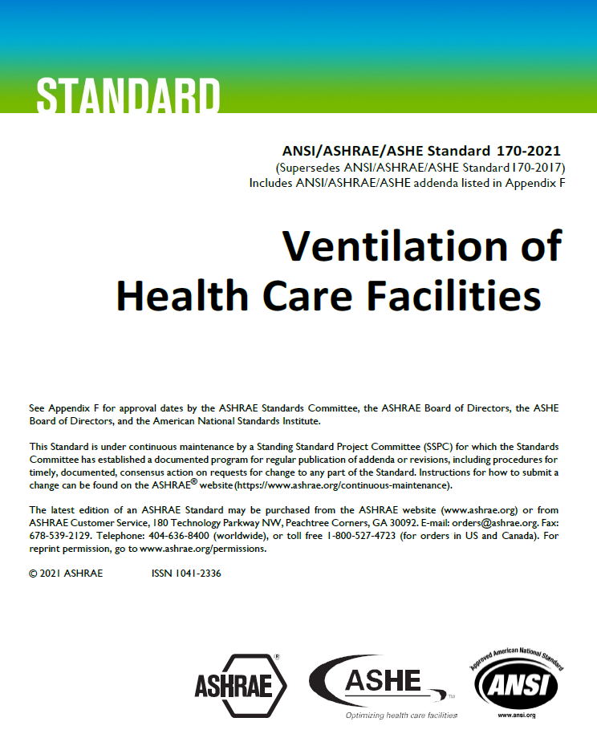
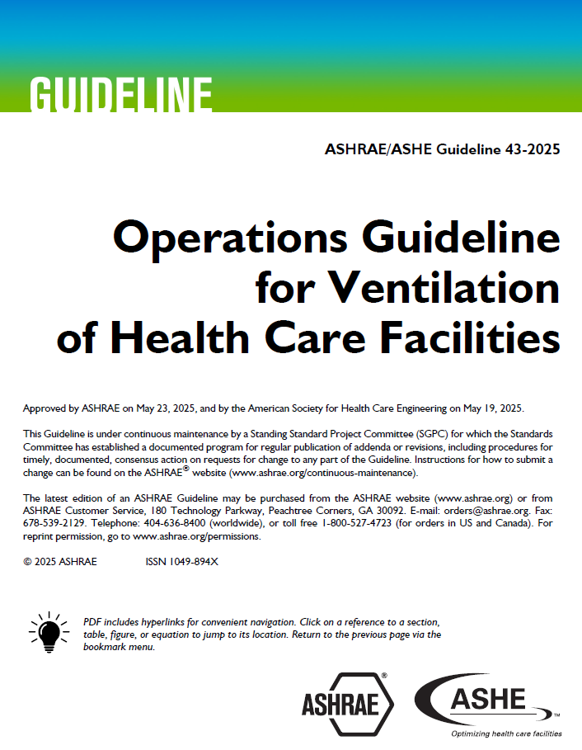
Standard 170 verses Guideline 43
JF

Slide 7
Steps to Developing a VMP
Form a Committee
Develop a “Source of Truth”
Risk Ranking
Condition Indicators
Excursion Response
Create the VMP
Get Approval
Educate Staff
Maintain the Plan
AW

Slide 8
Multidisciplinary Committee
Accreditation, PDC, Engineering, Infection Prevention, Nursing, Perioperative Services, Pharmacy, Site Leaders
Subcommittee of EoC?
Meet often during development
  Standardize meeting with EoC/Utility Management
AW

Slide 9
Develop Source of Truth
Create list of spaces/equipment
  Ventilation Requirements
  Patient Services
  Equipment
    Consider utilizing existing lists
    ASC (Align, Standardize, Combine)
Code References
  AAMI, ANSI, ASHRAE, USP, State & Local Codes
  Different editions based on time of design/construction
  Design versus Operations
JF

Slide 10
Risk Ranking
Patient Services Provided
Impact of HVAC to Services
  Pressure
  Temperature
  Humidity
  Exhaust
Example - NFPA 99 Categories
  Category 1 – Major Injury/Death
  Category 2 – Minor Injury
  Category 3 – Cause Injury/Discomfort
  Category 4 – No Impact on Patient Care
JF

Slide 11
Why do a Risk Assessment
CMS CoP § 482.41 Condition of Participation: Physical Environment
  The hospital must be constructed, arranged, and maintained to ensure the safety of the patient, and to provide facilities for diagnosis and treatment and for special hospital services appropriate to the needs of the community
Paragraph (c) Standard: Building Safety
  The hospital must meet the applicable provisions and must proceed in accordance with the 2012 Health Care Facilities Code - NFPA 99
JF
Notes:
So to address the legal and regulation requirement mentioned on the last slide …. CMS CoP or condition of participation for physical environment states .... The readiness… for the hospital must be constructed ….arranged…. and maintained to ensure safety of the patient… Diagnostics… treatment… and special service needs of the community and ….that brings in the NFPA 99 2012 health care facilities code……
So this is The why we do a safety risk assessment…. It is a requirement.

Slide 12
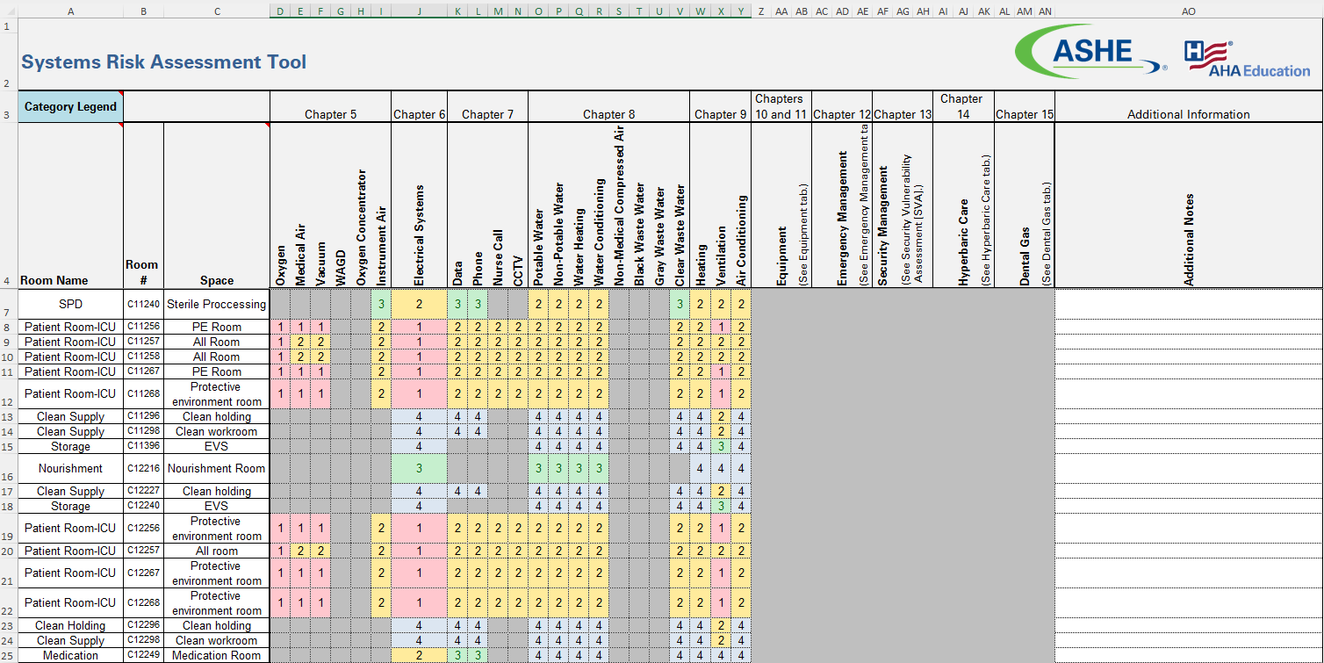
Risk Ranking
AW

Slide 13
ASHRAE/ASHE Guideline 43 - Chapter 5
Chapter 5: Monitored Spaces - categorized based on risk of harm
  Critically Ventilated Spaces
    Those spaces used for invasive or high-risk procedures, infection control isolation, or any space where loss of required air flow, temperature, humidity, and/or pressurization could result in harm, injury or death to patients, visitors or staff.
  Generally Ventilated Spaces
    Those spaces not used for invasive or high-risk procedure areas, not used for infection control isolation, and where loss of required air flow, temperature, humidity, and/or pressurization would not result in harm, injury or death to patients, visitors or staff.
AW
Notes:
The continued application of building management systems and computer maintenance management systems provides for advanced monitoring and verification of condition indicators throughout a facility is encouraged and can provide a more reliable and proactive response to excursions from established condition indicators.

Slide 14
Develop Condition Indicators
Develop Condition Indicators
  Physical characteristics and delivery performance of equipment
  Ranges for operation
Measurements/Observations of physical condition and delivery
  Thermal comfort
  Indoor air quality
  Energy efficiency
Monitor changes to provide advance indication of problems
AW

Slide 15
Table 5.1
Recommended Monitoring Frequencies
Function of Space(s) | Testing frequency for Temperature, Humidity, and Pressure ª
Airborne Infection Isolation (AII) Room, Protective Environment (PE) Room, Combination AII/PE Room, Operating Room, Operating/surgical cystoscopic rooms, Critical care patient care, Neonatal intensive care, Wound intensive care (burn unit), Class 2 & 3 Imaging rooms, Pharmacy Services: Pharmacy Areas (USP-regulated), Sterile storage room (clean/sterile medical/surgical supplies), Cesarean Delivery room | Daily or as determined by the VMP
Continued care nursery, Newborn nursery, Nursery workroom, Emergency department public waiting area, Emergency department trauma/resuscitation room, Emergency service triage area, Labor/delivery/recovery (LDR), Labor/delivery/recovery/postpartum (LDRP), Laser eye room, Patient room, Phase 1 PACU and Phase II recovery, Radiology waiting rooms, Seclusion room, Treatment Room, Class 1 imaging room, Dialysis treatment area, General examination room, Hydrotherapy, Physical therapy, Special examination room, Treatment room, ECT procedure room, Nuclear medicine hot lab, Instrument processing room, Procedure room, Intermediate care patient room, Bronchoscopy, sputum collection, and pentamidine administration, Gastrointestinal endoscopy procedure room, Pharmacy Services: Pharmacy Areas (non-USP regulated) | Semiannually or as determined by the VMP
Laboratory work areas (all), Food and supply storage, Food preparation areas, Toilet Room, Clean assembly /workroom, Soiled workroom/decontamination room, Autopsy room, Clean linen storage room, Nonrefrigerated body holding room, additional spaces identified within the VMP. ^{b} | Annually or as determined by the VMP
a. Accuracy of sensors should be verified as determined within the VMP.
b. Not all spaces must be identified within the VMP.
AW

Slide 16
Excursion Response
Excursions Happen
Develop Responses
  Base on Patient Impact
  Base on Risk Ranking
Document in VMP
  Follow and document
JF

Slide 17
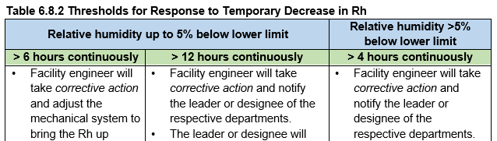
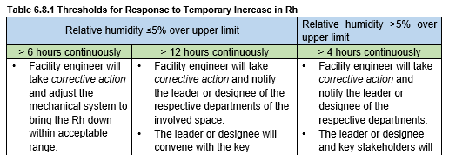
ASHRAE/ASHE Guideline 43
Section 6: Implementation
  Excursion Variations
    Recommended Actions
JF

Slide 18
Create the VMP
Ventilation Management Plan
Defined and Published
Should Include
  Committee Members
  Code References
  Listing of Spaces
  Control Indicators
  Excursion Responses
AW

Slide 19
Get Approval
Each aspect of VMP needs committee approval
Needs approval from Leadership
AW

Slide 20
Educate Staff
Educate Committee Members
Educate Clinical Staff
Educate Facility Staff
JF

Slide 21
Maintain the VMP
Requires regular maintenance and updates
Evaluate condition indicators at committee meetings
Update space listing
Update operational requirements
Update per construction/renovations/repairs
JF

Slide 22

Questions?
Thank you for attending!
Jonathan Flannery April Woods
jflannery@aha.org April.Woods@wsp.com
501-813-2400 407-587-7864
JF

