Slide 1




Navigating the 2026 Code Convergence
Leveraging Commissioning and Life Safety Assurance as Your Lifeline in Florida's Evolving Regulatory Landscape
Notes:
"Good afternoon, everybody — and congratulations. You’ve made it. It’s the last day of the conference, and if you’re here, you are officially the survivors of three straight days of sessions, acronyms, and more code references than any human should have to endure.
So we figured, if you’ve survived this long, you deserve something a little different. That’s why we built this session like a late-night show — a mix of laughs, interviews, games, and yes, even a Top 10 countdown.
Now, the topic isn’t comedy — it’s codes. And at the end of 2026, we’re not just getting one code update, we’re getting three at the same time: the newest FGI Guidelines, the Florida Building Code, and the 2024 Life Safety Code.
It’s like three surveyors walking into your hospital, each with a different checklist — and you still have to pass all of them.
And while Florida’s moving forward, CMS is still behind, which means the gap between state and federal requirements is about to get even wider. More complexity. More confusion. More opportunities to get caught in the crosshairs.
But here’s the good news: we’ve got a panel tonight with owners, project managers, and commissioning experts — people who have lived these challenges — and they’re here to help us figure out how to not just survive, but thrive in this convergence.
So buckle up. By the end, you’ll leave with some laughs, a few war stories, and most importantly, a Top 10 list of lifelines to keep your projects compliant, efficient, and future-proof.
Alright — let’s get this show started.

Slide 2

Notes:
Now, since this is the Late Night Code Clash, we’re doing this with a live studio audience… which is all of you.
And just like on a real late-night show, we’ve got one of these [click → slide: bold APPLAUSE!].
When this comes up, that’s your cue to give a round of applause, help us welcome a guest, transition a segment, or just wake yourselves up a little.
Let’s try it once — ready? [click → Applause slide].
Beautiful. You guys sound way better than the studio audience on Letterman.

Slide 3



Slide 4

Matt Rooke

Slide 5
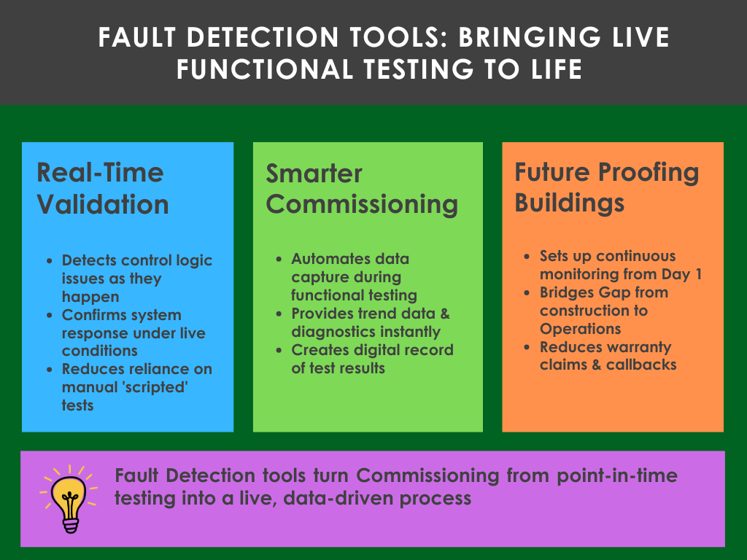

Slide 6
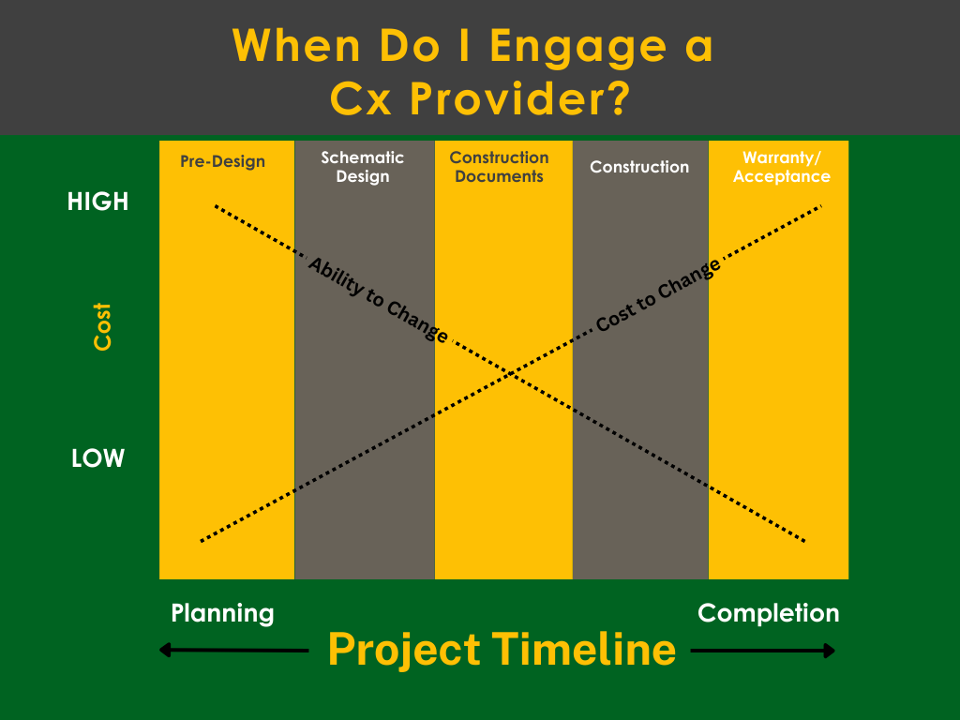

Slide 7

Jordan smith

Slide 8
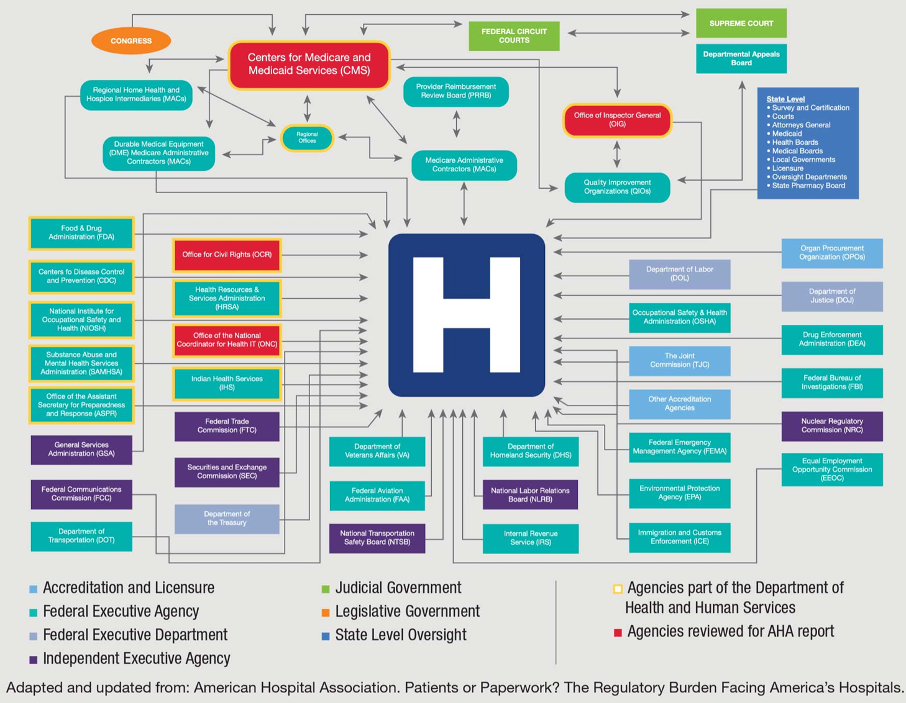

Slide 9
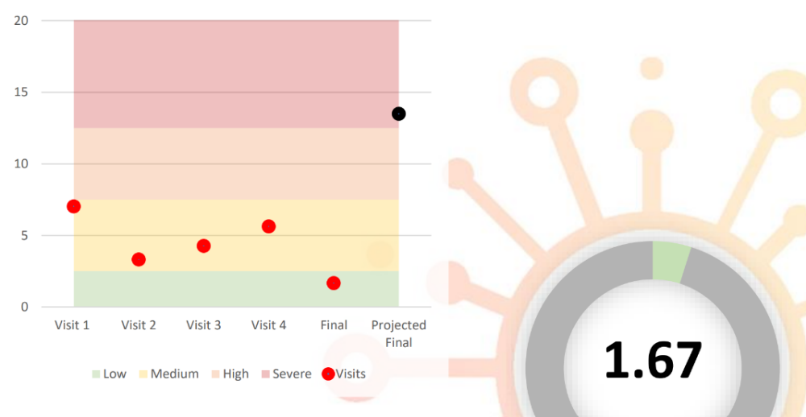
Operational Readiness Score
Riverview Hospital
Notes:
We created the Operational Readiness Score — or ORS — as a simple way to measure how ready a hospital really is.
It was developed from lessons learned on projects where gaps showed up late in life safety, compliance, or operations. ORS takes those lessons and turns them into a score — like a readiness report card.
The way it works is simple: we track the number of observations across a facility and normalize it by square footage. That way a small clinic and a large hospital can be compared on the same scale.
Jordan, you used ORS at AdventHealth Riverview — how did it help you as an operations leader, and what did you learn from seeing your score?

Slide 10

Megan Looby

Slide 11
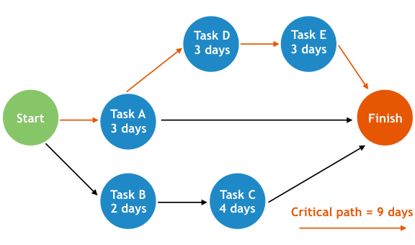
Critical Path Method (CPM)
Notes:
As an owner’s rep, one of the key tools we use is the Critical Path Method — or CPM.
At its core, CPM is about identifying the sequence of tasks that absolutely must be done on time for the project to finish on schedule. If something on the critical path slips, the whole project slips.
For a hospital, that path often runs straight through compliance checkpoints. You can build fast, but if you’re not aligned with codes or life safety requirements, you won’t pass inspection — and you’re immediately off the path.

Slide 12
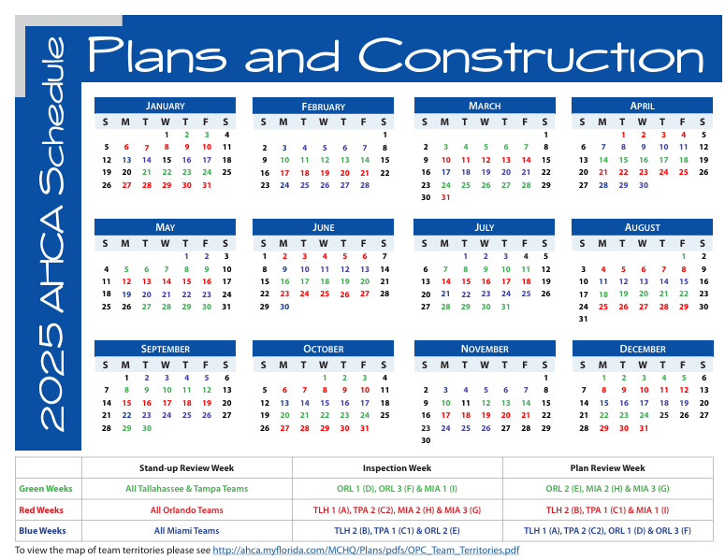
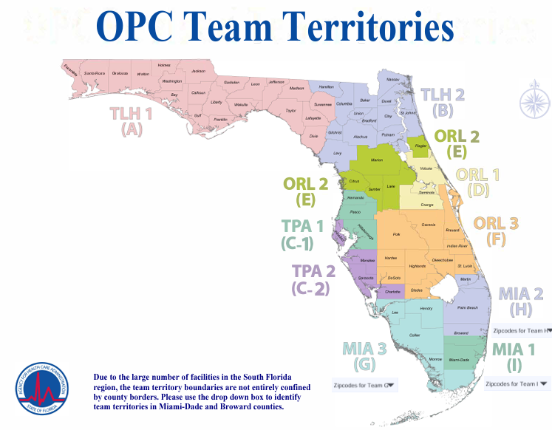
Office of Plans and Construction (OPC)
Notes:
Which brings us to AHCA. Their inspections run on a three-week cycle.
That means if you miss compliance the first time, you don’t just lose a day — you lose three weeks.
And on a critical path, three weeks can be the difference between opening on time or delaying patients from moving into the building."*

Slide 13

Notes:
Alright, time for a little audience participation. We’re calling this segment Myth vs. Reality.
Here’s how it works: I’ll throw out a statement about codes, commissioning, or accreditation. You decide — is it a myth, or is it reality?
Don’t be shy — shout it out, raise your hand, make a guess. Then we’ll let our panel of experts reveal the truth, set the record straight, and share a quick story or lesson learned.
Ready? Let’s play Myth vs. Reality!

Slide 14
If AHCA approves your project, you’re automatically good with CMS.
Myth or Reality
Notes:
Panelist (Jordan): AHCA ≠ CMS. Federal adoption lags; owners get stuck between conflicting rules.

Slide 15
Mechanical commissioning has become more common because it’s now required by many codes and considered best practice.
Myth or Reality
Notes:
Panelist (Matt): Once optional, commissioning is now embedded in energy codes and recognized as essential.

Slide 16
The project manager’s job is Scope, schedule, and budget … compliance is someone else’s problem.
Myth or Reality
Notes:
Panelist (Megan): Compliance is the schedule. If you don’t meet minimum regulatory requirements, everything slips.

Slide 17
Commissioning only matters at the end of a project, during activation.
Myth or Reality
Notes:
Panelist (Matt): If you start late, you’re documenting problems instead of preventing them.

Slide 18
The general contractor is responsible for building to the drawings and specs …
However, it takes the whole team to make sure the project meets code.
Myth or Reality
Notes:
Megan: True — GCs build to plans, but compliance requires alignment with owner, design, commissioning, and operations

Slide 19
Once AHCA approves a new hospital, CMS reimbursement can begin
Myth or Reality
Notes:
Panelist (Jordan): CMS won’t reimburse a dime until the facility is accredited. AHCA approval just opens the door — it doesn’t guarantee revenue flow.

Slide 21
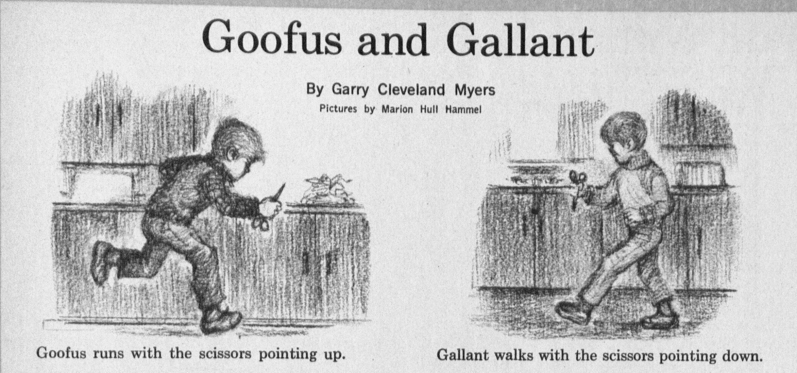

HOSPITAL EDITION
Notes:
Okay, you’ve all been great sports so far with Myth vs. Reality. Now let’s shift gears into a little story time.
Some of you might remember the old Goofus and Gallant cartoons — one kid always did things the wrong way, and the other showed the right way.
Well, today we’re applying that same idea to hospitals. We’re going to follow Goofus Hospital and Gallant Hospital as they go from design, to construction, to activation.
At each stage, Goofus takes shortcuts and sets themselves up for failure… while Gallant makes smart decisions that keep the project on track.
Along the way, our panel will weigh in on what happens when you go the Goofus route versus the Gallant route — and how you can make sure your project ends up on the right side of the story.

Slide 22
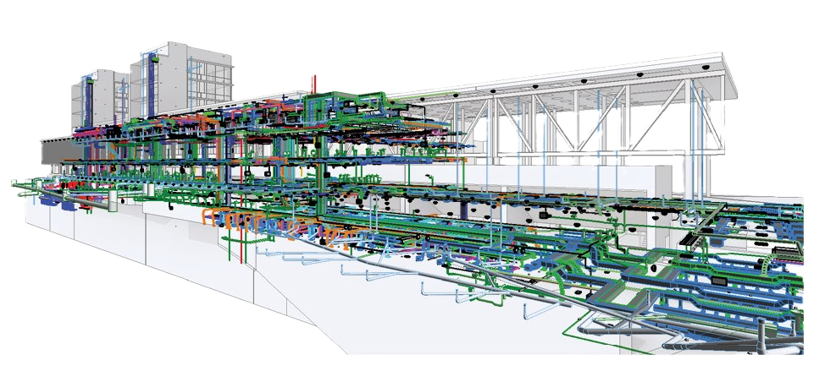
Design Phase
Goofus Gallant
Doesn’t define success early → everyone has different expectations.
Skips third-party accreditation reviews.
No commissioning input during design.
Assumes AHCA or local fire marshal will catch issues later.
Lacks quality control, over-relies on BIM coordination without field validation.
Defines success early → owners, contractors, architects, and facilities aligned.
Uses third-party accreditation reviews to catch issues before construction.
Brings commissioning into system design early.
Involves facilities leaders to validate operational workflows.
Combines BIM with quality control + human oversight.
Notes:
Panel Prompts
Jordan (Owner/Operator):
"Jordan, what happens when accreditation review is skipped at the design stage? How does that come back to haunt operators later?"
Matt (Commissioning):
"Matt, why does commissioning need a seat at the design table — not just activation?"
Megan (Project Management):
"Megan, from a PM perspective, how do you keep design aligned with compliance, budget, and schedule all at the same time?"

Slide 23
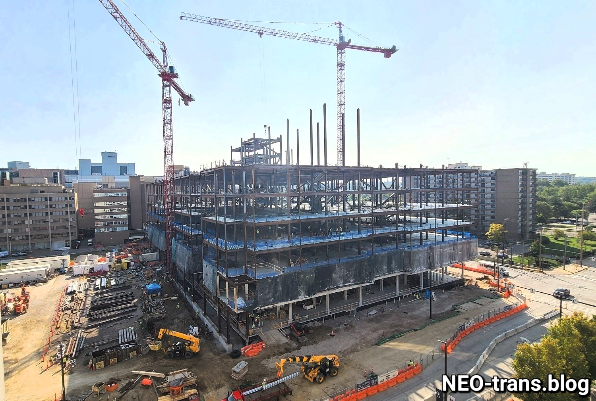
Construction Phase
Goofus Gallant
Reacts to code issues instead of planning for them.
Cuts corners as the schedule gets tight.
Tunes systems “just enough” to pass AHCA, leaving no buffer for real operations.
Failed inspections lead to costly delays and rework.
Commissioning treated as a checkbox, not a process.
Monitors for compliance and integrates them into the project proactively.
3rd party Commissioning authority engaged throughout construction to validate progress.
Systems tested under real operating conditions, not just for inspection day.
Compliance checkpoints built into the schedule → no surprises at inspection.
Notes:
Jordan (Owner/Operator)
“Jordan, what happens to owners when projects cut corners in construction just to hit schedule?”
“How do failed inspections impact operations and opening timelines from your perspective?”
Matt (Commissioning Authority)
“Matt, why is it risky to tune systems just enough to pass AHCA? What happens once the building is actually in use?”
“How does ongoing commissioning during construction help avoid failed inspections and rework?”
Megan (Project Management)
“Megan, when compliance issues pop up, how do you keep the team aligned without blowing the schedule?”
“What’s the PM’s role in making sure quality control doesn’t get sacrificed when deadlines get tight?”

Slide 24

Activation Phase
Goofus Gallant
Treats activation as a last-minute sprint leading to last minute changes.
Staff training crammed in right before survey.
Assumes AHCA approval = life safety quality
Facilities submits hundreds of warranty claims and chases documentation for CMS.
Contractor forced to remobilize → operations disrupted during rework.
Systems drift quickly → higher energy costs and unstable performance.
Survey readiness is reactive → findings, stress, and costly delays.
Builds operational function into the project plan well in advance.
Staff trained continuously with refreshers tied to workflows.
Commissioning authority validates systems before handoff → facilities inherits a building that works and all necessary documentation.
Clear turnover process reduces warranty claims → GC able to focus on their next job.
Energy and systems stabilized with monitoring-based commissioning.
Proactively planned for CMS physical environment → smooth survey, no impact to operations.
Notes:
Jordan (Owner/Operator)
“Jordan, what’s it like for facilities teams when they inherit a project full of warranty claims right as they’re prepping for CMS?”
“How do physical environment issues discovered late impact survey readiness and daily operations?”
Matt (Commissioning Authority)
“Matt, how does ongoing commissioning stabilize systems and avoid the energy drift we see when buildings are just tuned for inspection day?”
“What role can commissioning play in reducing warranty claims before handover?”
Megan (Project Management)
“Megan, from a project management perspective, how costly is it when a contractor has to remobilize after turnover?”
“What’s the PM’s role in making sure activation is smooth, so operations aren’t disrupted by rework during survey prep?”

Slide 26

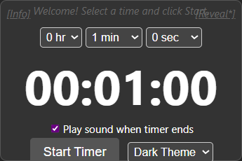
Notes:
This next segment is called War Stories.
Each of our panelists will have one minute to share a project horror story — the kind that keeps you up at night or makes you shake your head and say, ‘Only in healthcare.’
But don’t worry — we’re not here just for the scars. Every war story comes with a lesson you can take back to your own projects to avoid the same mistakes.
Panel, let’s hear your War Stories.

Slide 28

Notes:
Alright, we’ve laughed, we’ve shared some war stories, we’ve even busted a few myths. But now it’s time to bring it all home.
But now it’s time to give you something you can take back to your projects.
Since this is the Late Night Code Clash, we’re wrapping up with a David Letterman style countdown — the Top 10 Lifelines to help your next project avoid the code crosshairs.
Let’s kick it off with number 10…

Slide 29
10
If you have multiple AHJ’s, the most stringent you must obey

Slide 30
9
Define success early
if owners, architects, contractors, facilities, etc., don’t agree on the finish line, you’ll never cross it together.

Slide 31
8
When in doubt, ask your commissioning Partner.
(Or better yet, hire one.)

Slide 32
7
A dollar spent in design saves ten in construction …
and a hundred after opening.

Slide 33
6
Commissioning isn’t an add-on, it’s your insurance policy.
unlike your insurance, it
Actually saves you money.

Slide 34
5
Plan for both AHCA and CMS
one gets you open, the other pays the bills.

Slide 35
4
Start activation planning early
the end of construction isn’t the beginning of readiness.

Slide 36
3
Compliance is tricky,
the codes overlap,
It takes a village
to bridge every gap.

Slide 37
2
keep the end in view,
Get it right the first time …
your team, patients, and budget will thank you

Slide 38
1
Our purpose is clear,
it’s not for ourselves,
Codes guard the patients who can’t guard themselves.

Slide 39
Notes:
Alright, let’s give a big round of applause for our guests today — Jordan, Matt, and Megan.
They’ve survived the code clash, shared their war stories, and brought best practices that will keep all of us out of the code crosshairs in 2026.

Slide 40

Questions and Answers
Notes:
Now it’s your turn. We’ve saved the last 10 minutes for Q&A — so bring your toughest questions, because this is your chance to put the panel in the hot seat.
Who wants to kick us off

