Slide 1

RETHINKING 277V SYSTEMS
IN HOSPITAL DESIGN

Slide 2


MEET YOUR
PRESENTERS
Paul Carastro, PE
Principal
BSA
Nate Jones
Engineering Practice Director/Principal
BSA
Notes:
ALL – Introduce yourself
Paul:
Bachelor's degrees in Industrial and Electrical Engineering (Georgia Tech)
37 years of consulting engineering experience
Principal at BSA LifeStructures; former leader at Carastro & Associates
Specializing in healthcare, learning, discovery, and mission critical projects
Expert in medium/low voltage systems, backup generation, SCADA, and power studies
Nate
20+ years in healthcare facility electrical design
Leads multidisciplinary engineering teams through full project lifecycle
Focused on code compliance, reliability, and client satisfaction
Expert in mission critical power systems and regulatory standards
B.S. Electrical Engineering – University of South Florida

Slide 3

PRESENTATION
OVERVIEW
HOSPITALS REQUIRE
robust electrical infrastructure with major emphasis on reliability and safety.
480/277V 4 WIRE SYSTEMS
are widely used but may not be ideal for large healthcare facilities.
PRESENT AN ALTERNATIVE
to the traditional 4 wire design of hospital electrical systems to:
Challenge conventional design practices
Simplify ground fault detection
Reduce impacts of line to ground faults
Safety
Reduce cost
Notes:
Hospitals demand reliability and safety. Today, we’ll show you why the traditional 4-wire system isn’t always the best way forward.

Slide 4

BAYCARE MANATEE
HOSPITAL
  BayCare Manatee Hospital
  New greenfield hospital
  Allowed us to challenge typical design conventions for greater benefits
Notes:
We recently had the opportunity to design a green field hospital for BayCare. We looked to challenge conventional design to achieve a higher level of safety and reliability for this facility while still emphasizing constructability and cost efficiencies.

Slide 5
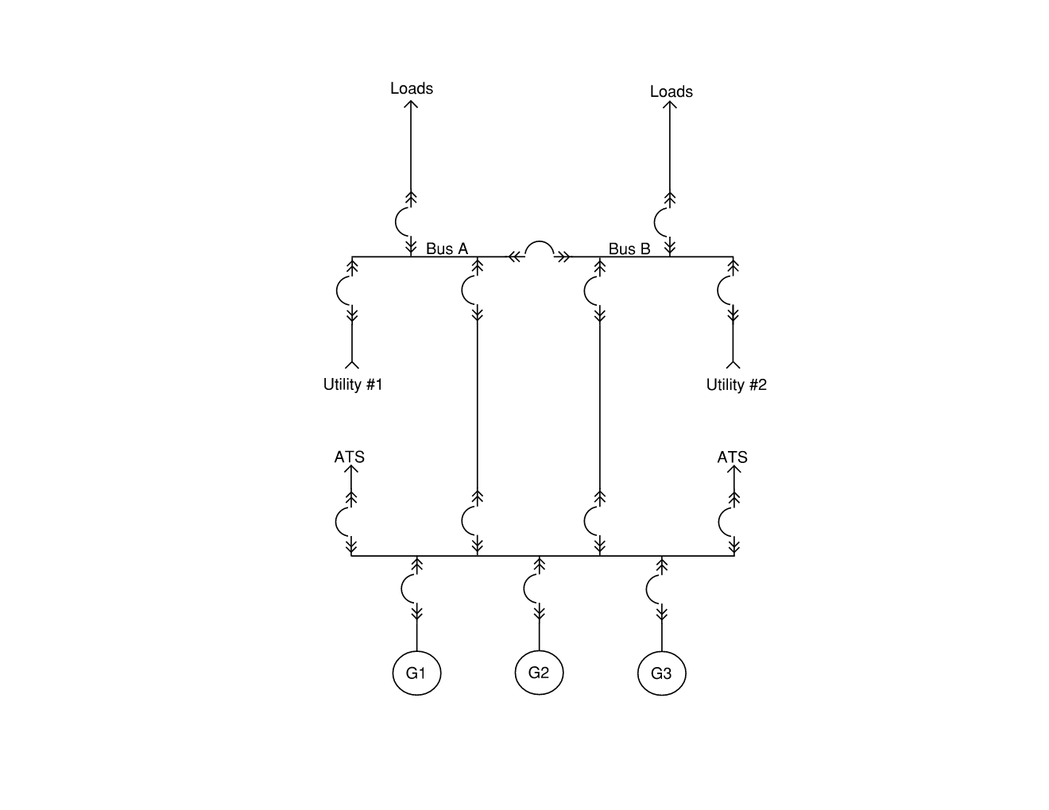
MANATEE HOSPITAL
ELECTRICAL DESIGN COMPONENTS
  The largest utility provided transformers typically range from 2000-3000kVA.
  Manatee Hospital was designed with (4) 480V utility service transformers for capacity and redundancy.
  Onsite diesel generators designed for 100% backup using closed transition transfers
  We have main switchgear fed by multiple sources of power – utility and generator

Slide 6
WHAT ARE THE
CONSTRAINTS?
  The neutral of each utility and generator source must be bonded to ground
  A bus tie breaker can have current flow in either direction
  Multiple neutral to ground bonds can result in neutral current flowing on ground conductors

Slide 7

COMMON USES
OF 277V
  Lighting
  HVAC equipment
  Diagnostic/imaging equipment
  Isolation panels

Slide 8
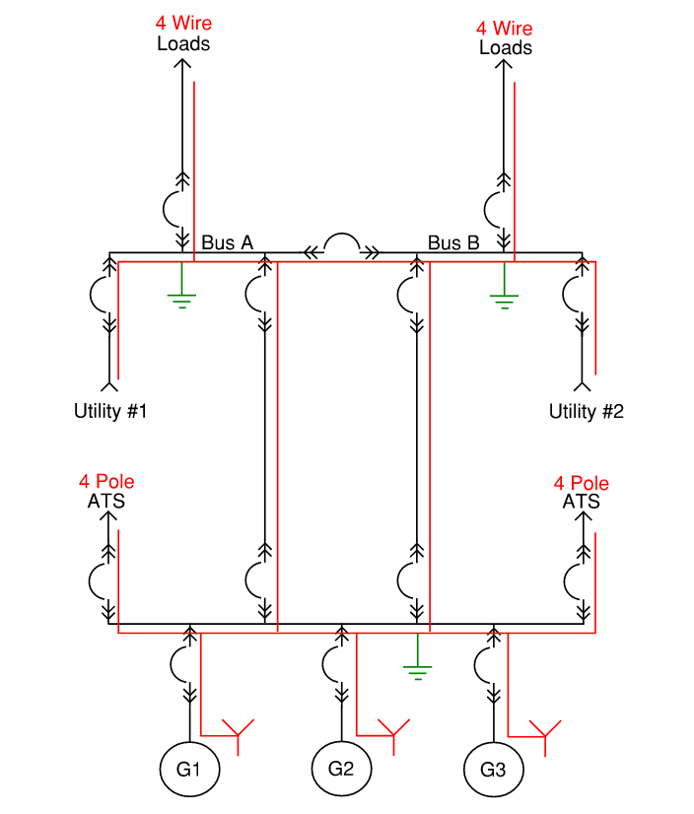
NEUTRALS REQUIRED
IN 480/277V
  Switchboards and panelboards
  Main switchboards - neutral CT required for 4 wire feeders
  Feeders
  4 Pole transfer switches

Slide 9
GROUND FAULT PROTECTION
REQUIREMENTS
  Two levels of ground fault protection required by NEC
  For 4 wire multi-source systems, ground fault sensing can be complex and expensive
  When a neutral exists, ground fault detection must monitor both phase and neutral conductors, requiring more complex protection (e.g., 50N/51N using zero-sequence CTs).
  Most common way is Modified Differential Ground Fault Protection
    It works
    It can be very complicated
    It can be very expensive

Slide 10
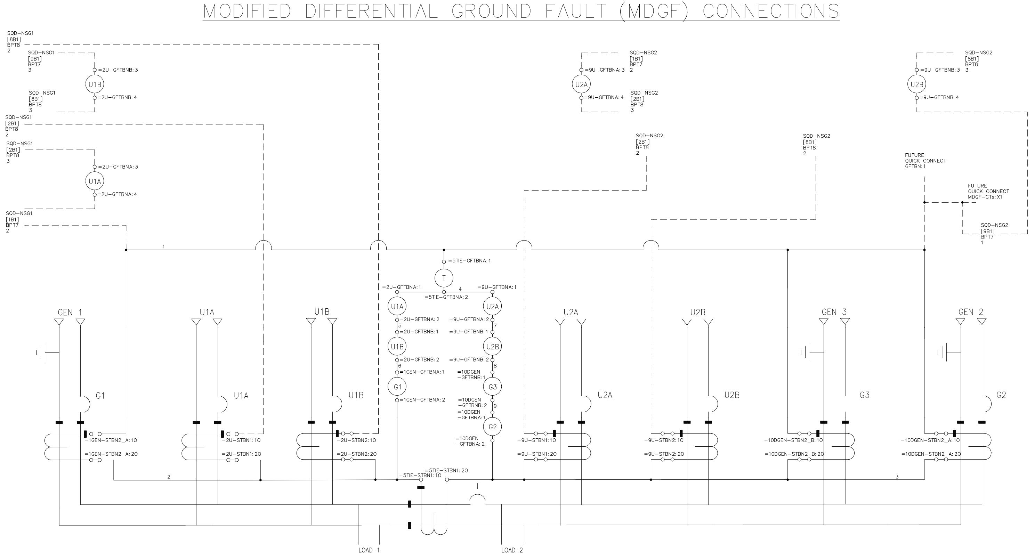
MODIFIED DIFFERENTIAL
GROUND FAULT PROTECTION

Slide 11

3 Wire or 4 Wire? CHOOSING THE RIGHT DISTRIBUTION SYSTEM

Slide 12



CODES AND STANDARDS
REVIEW
NFPA
NEC
ARTICLE 517
FGI
GUIDELINES
NFPA 99
HEALTHCARE FACILITIES ELECTRICAL SYSTEMS
HEALTHCARE ESSENTIAL ELECTRICAL SYSTEMS
HOSPITAL DESIGN AND CONSTRUCTION
  Important Note: The code does not require distributed neutral everywhere.

Slide 13

3 WIRE VS
4 WIRE
  INTERIOR LIGHTING
  Energy efficient LED fixtures can be easily fed with 120V.

Slide 14
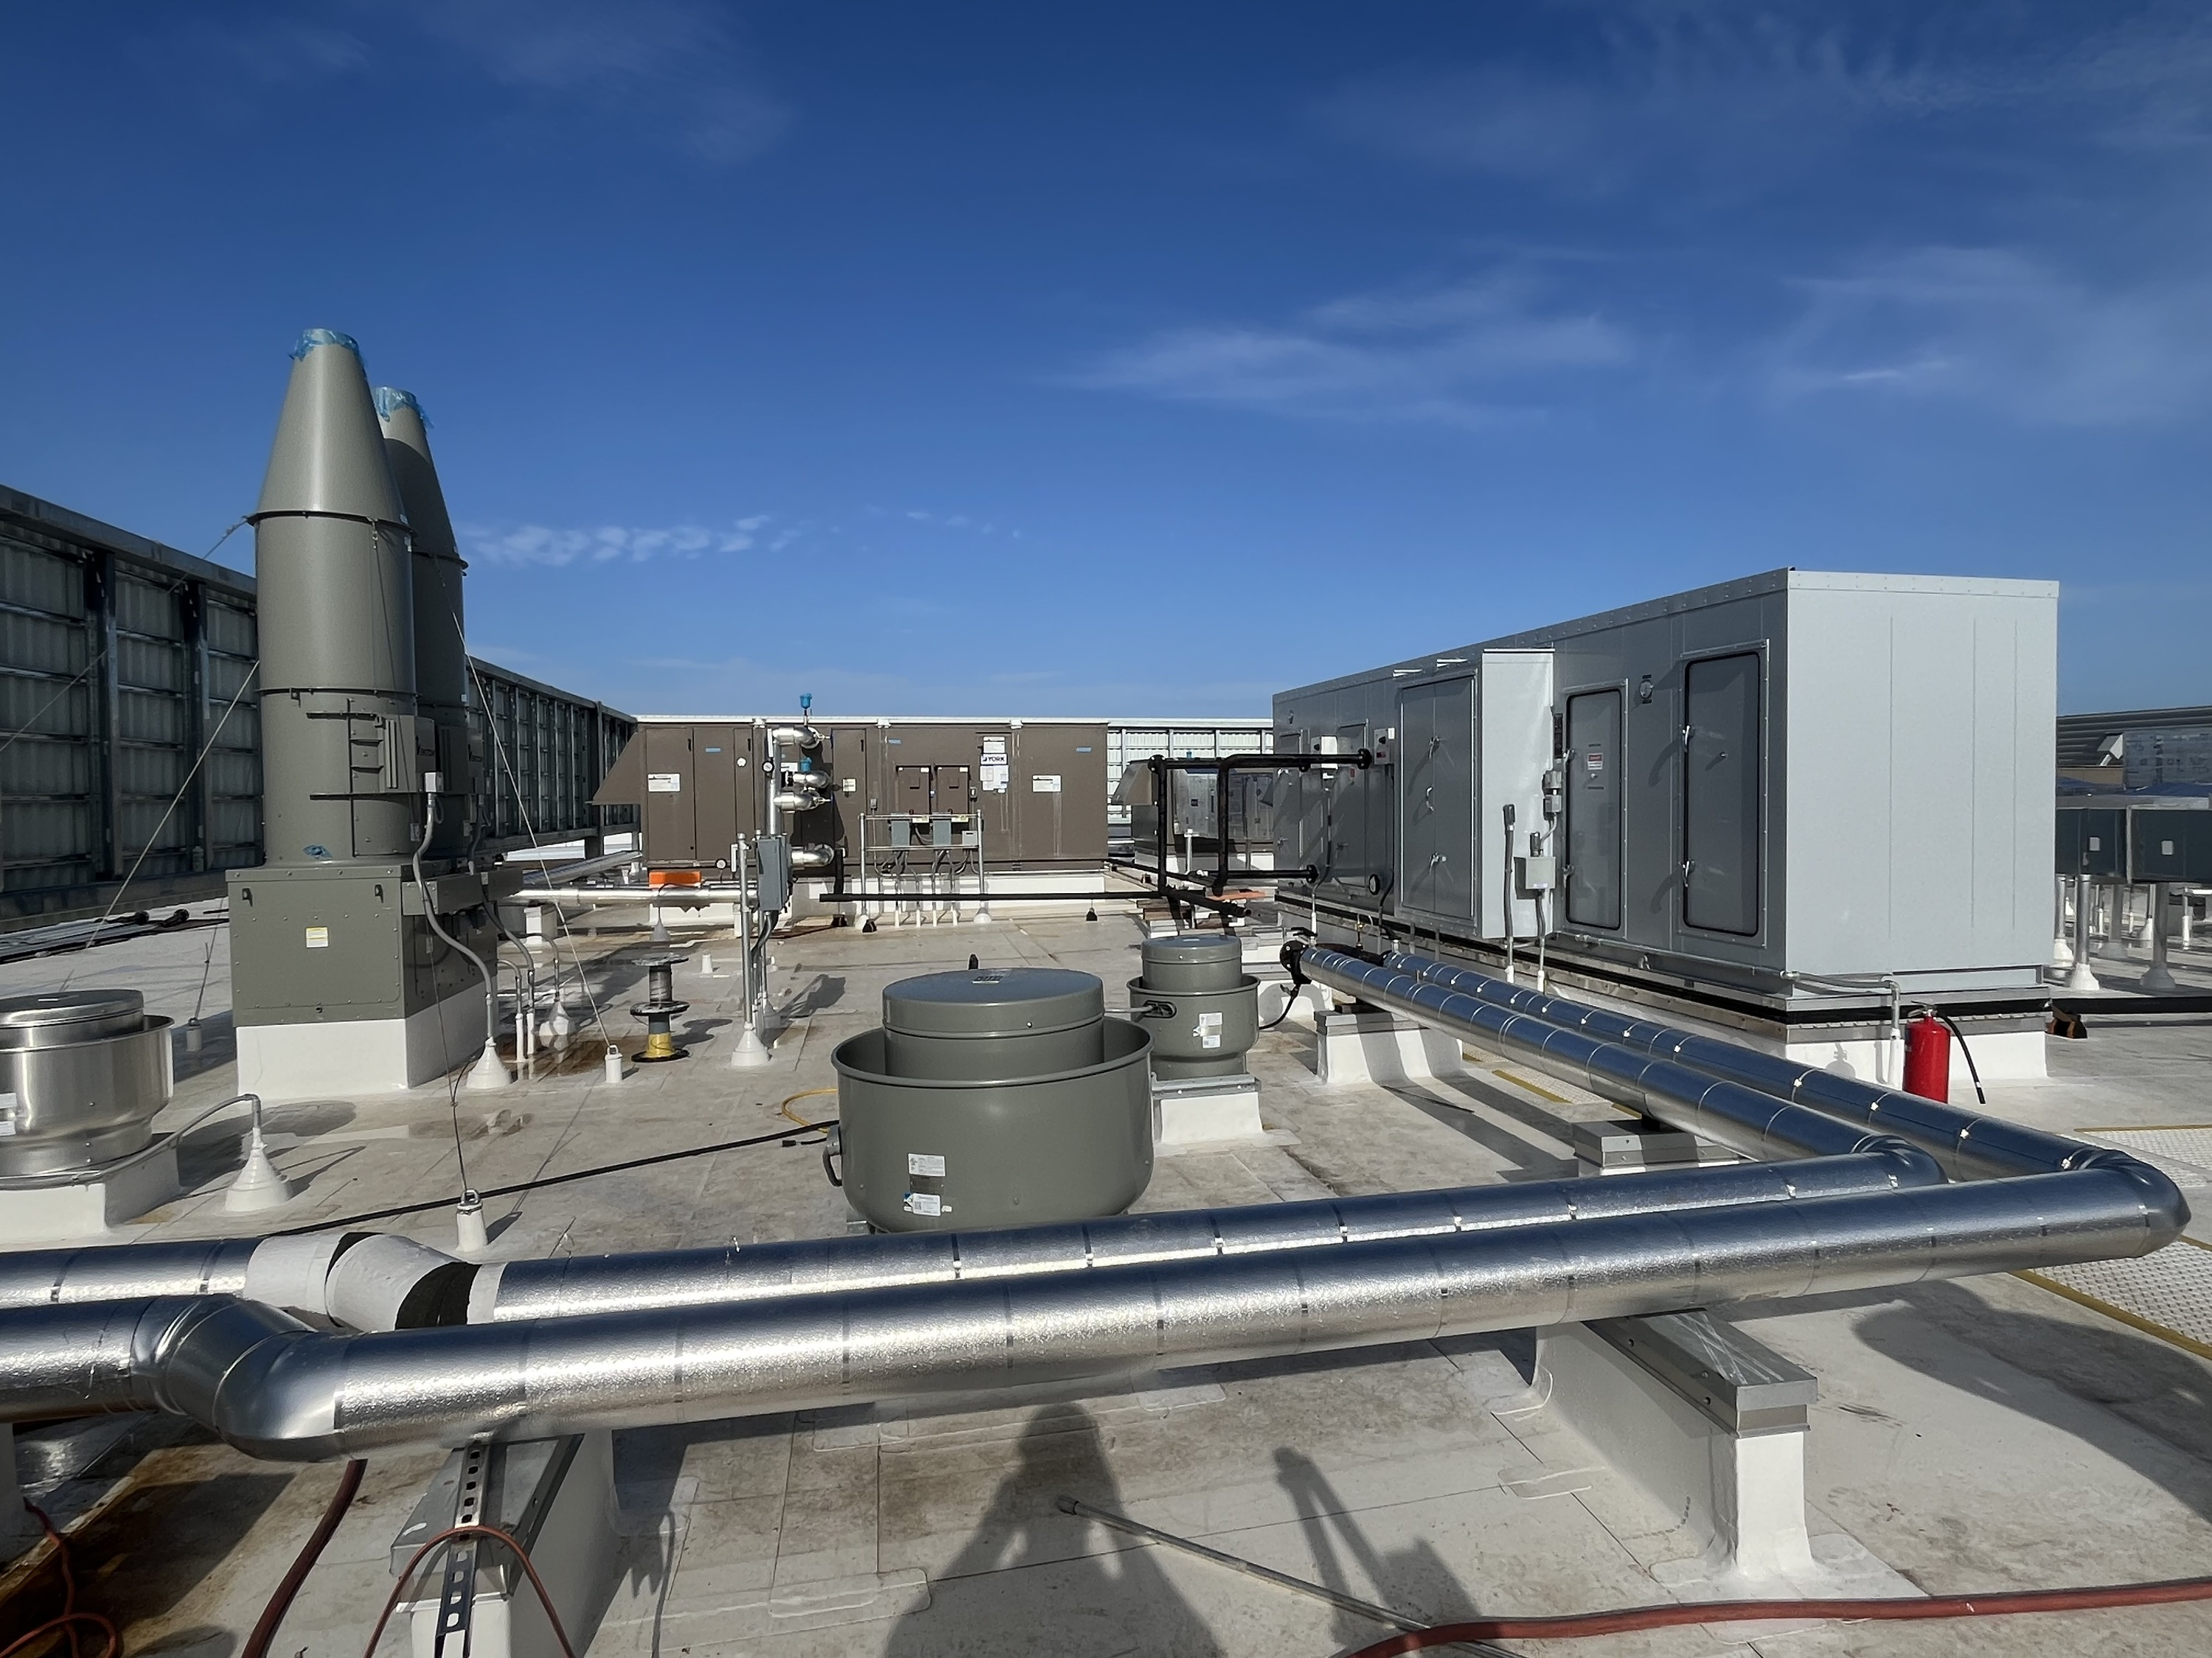
3 WIRE VS
4 WIRE
  HVAC EQUIPMENT
  AHUs, pumps, chillers and fans have VFD fed by 480V circuits. Dampers and controls can be powered at 120V.

Slide 15
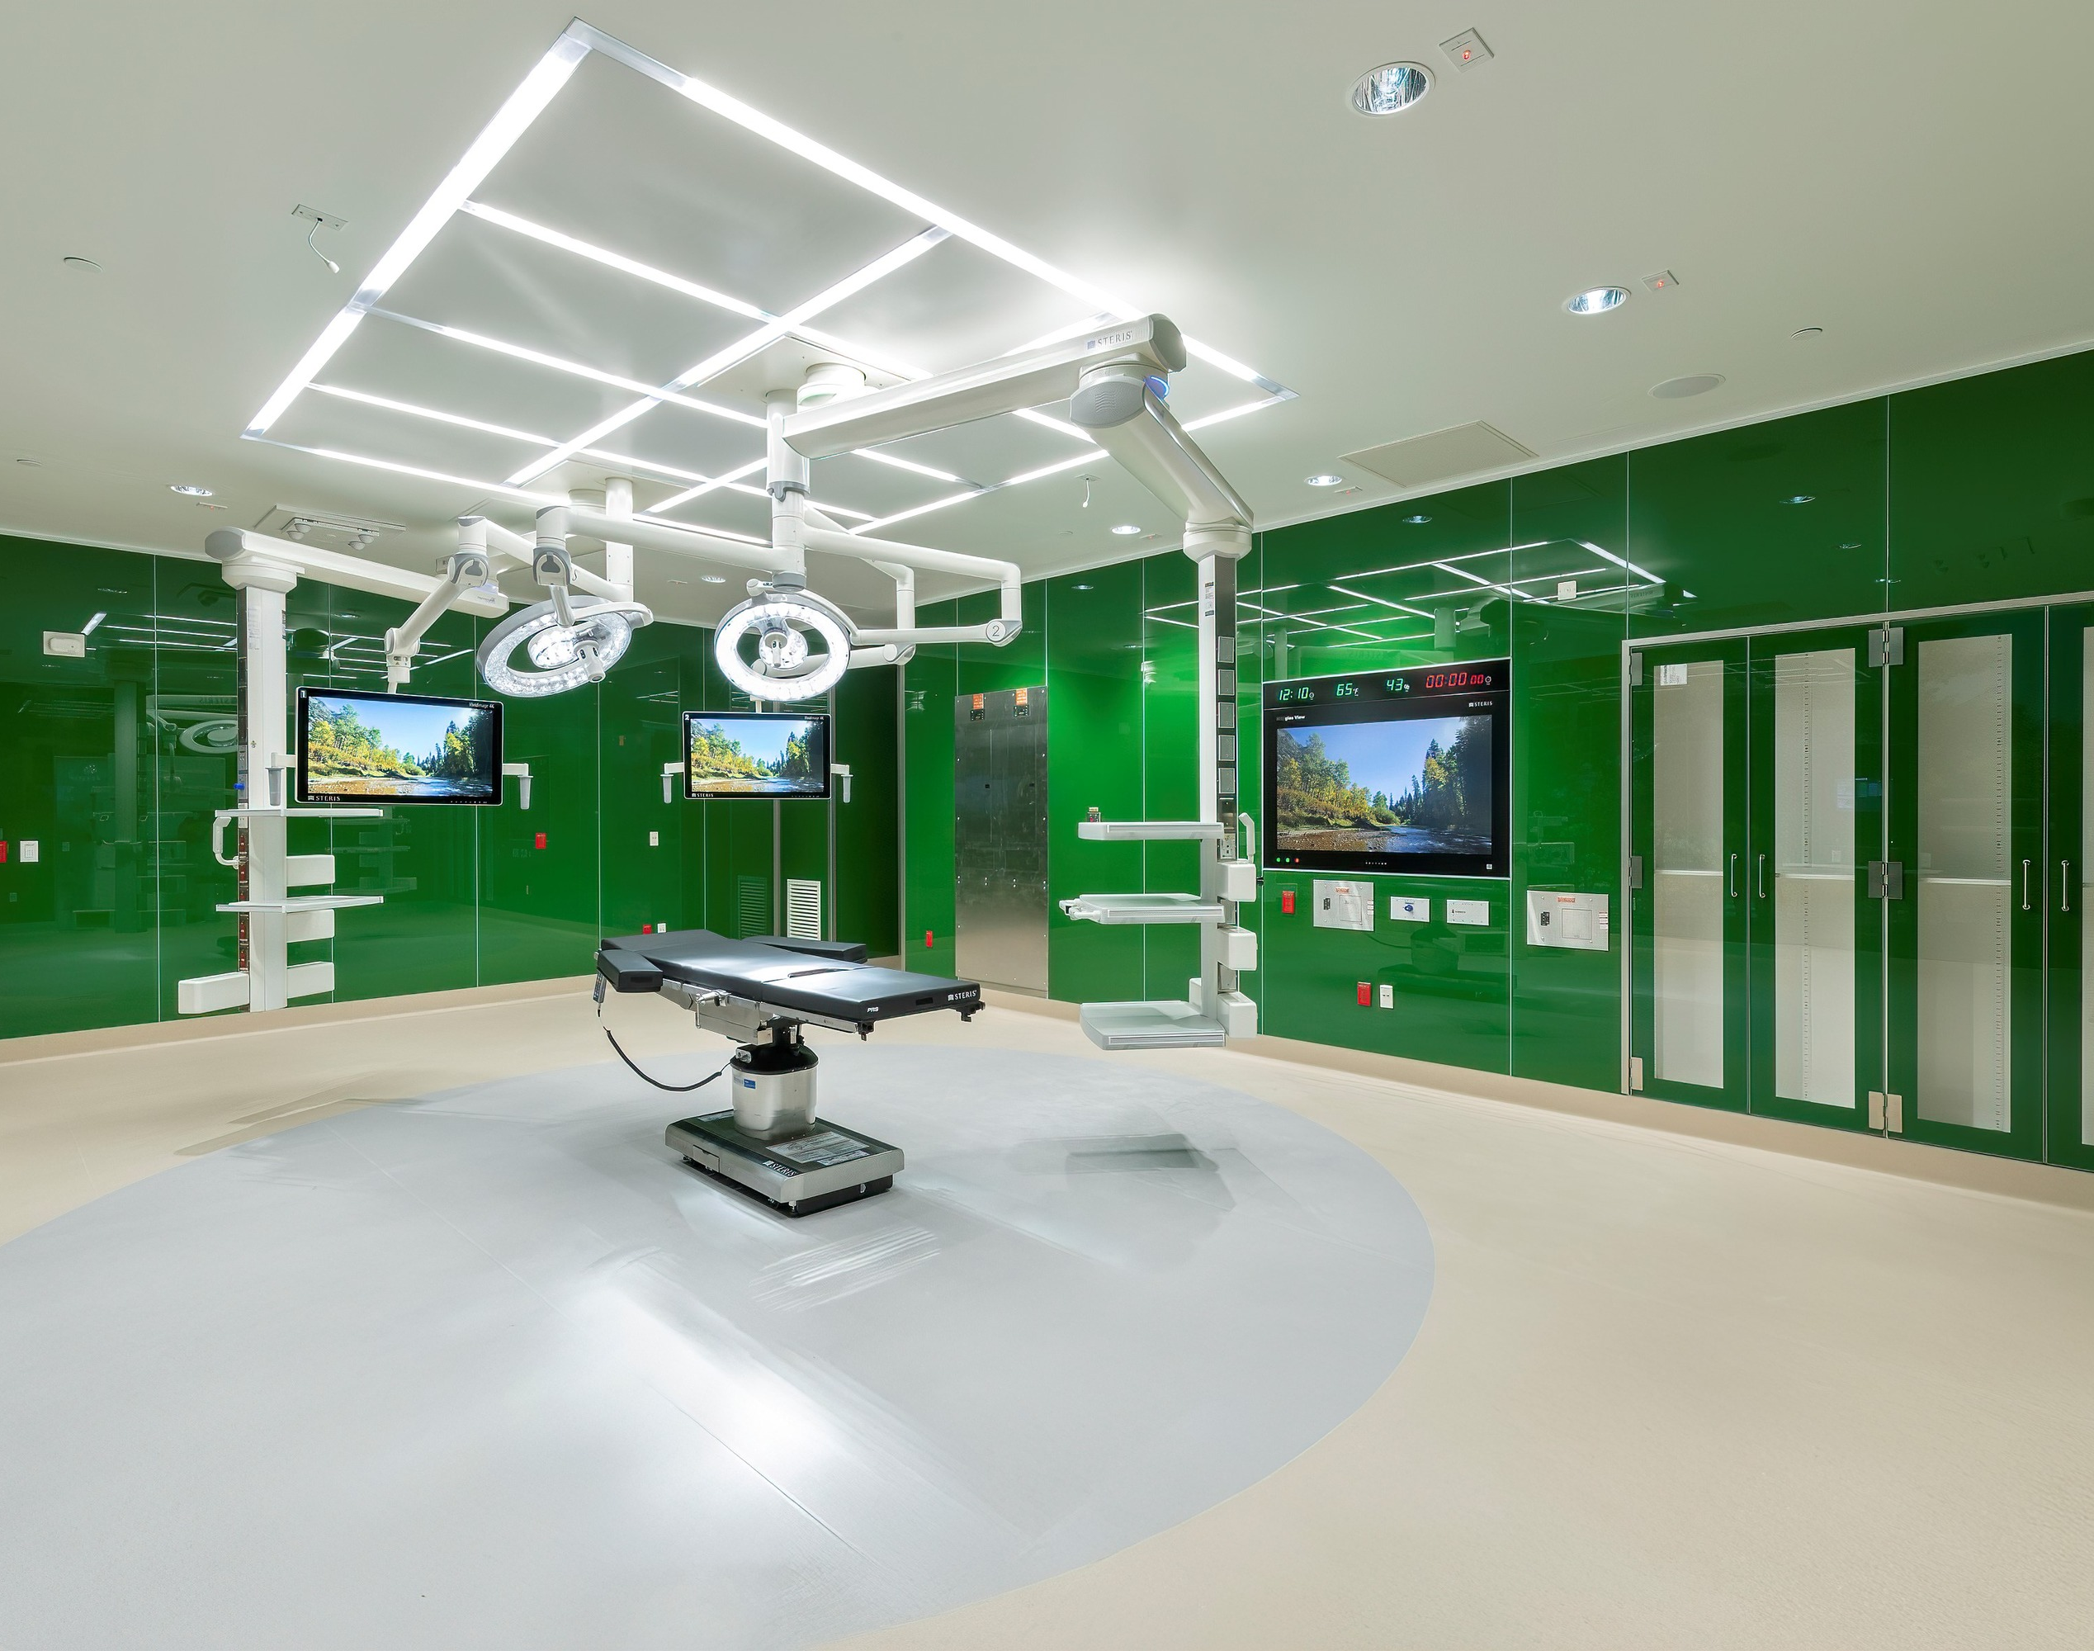
3 WIRE VS
4 WIRE
  ISOLATION PANELS
  can be specified with 480V, single phase input.

Slide 16
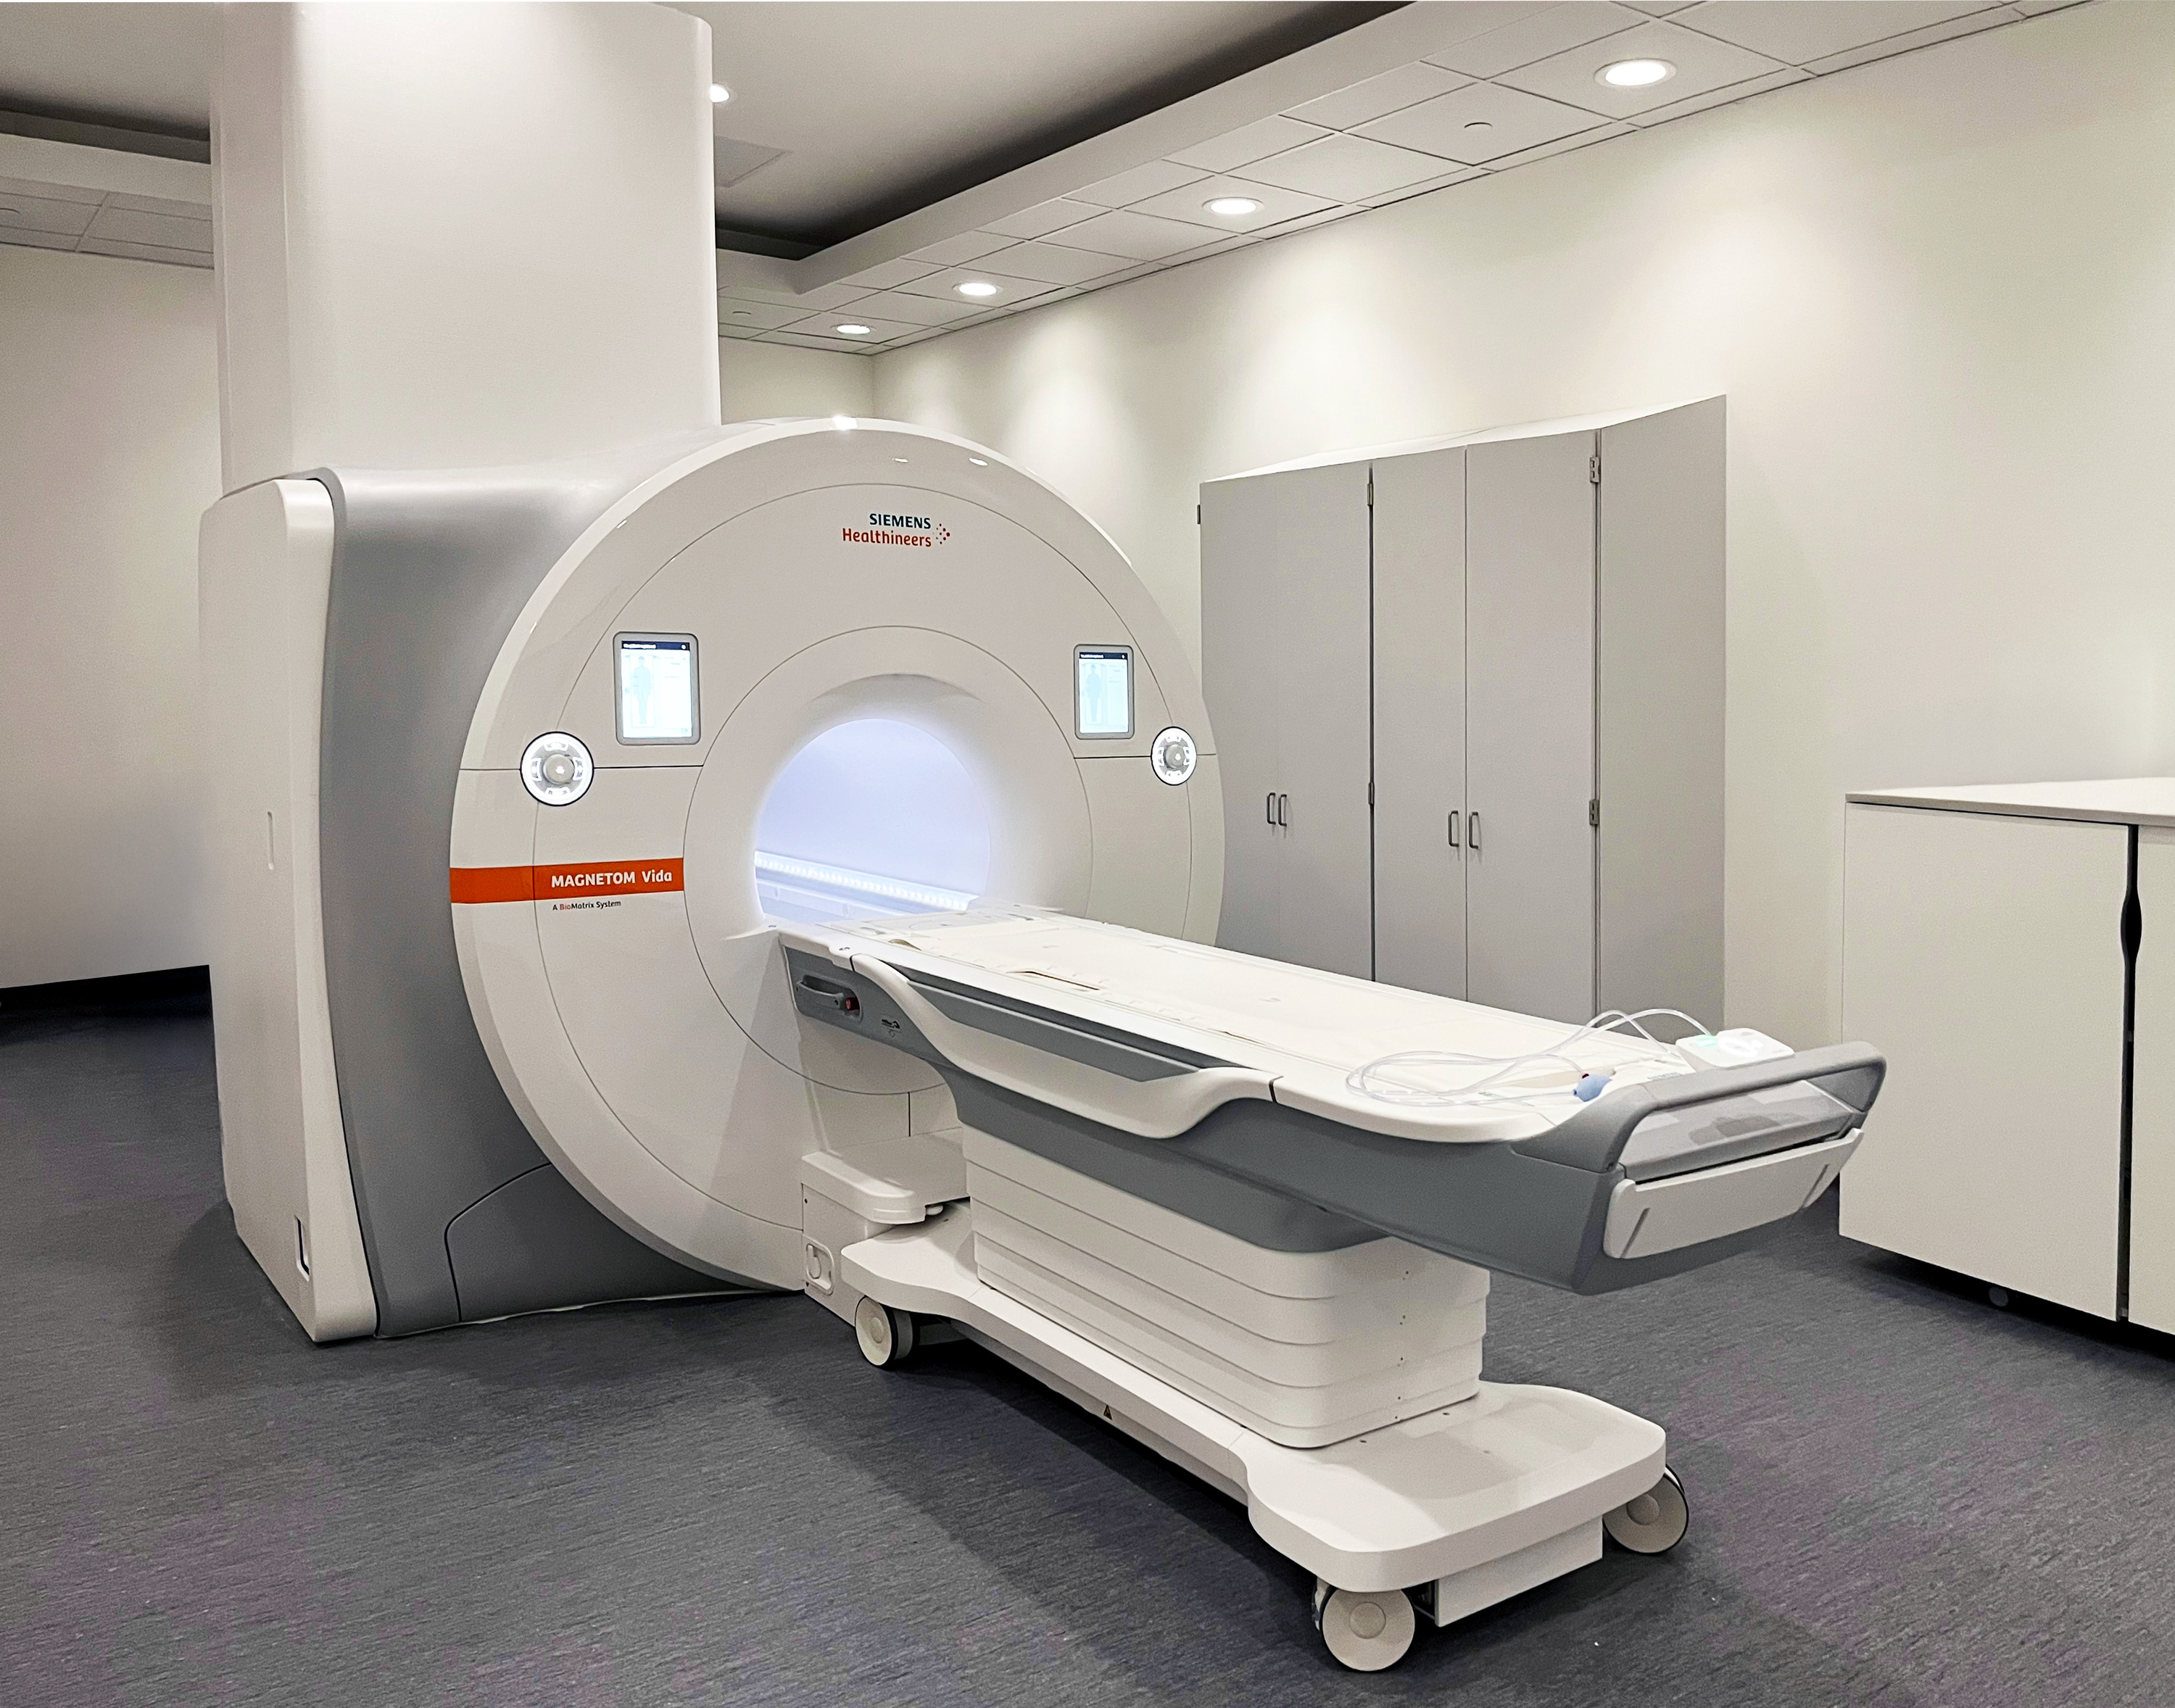
3 WIRE VS
4 WIRE
  What about imaging systems that require a 277V neutral?
  Add isolation transformers to provide 480/277V to distribution systems serving imaging equipment, IRs and cath labs when neutral is required.

Slide 17
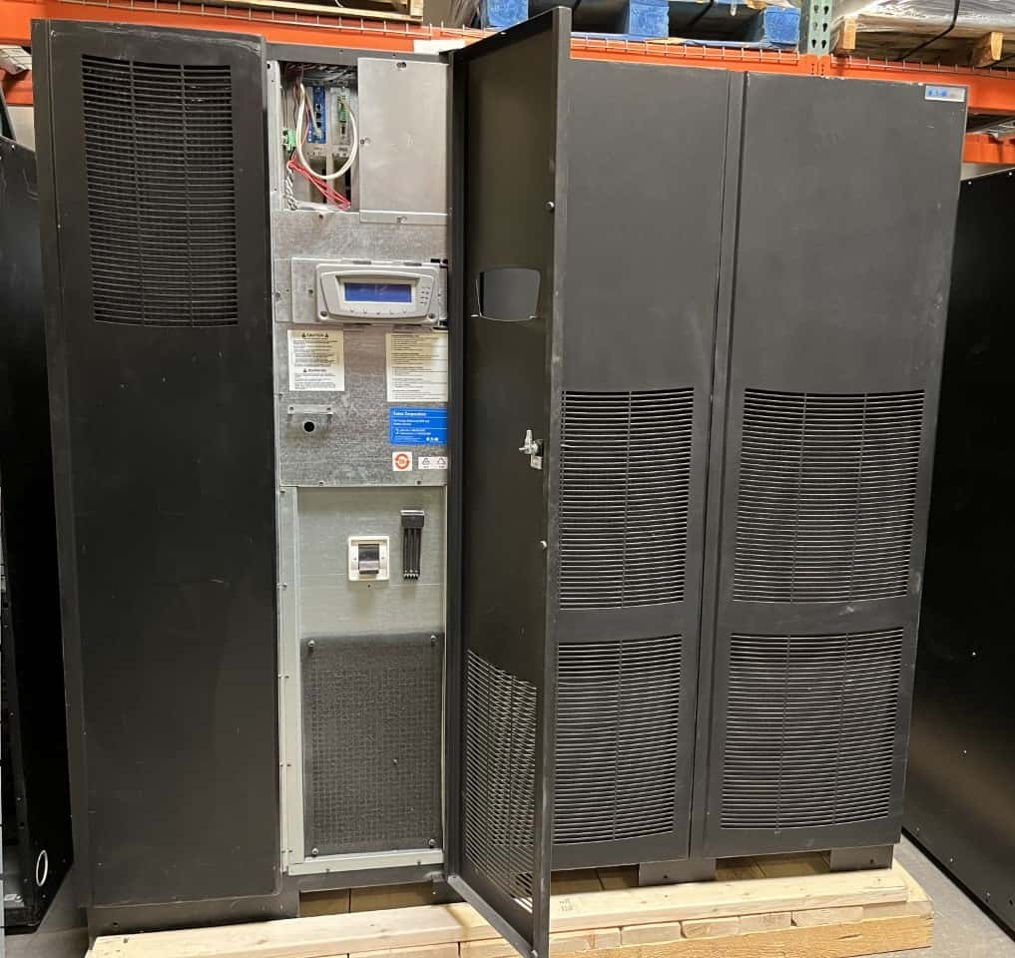
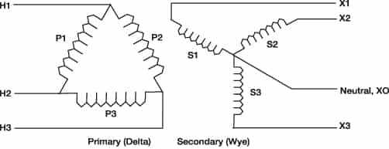
UPS
SYSTEM
  480V UPS systems are typically manufactured with 3 wire input and output.
  Larger 480/277V UPS systems are available but may require a bypass cabinet with 4 pole breakers.
  Add isolation transformers to provide 480/277V to distribution systems requiring a neutral
Notes:
Many hospitals now have UPS systems designed to backup imaging equipment, ORs, IRs, Cath Labs and other critical functions.

Slide 18
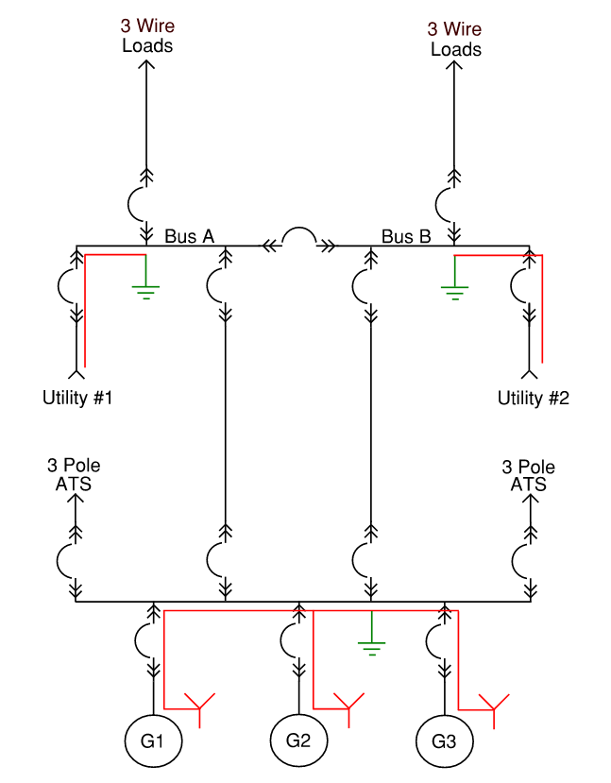
3 WIRE
SYSTEM

Slide 19
BENEFITS OF
A 3 WIRE SYSTEM
  No 277V neutrals – switchboards, panelboards
  3 Wire feeders
  3 pole transfer switches
  Simple ground fault sensing
  Without a neutral, a simple
  3-phase residual sensing scheme (50G/51G) is sufficient.
  Fewer CTs and relay inputs
  Easier testing and maintenance
  Lower risk of mis-coordination or undetected faults
  Benefit: Better selectivity and reliability for healthcare emergency systems.

Slide 20
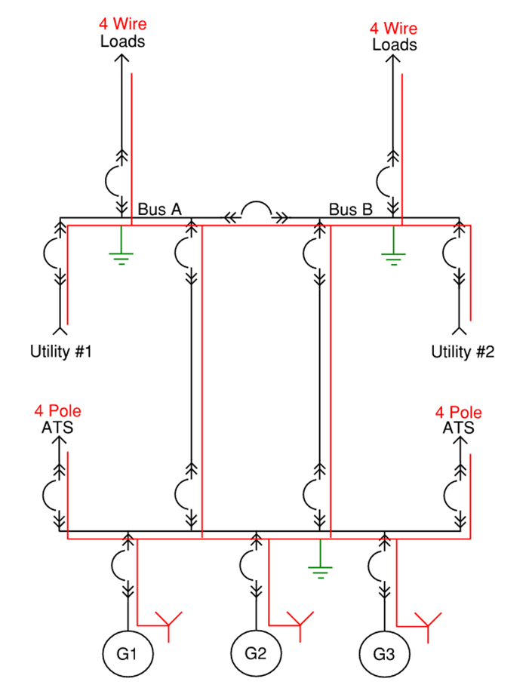
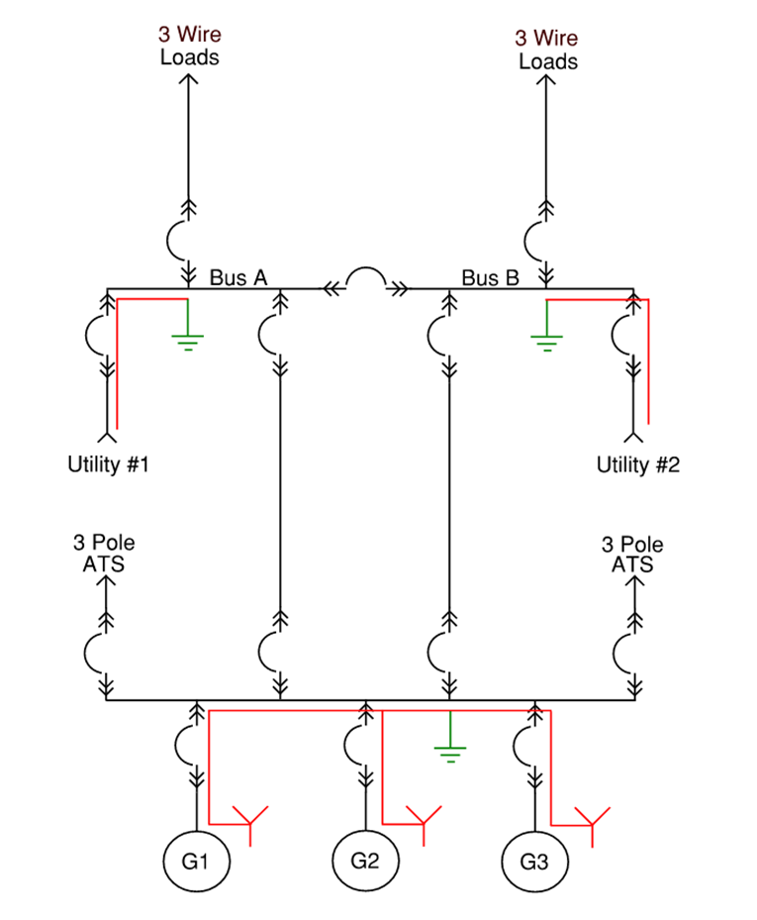
4 WIRE VS 3 WIRE

Slide 21
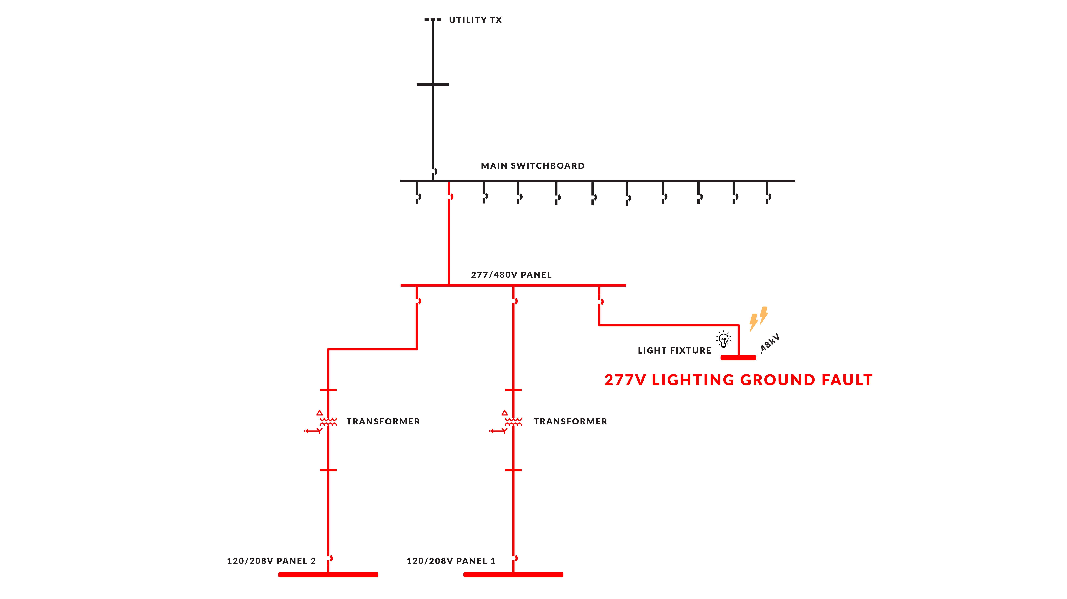
WHY NO NEUTRAL
MORE RELIABLE
Notes:
Ground fault trips upstream ground fault protection

Slide 22
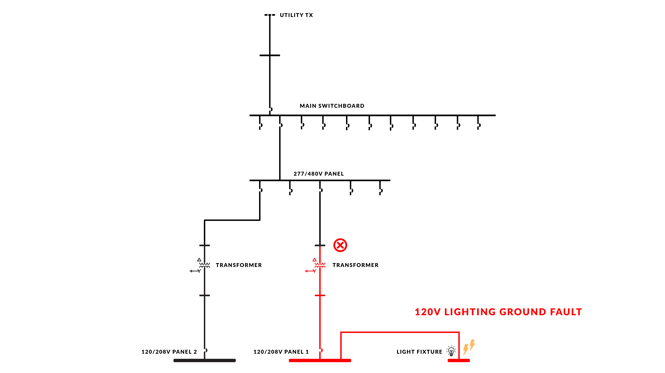
WHY NO NEUTRAL
MORE RELIABLE
Notes:
Ground fault does not trip upstream ground fault protection

Slide 23
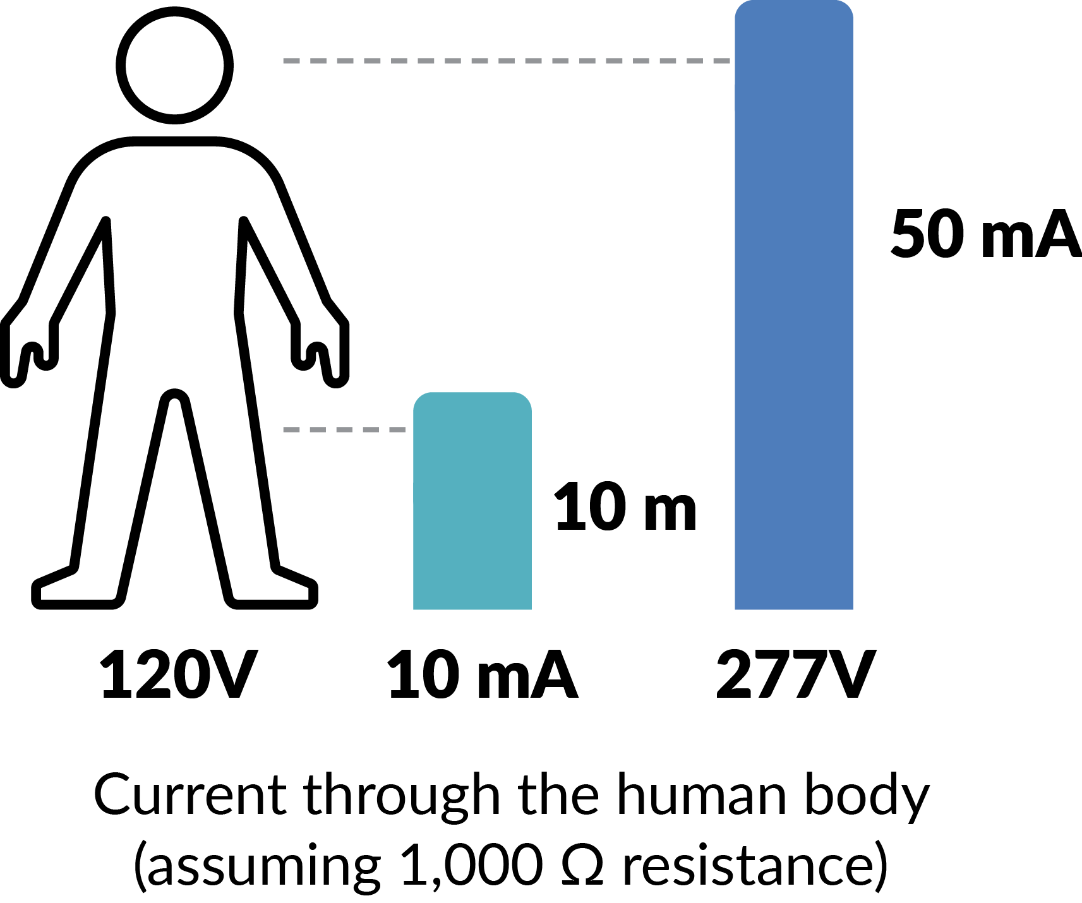
SAFETY CONCERNS
IN HEALTHCARE SETTINGS
Notes:
Higher shock hazard with 277V

Slide 24
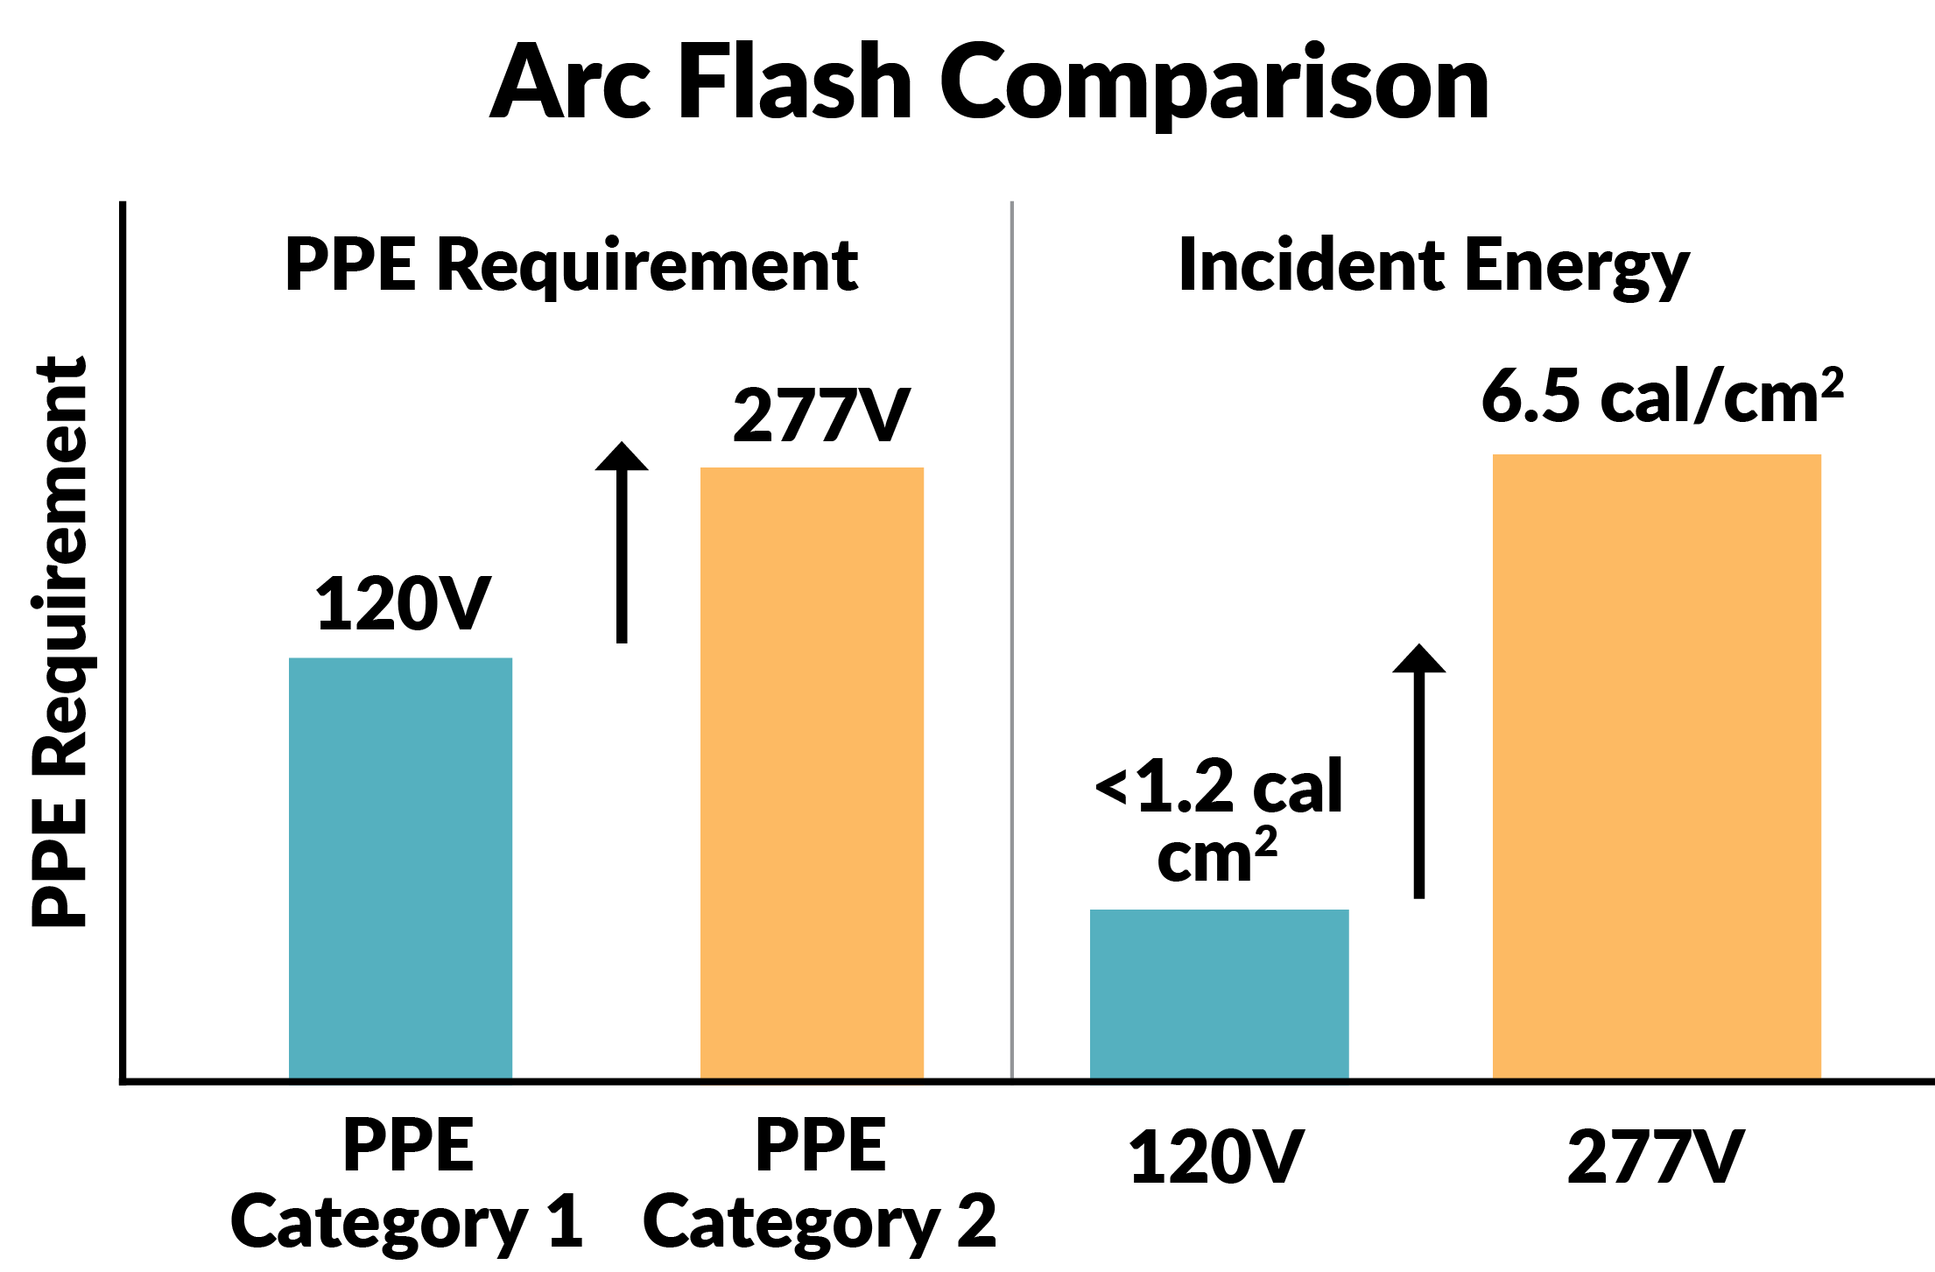
SAFETY CONCERNS
IN HEALTHCARE SETTINGS
Notes:
Arc flash hazard higher with 277V
Reduced arc energy = lower PPE levels.

Slide 25
FINANCIAL CONSIDERATIONS
AND COST SAVINGS
Over $200k in savings from deleting the neutral at the 480V distribution system
Over $500k in savings from simplified ground fault protection scheme
3 pole transfer switches less expensive than 4 pole (20% savings)
Long-term: safer systems save money over time

Slide 26

CONCLUSIONS
AND RECAP
3 wire power distribution is a smart alternative for new hospital distribution systems.
By challenging conventional design and deleting the neutral from the 480V power distribution system we were able to:
Simplify ground fault detection
Reduce impacts of ground faults on patient care
Enhance safety by reducing hazards
Reduce costs

